Slide 1
Internet Skills
The World Wide Web (Web) consists of billions of interconnected pages of information from a wide variety of sources.
In this section:
Web Research
Web Publishing
Skills > Internet Skills

Slide 2
Web Research
When faced with the task of searching a topic online, it can be difficult to know where to start.
In this section:
Introduction to Web Research | Publications and Academic Resources
Web Search Engines | Crowd-Sourced Resources
Web Directories | Evaluating and Citing Online Resources
Skills > Internet Skills > Web Research

Slide 3
Introduction to Web Research
Online content is provided by:
Commercial sites
Newspapers, magazines, journals
Academic publications
Books, encyclopedias, reference materials
Blogs, tweets, discussions
Photos, movies, podcasts
It can be a challenge to avoid the tremendous volume of utterly useless information.
Skills > Internet Skills > Web Research > Introduction to Web Research

Slide 4
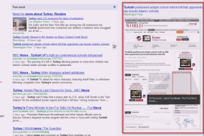
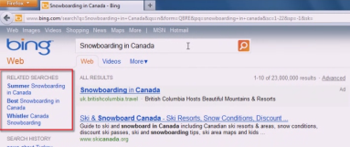
Web Search Engines
Web search engines are the most powerful tools for finding information online.
Search engines provide advanced search and filtering tools to refine a search.
A meta search engine lets you run a search using several search engines at once.
Skills > Internet Skills > Web Research > Web Search Engines

Slide 5
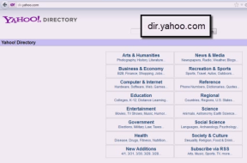
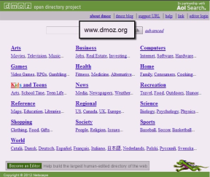
Web Directories
Web directories are created and maintained by human editors, not computer-based algorithms.
Web directory editors collect useful Web pages on many topics and organize them into a hierarchical structure.
Skills > Internet Skills > Web Research > Web Directories

Slide 6
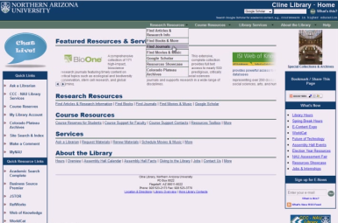
Publications and Academic Resources
Many traditional paper-based resources are now available on the Web.
When it comes to finding information across many journals and publications, your school library remains the best resource.
Skills > Internet Skills > Web Research > Publications and Academic Resources

Slide 7
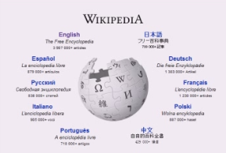
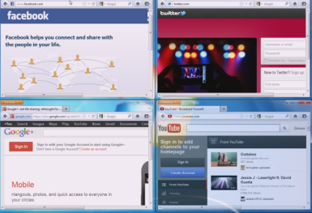
Crowd-Sourced Resources
The advent of Web 2.0 transformed the Web into a dynamic community where everyone is now able to share their knowledge, thoughts and opinions. This activity is called crowd-sourcing.
Social media (e.g., Facebook, Twitter, Google Plus, and YouTube) also can provide useful crowd-sourced information.
Skills > Internet Skills > Web Research > Crowd-Sourced Resources

Slide 8
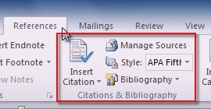
Evaluating and Citing Online Resources
How do you know if a source is credible, accurate and unbiased? Ask:
What type of site is it?
What is the site’s bias?
What is the site creator’s authority?
How current is the content?
Failing to credit sources is called “plagiarism,” a practice that is not only heavily penalized in most schools, but is also against the law.
Skills > Internet Skills > Web Research > Evaluating and Citing Online Resources

Slide 9
Web Publishing
In this section: | Publishing Videos
Publishing a Blog | Publishing to Social Media
Publishing Images | Publishing a Web Site
Skills > Internet Skills > Web Publishing

Slide 10
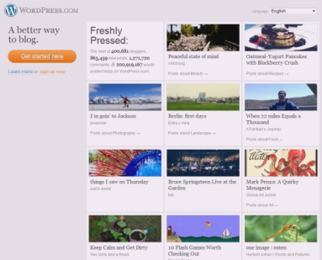
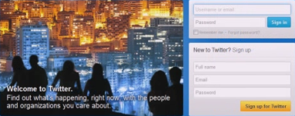
Publishing a Blog
A weblog (blog) is a Web site you use to regularly post your thoughts, pictures or videos.
Visitors to a blog can comment on it, link to it, or e-mail a response.
Regular followers can subscribe to receive notifications when new comments are posted.
Another way for your followers to keep up-to-date is with microblogging (e.g., Twitter).
Skills > Internet Skills > Web Publishing > Publishing a Blog

Slide 11
Publishing Images
Sharing images online is one more way the Internet has made the world a little friendlier.
Web 2.0 technologies provide online services designed specifically for sharing photos online, saving you the task of setting up a Web site or blog for this purpose.
Skills > Internet Skills > Web Publishing > Publishing Images

Slide 12
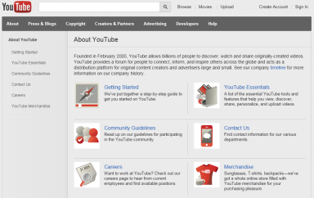
Publishing Videos
As technology allowed us to easily capture video on video cameras, point-and-shoot cameras, and cell phones, it was only a matter of time before we could post and share those videos online.
Skills > Internet Skills > Web Publishing > Publishing Videos

Slide 13
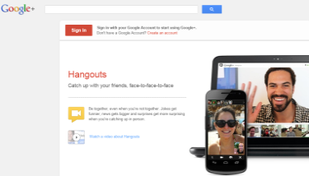
Publishing to Social Media
Social networks combine all forms of Web publishing, allowing users to easily publish new content for friends, family, and the world to see.
Spend time examining the privacy policies for any of the networks you join, since the default settings may make public more information than you are willing share.
Skills > Internet Skills > Web Publishing > Publishing to Social Media

Slide 14
Publishing a Web Site
There are many online services that make it easy to create a personal Web site.
You can host your own site or have your site hosted for free (e.g., Weebly and Google Sites) or for a fee.
Skills > Internet Skills > Web Publishing > Publishing a Web Site

