Slide 1
PowerPoint for Mac 2011
PowerPoint is a versatile program, designed to support a wide variety of presentations with an extensive package of creativity tools.
In this section: | Using Graphics Objects
Overview of PowerPoint | Formatting a Slide Show
Working with Slides and Text | Presenting and Publishing
Skills > PowerPoint for Mac 2011

Slide 2
Overview of PowerPoint
Features built into Microsoft PowerPoint visually support the message you need to convey.
In this section:
PowerPoint Tools and Features
Effective PowerPoint Presentations
PowerPoint Presentation Uses
Skills > PowerPoint for Mac 2011 > Overview of PowerPoint

Slide 3
PowerPoint Tools and Features
Unique to PowerPoint are:
Tabs: Themes, Transitions, Animations, and Slide Shows.
Previous Slide and Next Slide buttons.
Status bar: Fit to slide pane button, current slide number and total number of slides, View buttons (Normal, Slide Sorter, and Slide Show).
Normal View includes:
Notes pane for presenter notes.
Slides tab with thumbnails.
Outline tab with text outline.
Skills > PowerPoint for Mac 2011 > Overview of PowerPoint > PowerPoint Tools and Features
Notes:
Bullet 2 modified

Slide 4
Effective PowerPoint Presentations
Four steps to preparing and delivering an effective PowerPoint presentation:
Plan: purpose, audience, length, handouts/visual aids.
Prepare: research topic, outline key points, format. presentation, backup plan
Practice: energy and positive body language, business-like tone and word usage.
Present: business attire, eye contact and smile, present what you practiced.
Skills > PowerPoint for Mac 2011 > Overview of PowerPoint > Effective PowerPoint Presentations
Notes:
Bullet 2 modified

Slide 5
PowerPoint Presentation Uses
Common uses include: marketing presentations, sales support, education and classroom sessions, training workshops and seminars, not-for-profit and religious organization presentations, motivational speeches, project status updates, and investor and board presentations.
Skills > PowerPoint for Mac 2011 > Overview of PowerPoint > PowerPoint Presentation Uses
Notes:
Bullet 2 modified

Slide 6
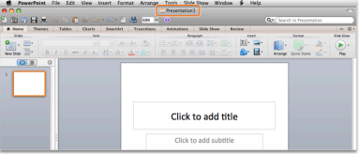
Working with Slides and Text
In this section: | Entering and Formatting Text and Hyperlinks
Creating and Editing Presentations
Integration: Creating a Presentation From a Word Outline | Inserting Symbols and Equations Presentation Views
Working With Slides | Using the Ruler and Gridlines
Skills > PowerPoint for Mac 2011 > Working with Slides and Text

Slide 7
Creating and Editing Presentations
Create presentations from scratch or from one of the available templates.
By default, PowerPoint starts with a title slide when the application is launched.
When text is entered into a text placeholder, the placeholder changes to a text box.
Another way to enter text on a slide is to use the Outline tab in the left-side navigation pane.
Skills > PowerPoint for Mac 2011 > Working with Slides and Text > Creating and Editing Presentations
Notes:
Bullet 2 modified

Slide 8
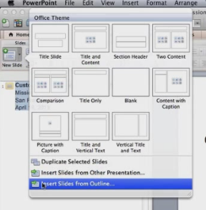
Integration: Creating a Presentation from a Word Outline
It is easy to populate a presentation with content that’s already been created in another Office application.
To import an outline from a Word document:
Make sure the Word file is saved as an .rtf file.
In PowerPoint, click “Insert Slides from Outline.”
Skills > PowerPoint for Mac 2011 > Working with Slides and Text > Integration: Creating a Presentation from a Word Outline
Notes:
Bullet 2 modified

Slide 9
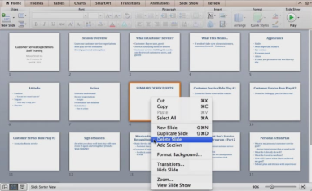
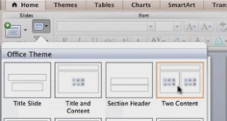
Working With Slides
To change the order of slides in Slide Sorter view, hold down mouse button, then drag to where it belongs.
To delete a slide, control-click the slide to get a shortcut menu, then choose “Delete Slide.”
To change the layout of slide(s), select slide(s), click Layout button in Slides group on Home tab, and choose layout option.
Skills > PowerPoint for Mac 2011 > Working with Slides and Text > Working With Slides
Notes:
Bullet 2 modified

Slide 10
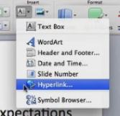
Entering and Formatting Text and Hyperlinks
Edit text on slides by selecting text, then insert, replace or format.
Increase the indent (demote the line) to change levels in bulleted lists.
Insert a text box by dragging the crosshair pointer to “draw” the box.
Add a hyperlink to a slide to link to a Web site or to another slide.
Skills > PowerPoint for Mac 2011 > Working with Slides and Text > Entering and Formatting Text and Hyperlinks
Notes:
Bullet 2 modified

Slide 11
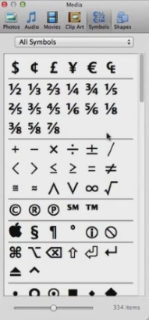
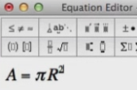
Inserting Symbols and Equations
To insert a Symbol, click the Text button in the Insert group on the Home tab, and then click the Symbol Browser option.
To insert an equation, click the Insert menu, and then click the Object option. In the Insert Object dialog box, scroll down in the Object type box, select the Microsoft Equation option, and then click OK. Type the equation in Equation Editor.
Skills > PowerPoint for Mac 2011 > Working with Slides and Text > Inserting Symbols and Equations
Notes:
Bullet 2 modified

Slide 12
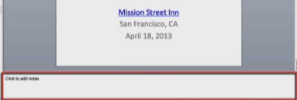
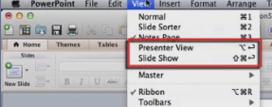
Presentation Views
In Normal view, type speaker notes at bottom of slide pane.
Slide Sorter view displays thumbnails, making it easy to rearrange slides.
Notes Page lets you see each slide and its notes on one page.
The Presenter View and Slide Show view options allow you to see what the presenter would see and what the audience would see during a presentation.
Skills > PowerPoint for Mac 2011 > Working with Slides and Text > Presentation Views
Notes:
Bullet 2 modified

Slide 13
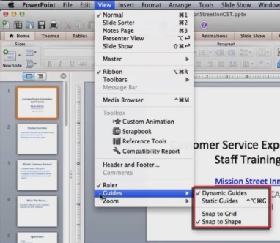
Using the Ruler and Guides
Rulers are useful when you want to make sure content is lined up consistently across all slides in a presentation.
Guides are useful when positioning graphics and other objects consistently on all slides in a presentation.
Skills > PowerPoint for Mac 2011 > Working with Slides and Text > Using the Ruler and Guides
Notes:
Bullet 2 modified

Slide 14
Using Graphics Objects
In this section: | Animating Objects
Inserting Graphics | Working with Tables and SmartArt
Adjusting Object Properties | Inserting Video and Music
Layering and Grouping Objects | Integration: Inserting a Spreadsheet Table
Skills > PowerPoint for Mac 2011 > Using Graphics Objects

Slide 15
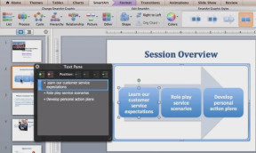
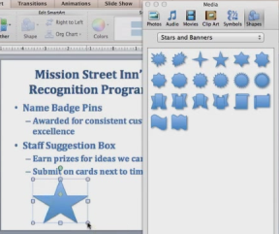
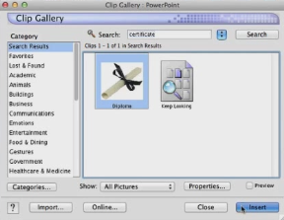
Inserting Graphics
PowerPoint allows you to easily add graphics with the Insert menu.
With these tools, you can insert pictures, insert SmartArt, convert text to SmartArt, insert shapes, insert Clip Art, and insert a hyperlink on a picture.
Skills > PowerPoint for Mac 2011 > Using Graphics Objects > Inserting Graphics
Notes:
Bullet 2 modified

Slide 16
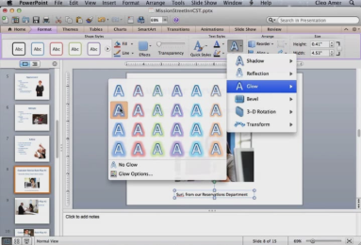
Adjusting Object Properties
After inserting graphics objects into a presentation, you can modify their appearance.
Move objects using click-and-drag.
Format Picture contextual tab includes groups for Adjust, Picture Styles, Arrange, and Size.
Format contextual tab includes groups for Shape Styles, Text Styles, Arrange, and Size.
Skills > PowerPoint for Mac 2011 > Using Graphics Objects > Adjusting Object Properties
Notes:
Bullet 2 modified

Slide 17
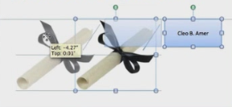
Layering and Grouping Objects
Occasionally, the objects on a slide may need to be layered or grouped in order to get them to display the way you want.
When you group objects, they can be treated as a single object instead of multiple separate objects.
Skills > PowerPoint for Mac 2011 > Using Graphics Objects > Layering and Grouping Objects
Notes:
Bullet 2 modified

Slide 18
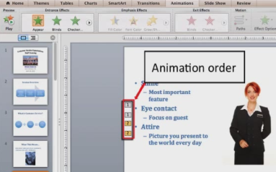
Animating Objects
Adding animation to the content of a presentation can really make it come alive.
Have some fun letting your creativity shine!
Skills > PowerPoint for Mac 2011 > Using Graphics Objects > Animating Objects
Notes:
Bullet 2 modified

Slide 19
Working with Tables and SmartArt
PowerPoint offers a variety of options for adding visual elements to presentations.
Add a table with the ribbon or with the Insert Table icon in the text content placeholder.
You can easily change the formatting of SmartArt objects, including: adding text, adding animation, applying Graphic Style, and changing colors.
Skills > PowerPoint for Mac 2011 > Using Graphics Objects > Working with Tables and SmartArt
Notes:
Bullet 2 modified

Slide 20
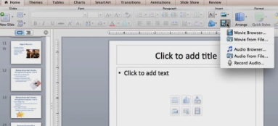
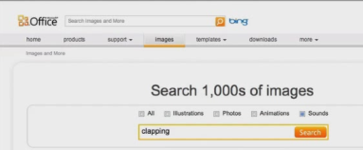
Inserting Video and Music
A well-placed video or audio clip can really enhance a presentation.
However, overuse can take an otherwise solid presentation and turn it into an embarrassment.
Skills > PowerPoint for Mac 2011 > Using Graphics Objects > Inserting Video and Music
Notes:
Bullet 2 modified

Slide 21
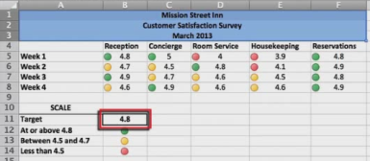
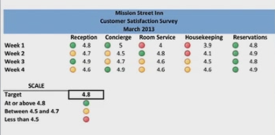
Integration: Inserting a Spreadsheet Table
One way to include quantitative data is to insert a table from an Excel spreadsheet directly onto a slide in the presentation.
In the Excel file, select the entire table, then the Copy button.
In the presentation, click Paste Special on the Edit menu to show the paste options.
Skills > PowerPoint for Mac 2011 > Using Graphics Objects > Integration: Inserting a Spreadsheet Table
Notes:
Bullet 2 modified

Slide 22
Formatting a Slide Show
In this section:
Slide Header and Footer | Working with a Slide Design
Inserting Date & Time and Slide Numbers | Working with Slide Transitions
Working with a Slide Master | Setting Up a Slide Show
Skills > PowerPoint for Mac 2011 > Formatting a Slide Show

Slide 23
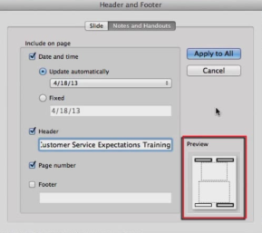
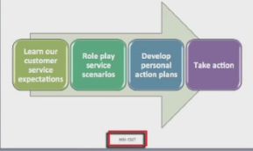
Slide Header and Footer
A header is text that appears at the top of every page in a document. In PowerPoint, you can’t insert a header onto slides. However, you can insert a header on items for printing, such as handouts, notes pages, and speaker’s notes.
A footer is text that appears at the bottom of every page. This option exists for slides and items for printing.
Skills > PowerPoint for Mac 2011 > Formatting a Slide Show > Slide Header and Footer
Notes:
Bullet 2 modified

Slide 24
Inserting Date & Time and Slide Numbers
The footer can contain date, presentation title, and slide numbers. By default, PowerPoint assumes you want date and time updated automatically.
For most presentations, you won’t want footer elements to appear on the title slide, since they could distract from your title slide contents.
Skills > PowerPoint for Mac 2011 > Formatting a Slide Show > Inserting Date & Time and Slide Numbers
Notes:
Bullet 2 modified

Slide 25
Working with a Slide Master
Slide masters in PowerPoint assure that all slides in a presentation have a similar look with similar elements.
Slide Master contextual tab includes Themes, Slide Master, Edit Master, Edit Layout, Background, and Master View groups.
Skills > PowerPoint for Mac 2011 > Formatting a Slide Show > Working with a Slide Master
Notes:
Bullet 2 modified

Slide 26
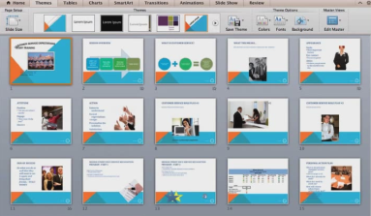
Working with Slide Design
Another way to modify the slides in a presentation is to use the tools found on the Themes tab. This tab includes Page Setup, Themes, Theme Options, and Master Views groups.
Skills > PowerPoint for Mac 2011 > Formatting a Slide Show > Working with Slide Design
Notes:
Bullet 2 modified

Slide 27
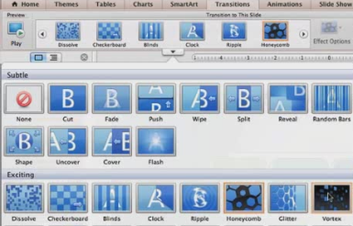
Working with Slide Transitions
A transition is a type of special effect between slides in a presentation.
When a transition is applied to a single slide, it occurs when that slide first appears.
Instead, you may apply a single transition effect to all the slides.
Skills > PowerPoint for Mac 2011 > Formatting a Slide Show > Working with Slide Transitions
Notes:
Bullet 2 modified

Slide 28
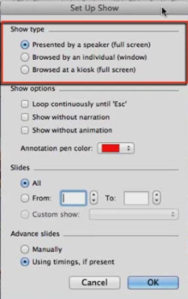
Setting Up a Slide Show
The Slide Show tab includes Play Slide Show, Presenter Tools, Set Up, and Setting for Two Displays groups.
Buttons in the Presenter Tools group let you rehearse the timing of the slide show and record the time spent on each slide, as well as the total presentation time.
Skills > PowerPoint for Mac 2011 > Formatting a Slide Show > Setting Up a Slide Show
Notes:
Bullet 2 modified

Slide 29
Presenting and Publishing
In this section:
Presenting a Slide Show
Printing Slides
Publishing a Presentation
Skills > PowerPoint for Mac 2011 > Presenting and Publishing

Slide 30
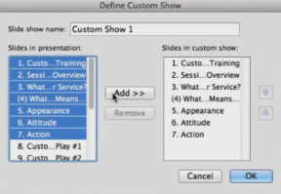
Presenting a Slide Show
On the Slide Show tab, the Play Slide Show group holds buttons for starting a slide show from the beginning and from a selected slide in the presentation.
The Custom Shows button in the Play Slide Show group allows you to create several versions of a slide show for different audiences.
Skills > PowerPoint for Mac 2011 > Presenting and Publishing > Presenting a Slide Show
Notes:
Bullet 2 modified

Slide 31
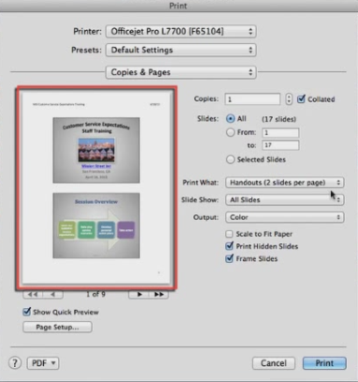
Printing Slides
You might need to print the slides from a presentation for a class, as audience handouts, or for inclusion in a packet of materials.
For PowerPoint, there is a unique decision required before printing anything: Print What (Slides, Handouts, Notes, and Outline).
Skills > PowerPoint for Mac 2011 > Presenting and Publishing > Printing Slides
Notes:
Bullet 2 modified

Slide 32
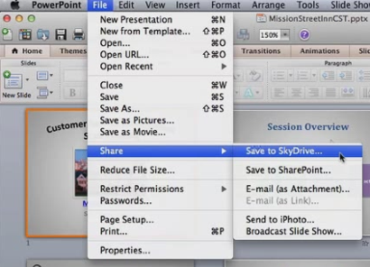
Publishing a Presentation
PowerPoint supports publishing a presentation online or as a video. Options on the File menu include:
Save As Picture.
Save As Movie.
Share (Save to SkyDrive, Save to SharePoint, E-mail as Attachment, Send to iPhoto, and Broadcast Slide Show).
Skills > PowerPoint for Mac 2011 > Presenting and Publishing > Publishing a Presentation
Notes:
Bullet 2 modified

