Slide 1
Excel for Mac 2011
One of the most important skills a working professional possesses is the ability to work with financial data and prepare quantitative analyses to support financial decision-making.
In this section: | Functions
Overview of Spreadsheets | Formatting Spreadsheets
Cells and Cell Data | Spreadsheet Graphics
Formulas | Advanced Spreadsheet Tools
Skills > Excel for Mac 2011

Slide 2
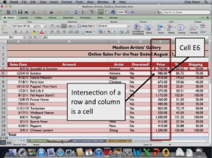
Overview of Spreadsheets
Excel worksheets are grids:
Rows are numbered, starting with 1.
Columns are named with letters, starting with A.
Cells are the intersection of a row and column (e.g., E6).
In this section:
Spreadsheet Tools and Features
Well-Formed Spreadsheets
Spreadsheet Uses
Skills > Excel for Mac 2011 > Overview of Spreadsheets

Slide 3
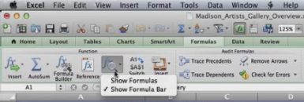
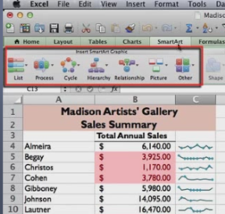
Spreadsheet Tools and Features
Tools on the Formulas tab allow use of pre-made functions to generate formulas efficiently and accurately.
Other tools (e.g., SmartArt graphics, charts, and Sparklines) are used for displaying information graphically.
Home tab tools enhance worksheet formatting, with a variety of number and cell formats.
Skills > Excel for Mac 2011 > Overview of Spreadsheets > Spreadsheet Tools and Features
Notes:
Bullet 2 modified

Slide 4
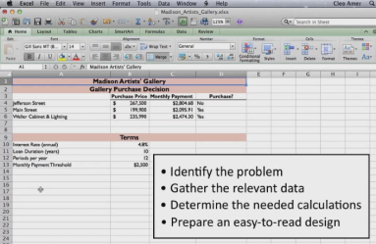
Well-Formed Spreadsheets
Well-formed spreadsheets are neatly organized and properly formatted to help support financial reporting and decision making.
Before entering any data, plan the layout.
Skills > Excel for Mac 2011 > Overview of Spreadsheets > Well-Formed Spreadsheets
Notes:
Bullet 2 modified

Slide 5
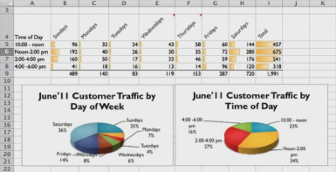
Spreadsheet Uses
Spreadsheet programs make it easy to enter, edit, and format text and numerical data for professional-looking documents.
Spreadsheets are best suited for decisions that need quantitative support.
Skills > Excel for Mac 2011 > Overview of Spreadsheets > Spreadsheet Uses
Notes:
Bullet 2 modified

Slide 6
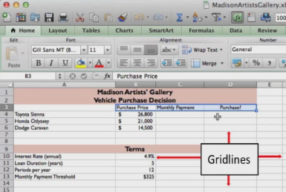
Cells and Cell Data
In this section:
Creating and Editing Spreadsheets | Grouping Rows and Columns
Selecting Objects | Copying Cell Data
Entering and Editing Data | Using the Fill Handle
Adjusting Rows and Columns | Inserting and Deleting
Skills > Excel for Mac 2011 > Cells and Cell Data

Slide 7
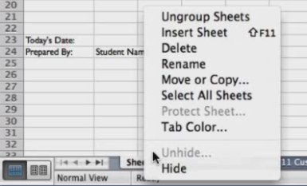
Creating and Editing Spreadsheets
Create spreadsheets from scratch or from available templates.
To edit an existing file, navigate to storage location and double-click.
To rename a tab, Control-click, choose Rename, and type new name.
To rearrange tab order, use click-and-drag to new location.
To delete a tab, Control-click and choose Delete.
Skills > Excel for Mac 2011 > Cells and Cell Data > Creating and Editing Spreadsheets
Notes:
Bullet 2 modified

Slide 8
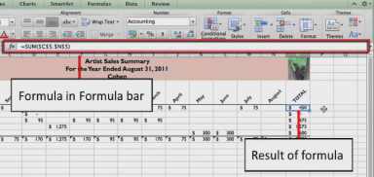
Selecting Objects
An object is anything that can be selected, edited, or manipulated.
When you select a picture object, Format Picture contextual tab appears.
To see a formula, click the cell and the formula appears in Formula bar.
Other types of objects include charts, graphs, videos, and sound clips.
Skills > Excel for Mac 2011 > Cells and Cell Data > Selecting Objects
Notes:
Bullet 2 modified

Slide 9
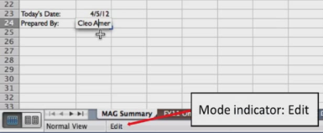
Entering and Editing Data
To enter data in a cell, click the cell, then type the text/data OR type equal sign to add a formula.
To edit data in cell, click cell and replace entire cell contents by typing OR double-click cell, position insertion point, and make changes.
Click outside a cell to save/commit changes.
Skills > Excel for Mac 2011 > Cells and Cell Data > Entering and Editing Data
Notes:
Bullet 2 modified

Slide 10
Adjusting Rows and Columns
To adjust column width (or row height) to fit the data, use AutoFit: position pointer on the border, then double-click to automatically adjust the fit.
To manually set column width (or row height), drag pointer.
To adjust a group of columns (or rows), use Format button in Cells group on Home tab.
Skills > Excel for Mac 2011 > Cells and Cell Data > Adjusting Rows and Columns
Notes:
Bullet 2 modified

Slide 11
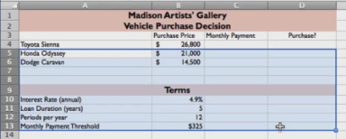
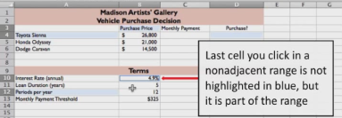
Grouping Rows and Columns
A group of specific cells in a worksheet is called a range. To reference a range, include the beginning cell, a colon, and the ending cell (e.g., B3:D3).
To select a range of adjacent cells, click a cell and drag the pointer to select additional cell(s).
To select a range of non-adjacent cells, click a cell, press and hold the Command key, then click additional cell(s).
Skills > Excel for Mac 2011 > Cells and Cell Data > Grouping Rows and Columns
Notes:
Bullet 2 modified

Slide 12
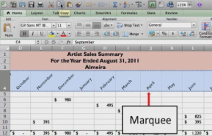
Copying Cell Data
To copy contents of a single cell (or range of cells), select cell(s), click Copy button, click destination, click Paste button.
To copy adjacent cells, highlight cells to be copied.
To copy non-adjacent cells, select first cell, hold down Command key, select additional cell(s) to be copied.
Display Paste Options menu by clicking Paste button.
Skills > Excel for Mac 2011 > Cells and Cell Data > Copying Cell Data
Notes:
Bullet 2 modified

Slide 13
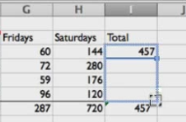
Using the Fill Handle
The fill handle is the fastest way to copy and paste content from one cell or range to another.
To copy, click in cell, move mouse over fill handle, press and hold mouse, then drag through ending cell.
Use fill handle to complete a text series (e.g., month names).
Skills > Excel for Mac 2011 > Cells and Cell Data > Using the Fill Handle
Notes:
Bullet 2 modified

Slide 14
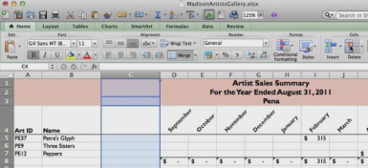
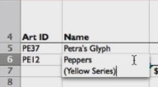
Inserting and Deleting
To insert row, select row number below new row location, click Insert button.
To insert column, select column letter right of new column, click Insert button.
To delete row (or column), select row number (or column letter) to delete, click Delete button.
To insert line break in cell, press and hold Control and Option keys, then press Return key.
Skills > Excel for Mac 2011 > Cells and Cell Data > Inserting and Deleting
Notes:
Bullet 2 modified

Slide 15
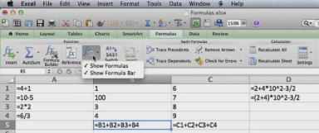
Formulas
A formula is an expression that usually results in a numerical value. Every Excel formula starts with an equal sign (=), followed by the expression needed to calculate the value.
In this section:
Using Arithmetic Formulas
Formula Auditing
Using Named Ranges
Skills > Excel for Mac 2011 > Formulas

Slide 16
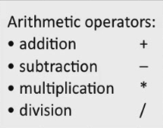
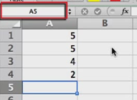
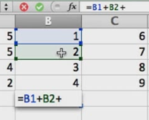
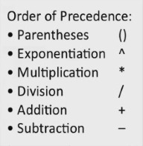
Using Arithmetic Formulas
The name box tells which cell is currently selected.
Most Excel formulas contain cell references, either a cell address or a range of cells. As a result, when a cell value changes, the formula results display the new value.
Skills > Excel for Mac 2011 > Formulas > Using Arithmetic Formulas
Notes:
Bullet 2 modified

Slide 17
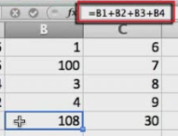
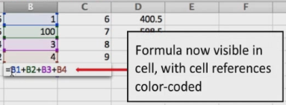
Formula Auditing
To examine contents of a formula, click a cell and the formula is visible in the Formula bar OR double-click a cell and a color-coded formula is also visible in the cell plus referenced cells are color-coded.
To display formulas instead of results:
Click Show button and choose Show Formulas, then again to display results.
Press Control+grave accent key to display formulas, then again to display results.
Skills > Excel for Mac 2011 > Formulas > Formula Auditing
Notes:
Bullet 2 modified

Slide 18
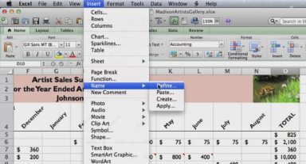
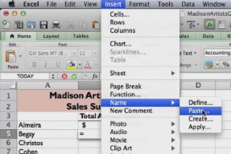
Using Named Ranges
To create a defined name, select the cell or range, click Insert menu, point to Name, and click Define.
To use a defined name in a formula, type equal sign (=), click Insert menu, point to Name, click Paste, and select a defined name.
Skills > Excel for Mac 2011 > Formulas > Using Named Ranges
Notes:
Bullet 2 modified

Slide 19
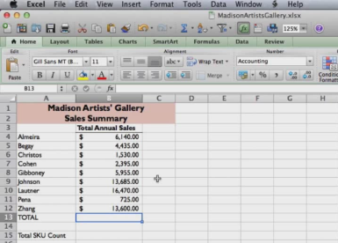
Functions
A function is a pre-made formula that computes a value. Functions are the fastest and most accurate way to include formulas in a spreadsheet.
In this section:
Using Functions | Using Logical Functions (IF)
Copying Functions | Advanced Functions (VLOOKUP)
3D Functions | Advanced Functions (PMT)
Absolute References | Function and Formula Troubleshooting
Skills > Excel for Mac 2011 > Functions

Slide 20
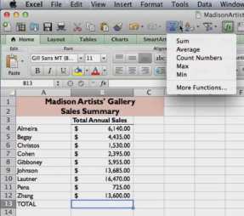
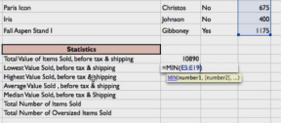
Using Functions
SUM adds the values in specified range.
MIN determines lowest (minimum) value.
MAX determines highest (maximum) value.
AVERAGE calculates average value.
MEDIAN calculates median value.
COUNTA counts number of cells not empty.
COUNTIF counts number of cells that meet a certain condition.
Skills > Excel for Mac 2011 > Functions > Using Functions
Notes:
Bullet 2 modified

Slide 21
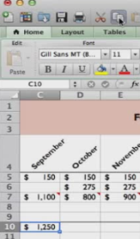
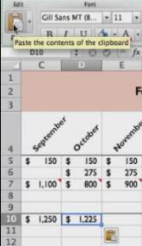
Copying Functions
Copying a formula is just like copying a number or value.
You can use Copy and Paste buttons on the Standard toolbar OR you can grab the fill handle and drag it.
Skills > Excel for Mac 2011 > Functions > Copying Functions
Notes:
Bullet 2 modified

Slide 22
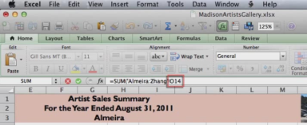
3D Functions
A 3-D reference refers to the same cell or range of cells on multiple worksheets.
In addition to summing, you can use 3-D references to compute statistics, such as averages, and much more.
Skills > Excel for Mac 2011 > Functions > 3D Functions
Notes:
Bullet 2 modified

Slide 23
Absolute References
So far you have used relative references, which means that when you copy a formula from one cell to another, the cell ranges automatically adjust to reflect the new position of the formula in the worksheet.
An absolute reference doesn’t change when the formula is copied to another cell. Adding dollar signs before the column and row of a cell reference tells Excel to “always go to” that cell.
Skills > Excel for Mac 2011 > Functions > Absolute References
Notes:
Bullet 2 modified

Slide 24
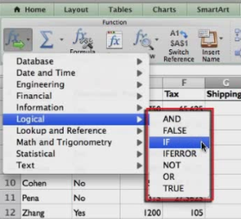
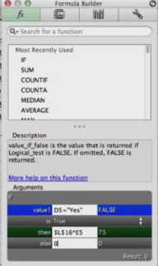
Using Logical Functions (IF)
A logical function is a formula that tests a condition that can either be true or false and then returns a value based on the result of the condition.
The IF function returns one value if the condition is true, and another if the condition is false.
The Formula Builder button in the Function group on Formulas tab can help!
Skills > Excel for Mac 2011 > Functions > Using Logical Functions (IF)
Notes:
Bullet 2 modified

Slide 25
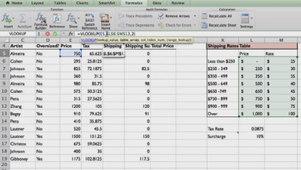
Advanced Functions (VLOOKUP)
VLOOKUP looks up values in a table of data and then inserts those values in another location in a worksheet.
The VLOOKUP function requires three pieces of information:
Value you want to look up.
Range of cells where the lookup table is located.
Table column with the value you want.
Skills > Excel for Mac 2011 > Functions > Advanced Functions (VLOOKUP)
Notes:
Bullet 2 modified

Slide 26
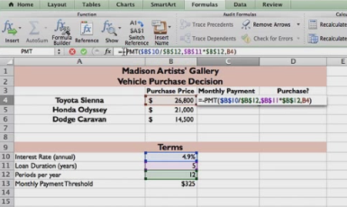
Advanced Functions (PMT)
The PMT, or Payment, function calculates what a series of loan payments will be before you commit to the decision.
The PMT function requires three pieces of information:
Amount borrowed.
Annual interest rate.
Duration of loan.
NOTE: Be careful with annual/monthly and negative values!
Skills > Excel for Mac 2011 > Functions > Advanced Functions (PMT)
Notes:
Bullet 2 modified

Slide 27
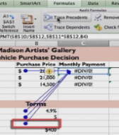
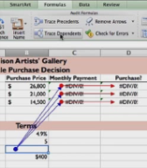
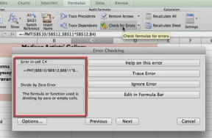
Function and Formula Troubleshooting
A green triangle in the upper left corner lets you know that Excel can provide information about an error. Holding the mouse pointer over the information icon displays a screentip.
Tools on the Formulas tab in the Audit Formulas group include:
Trace Precedents
Trace Dependents
Check for Errors
Skills > Excel for Mac 2011 > Functions > Function and Formula Troubleshooting
Notes:
Bullet 2 modified

Slide 28
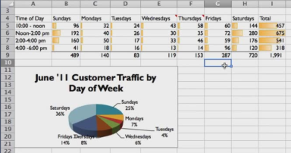
Formatting Spreadsheets
In this section:
Number Formats | Working With Tables
Aligning Cell Contents | Applying Borders and Shading
Sorting and Filtering Data | Applying Conditional Formatting
Skills > Excel for Mac 2011 > Formatting Spreadsheets

Slide 29
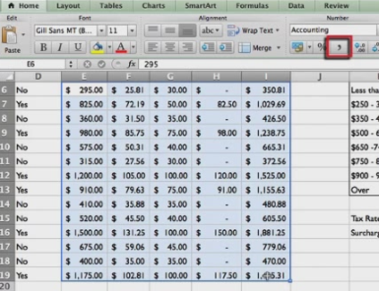
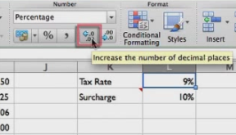
Number Formats
Currency format includes dollar sign at left, commas, zero, and 2 decimal places.
Accounting format changes dollar sign to be aligned on left margin and cells with zero show a dash.
Percent format includes percentage sign.
Comma format applies Accounting format without dollar signs and aligns decimals.
Increase/Decrease decimal places with buttons in Number group on Home tab.
Skills > Excel for Mac 2011 > Formatting Spreadsheets > Number Formats
Notes:
Bullet 2 modified

Slide 30
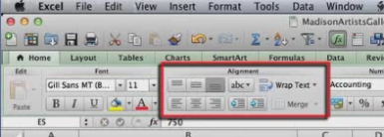
Aligning Cell Contents
The general rule for formatting is to center column headings, keep text left-aligned, and keep numbers right-aligned, with decimal places aligned.
To fully display text in a cell, you may need the Wrap Text button.
Adjust vertical alignment with the Align Top, Align Middle, and Align Bottom buttons.
Center text over multiple columns with the Merge button.
Skills > Excel for Mac 2011 > Formatting Spreadsheets > Aligning Cell Contents
Notes:
Bullet 2 modified

Slide 31
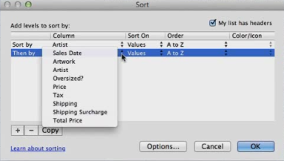
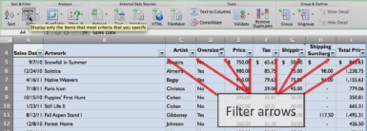
Sorting and Filtering Data
When working with large sets of data, it can be useful to sort (rearrange) the data to make it easier to read. You can also filter data to show only the data you need at the moment. Both sorting and filtering can make data easier to use when making decisions. The tools are in the Sort & Filter group on the Data tab.
Skills > Excel for Mac 2011 > Formatting Spreadsheets > Sorting and Filtering Data
Notes:
Bullet 2 modified

Slide 32
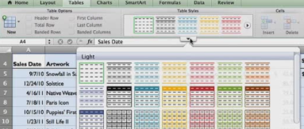
Working with Tables
A table style gives the range a cohesive look; with coordinated font colors, fill colors, and more. This formatting makes a table easier to read and work with.
More importantly, a range designated as an Excel table can be analyzed, sorted, transferred, filtered, and otherwise treated as separate from the rest of the Excel worksheet.
Skills > Excel for Mac 2011 > Formatting Spreadsheets > Working with Tables
Notes:
Bullet 2 modified

Slide 33
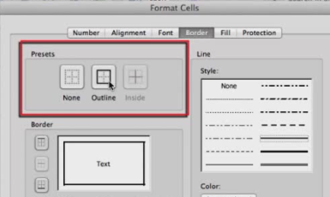
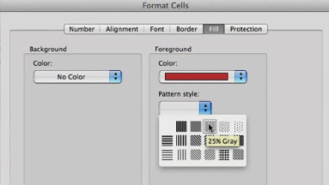
Applying Borders and Shading
One way to draw attention to the contents of a cell or range is to add a border – to the top, left, bottom, or right sides, or to all sides at once. You can add borders to one cell at a time, or to a range of cells.
Shading is another way to draw attention to individual cells or ranges. Using tools on the Fill tab, you can modify fill colors (background or foreground) and pattern style.
Skills > Excel for Mac 2011 > Formatting Spreadsheets > Applying Borders and Shading
Notes:
Bullet 2 modified

Slide 34
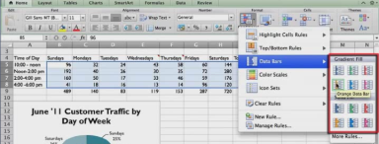
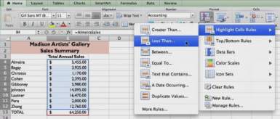
Applying Conditional Formatting
Conditional formatting is useful for highlighting trends in data that might otherwise be difficult to see.
Conditional formatting can also be used to highlight cells containing data that meet certain criteria.
Skills > Excel for Mac 2011 > Formatting Spreadsheets > Applying Conditional Formatting
Notes:
Bullet 2 modified

Slide 35
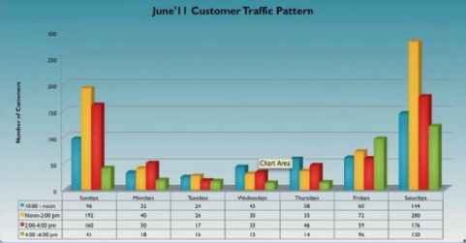
Spreadsheet Graphics
In this section: | Inserting Pictures
Creating Charts | Integration: Inserting Graphics From PowerPoint
Chart Types | Adjusting Page Layout
Creating Sparklines | Printing Spreadsheets
Skills > Excel for Mac 2011 > Spreadsheet Graphics

Slide 36
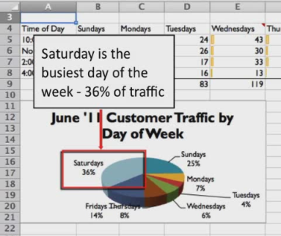
Creating Charts
Charts add visual interest to data- and text-intensive worksheets, showing trends and relationships in the data.
Four steps to creating charts:
Select the range of cells.
Choose a chart style.
Modify formatting and titles.
Position the finished chart on worksheet or move to new sheet.
Skills > Excel for Mac 2011 > Spreadsheet Graphics > Creating Charts
Notes:
Bullet 2 modified

Slide 37
Chart Types
The best type of chart depends on the data you want to illustrate. For example, pie charts are best for showing each data value as a percentage of the whole.
When you select a chart, two contextual chart tabs are visible; the Chart Layout tab (e.g., chart title and labels) and the Format tab (e.g., style and background fill).
Skills > Excel for Mac 2011 > Spreadsheet Graphics > Chart Types
Notes:
Bullet 2 modified

Slide 38
Creating Sparklines
A sparkline is a mini-chart within an Excel worksheet cell meant to show a large amount of graphical information in limited space.
Three types of sparklines:
A line sparkline shows a trend over time.
A column sparkline highlights trends in columnar form.
A Win/Loss sparkline shows positive and negative values.
Skills > Excel for Mac 2011 > Spreadsheet Graphics > Creating Sparklines
Notes:
Bullet 2 modified

Slide 39
Inserting Pictures
It’s easy to add visual interest to your spreadsheets by inserting a picture or two that supports the data contained on the spreadsheets.
Click where you want to insert the picture, click Insert menu, choose Photo, and click the Picture from File option.
Skills > Excel for Mac 2011 > Spreadsheet Graphics > Inserting Pictures
Notes:
Bullet 2 modified

Slide 40
Integration: Inserting Graphics From PowerPoint
In PowerPoint:
Click the graphic’s border to select the entire graphic.
Control-click in the white space inside the border to display the shortcut menu.
Click Copy.
In Excel, position cursor, click Paste Special, then Paste as Picture option in the Paste menu.
Skills > Excel for Mac 2011 > Spreadsheet Graphics > Integration: Inserting Graphics From PowerPoint
Notes:
Bullet 2 modified

Slide 41
Adjusting Page Layout
There are two choices for Gridlines: in the View group and in the Print group.
The Orientation of worksheets (Portrait or Landscape) is important when viewing and printing.
Headers and Footers appear when viewing and printing worksheets.
Skills > Excel for Mac 2011 > Spreadsheet Graphics > Adjusting Page Layout
Notes:
Bullet 2 modified

Slide 42
Printing Spreadsheets
To control data flow from one page to another, add page breaks.
To print only a portion of a sheet, set a print area.
To add print titles to multiple pages, designate the “Rows to repeat at top.”
Scaling lets you adjust the height and width of a printout’s contents to fit more data on a single sheet.
Skills > Excel for Mac 2011 > Spreadsheet Graphics > Printing Spreadsheets
Notes:
Bullet 2 modified

Slide 43
Advanced Spreadsheet Tools
In this section:
Pivot Tables
Using Data Tools
Using Add-Ins
Skills > Excel for Mac 2011 > Advanced Spreadsheet Tools

Slide 44
Pivot Tables
A PivotTable is an interactive Excel table that’s used to summarize a range of data for easy reporting and analysis:
Convert the data to a table.
Click on any cell in the table.
Click the Tables tab and click “Summarize with PivotTable” button.
The Pivot Table is now ready for formatting as a report.
Skills > Excel for Mac 2011 > Advanced Spreadsheet Tools > Pivot Tables
Notes:
Bullet 2 modified

Slide 45
Using Data Tools
The “What-If Analysis” button allows you to try out different values in a worksheet to see how the formula results change.
The Goal Seek option allows you to specify a goal. Excel then works backwards to determine the value that will produce that goal.
Skills > Excel for Mac 2011 > Advanced Spreadsheet Tools > Using Data Tools
Notes:
Bullet 2 modified

Slide 46
Using Add-Ins
“Solver” is a what-if analysis tool used to solve linear programming types of problems, helping to find the optimal solution to a problem, given certain constraints.
To load Solver:
Click the Tools menu
Click Add-Ins.
In the Add-Ins available box, check the Solver box.
Skills > Excel for Mac 2011 > Advanced Spreadsheet Tools > Using Add-Ins
Notes:
Bullet 2 modified

