Slide 1
Word for Mac 2011
One of the most important skills a working professional possesses is the ability to express ideas, opinions, and research findings in writing, using word processing software, such as Microsoft Word for Mac 2011.
In this section:
Overview of Word Processing
Document Formatting Techniques
Academic Publishing Tools
Skills > Word for Mac 2011

Slide 2
Overview of Word Processing
Word has many built-in tools and features to help you communicate effectively and impress your readers.
In this section:
How to Insert a Cover Page
Well-Formed Documents
Word Processing Uses
Skills > Word for Mac 2011 > Overview of Word Processing

Slide 3
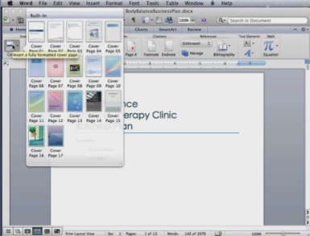
How to Insert a Cover Page
To add a cover page, click the Cover button.
To add content to a document control box, just click and type whatever you want to appear there.
If you don’t need one of the document controls, click and drag the mouse pointer over the control to select it, and delete it.
Skills > Word for Mac 2011 > Overview of Word Processing > How to Insert a Cover Page

Slide 4
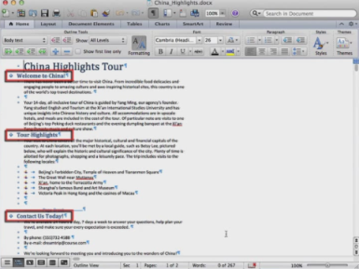
Well-Formed Documents
Well-formed documents are neatly organized and properly formatted to efficiently and effectively communicate a message.
Skills > Word for Mac 2011 > Overview of Word Processing > Well-Formed Documents

Slide 5
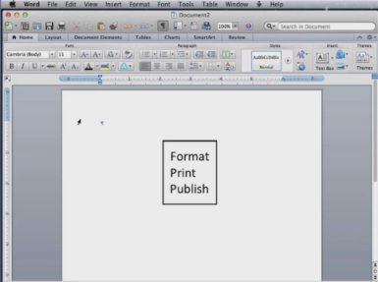
Word Processing Uses
The types of documents most often created include: reports, letters, memos, newsletters, brochures, and technical documents, such as training manuals and product user manuals.
Skills > Word for Mac 2011 > Overview of Word Processing > Word Processing Uses

Slide 6
Document Formatting Techniques
Word’s formatting tools help you apply consistent styles and themes for professional-looking results.
In this section:
Creating and Editing Documents | Tabs and Indents
Applying Styles | Setting Document Margins
Working with Themes | Working with Columns
Headers and Footers | Inserting Page and Section Breaks
Skills > Word for Mac 2011 > Document Formatting Techniques

Slide 7
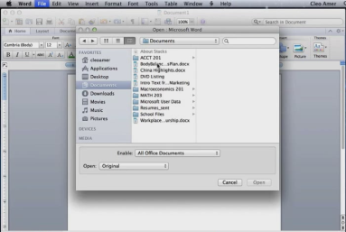
Creating and Editing Documents
Create documents from scratch or from one of the provided templates.
Edit documents by navigating to the storage location where it is saved and double-click to open it.
Replace text by selecting and typing new words.
Skills > Word for Mac 2011 > Document Formatting Techniques > Creating and Editing Documents

Slide 8
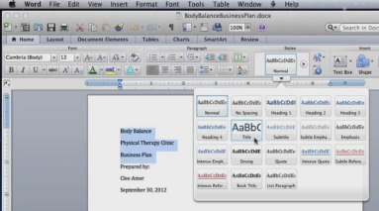
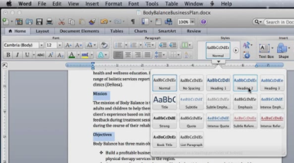
Applying Styles
A style is a collection of formatting options that you can apply with a single click in the Styles gallery in the Styles group on the Home tab.
Apply one style to multiple headings at the same time by selecting the first heading and then holding down the Command key while selecting the second and third headings.
Skills > Word for Mac 2011 > Document Formatting Techniques > Applying Styles

Slide 9
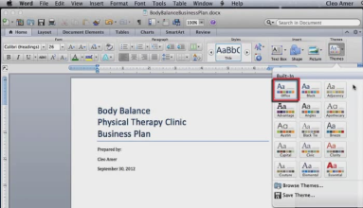
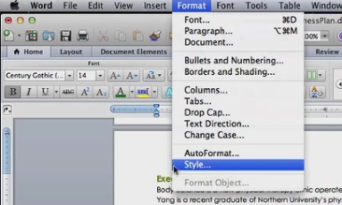
Working with Themes
A document theme is a set of formats designed to work together, including fonts, colors, and other visual effects. Click the Themes button in the Themes group on the Home tab.
Word provides options for modifying a theme’s colors, fonts, and other formats in the Style dialog box.
Skills > Word for Mac 2011 > Document Formatting Techniques > Working with Themes

Slide 10
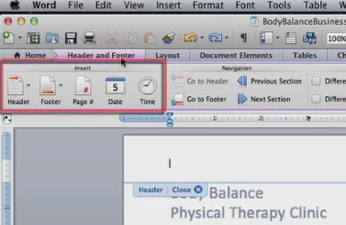
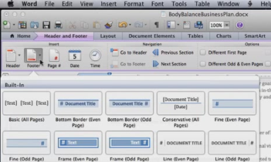
Headers and Footers
In the Header and Footer contextual tab, there are four groups. The Insert group has five buttons: Header, Footer, Page number, Date, and Time.
Click to insert the Page number.
Choose the desired option from the gallery and replace placeholders as needed.
Skills > Word for Mac 2011 > Document Formatting Techniques > Headers and Footers

Slide 11
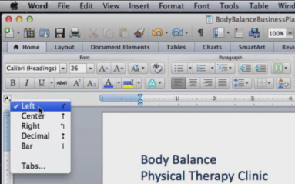
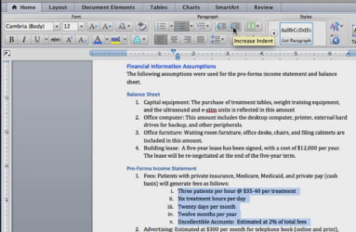
Tabs and Indents
Tab stop options include: Left, Center, Right, Decimal, and Bar.
The Increase/Decrease Indent buttons move all selected text to the next/previous tab stop.
In the horizontal ruler, there are three indent markers: top (First Line Indent), middle (Hanging Indent), and bottom (Left Indent).
Skills > Word for Mac 2011 > Document Formatting Techniques > Tabs and Indents

Slide 12
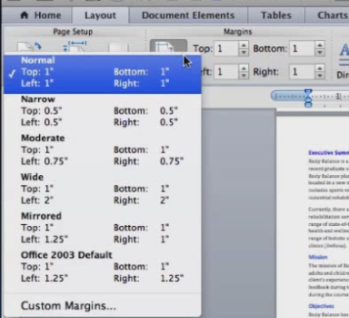
Setting Document Margins
By default, new Word documents contain a one-inch top and bottom margin and a one and a quarter inch left and right margin.
The horizontal and vertical rulers show the margins in light blue.
Margin settings are located in the Margins group on the Layout tab.
Skills > Word for Mac 2011 > Document Formatting Techniques > Setting Document Margins

Slide 13
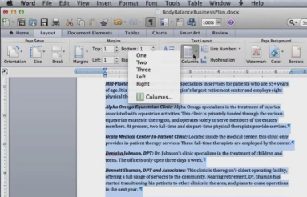
Working with Columns
When formatting text in columns, it is helpful to display nonprinting characters. On the Standard toolbar, click the “Show all nonprinting characters” button.
Select the text, click the Layout tab, then click the Columns button in the Text Layout group.
NOTE: when you format text into columns, Word adds Section Breaks before and after the columns.
Skills > Word for Mac 2011 > Document Formatting Techniques > Working with Columns

Slide 14
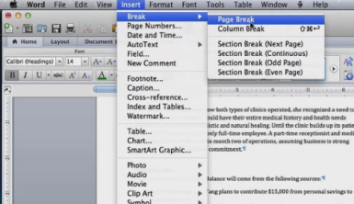
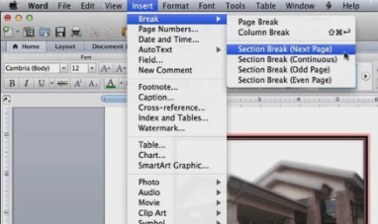
Inserting Page and Section Breaks
To insert a manual page break, position the insertion point, click Insert menu, point to Break, and click Page Break.
A section can have its own margins, page numbers, formatting, page orientation, headers, footers, and so on.
To insert a section break, position the insertion point, click the Insert menu, point to Break, and then click Section Break (Next Page).
Skills > Word for Mac 2011 > Document Formatting Techniques > Inserting Page and Section Breaks

Slide 15
Academic Publishing Tools
Word makes it easy to include graphics, equations, citations, and more in your writing.
In this section:
Inserting Figures with Captions | Symbols and Equations
Thesaurus, Research Tools, and Document Statistics | Citations and a Bibliography Table of Contents
Footnotes and Endnotes | Integration: Inserting Spreadsheet Data
Skills > Word for Mac 2011 > Academic Publishing Tools

Slide 16
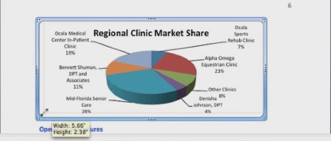
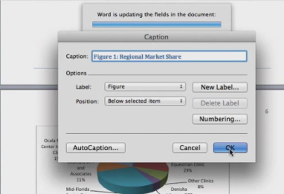
Inserting Figures with Captions
Select the figure you wish to include, Copy. On the Standard toolbar, click the Paste button to insert the image.
Resize the image by grabbing a corner.
Control-click the image to display a menu, click Insert Caption, and Caption dialog box opens.
Skills > Word for Mac 2011 > Academic Publishing Tools > Inserting Figures with Captions

Slide 17
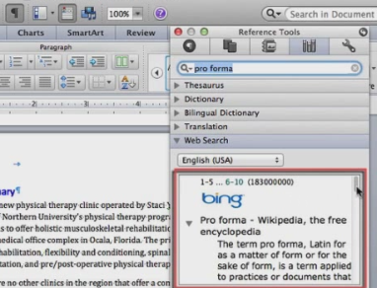
Thesaurus, Research Tools, and Document Statistics
With a word selected, click the Thesaurus option in the Tools menu.
If you don’t know what a term means, you can look it up using the Reference Tools in the Toolbox.
Click either the Word Count at the bottom of the screen OR the Word Count option in the Tools menu to see more document statistics.
Skills > Word for Mac 2011 > Academic Publishing Tools > Thesaurus, Research Tools, and Document Statistics

Slide 18
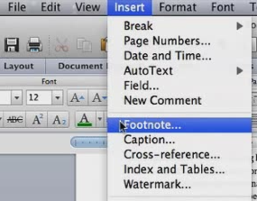
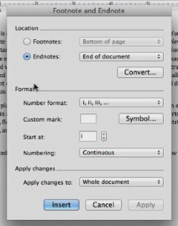
Footnotes and Endnotes
To insert a footnote, position the insertion point where you want to add the footnote, click the Insert menu, then click Footnote.
To insert an endnote, position the insertion point where you want to add the endnote, click the Insert menu, then click Footnote. Make sure the Endnotes button is selected before you click Insert.
Skills > Word for Mac 2011 > Academic Publishing Tools > Footnotes and Endnotes

Slide 19
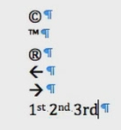
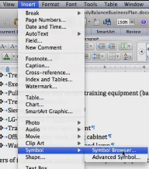
Symbols and Equations
You can insert symbols using keystrokes (e.g., trademark), or you can enter a symbol using the Symbol browser.
To access a variety of formulas, click the Document Elements tab, then choose the Equation button. NOTE: when you click on the content control, the Equation Tools contextual tab appears!
Skills > Word for Mac 2011 > Academic Publishing Tools > Symbols and Equations

Slide 20
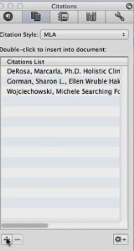
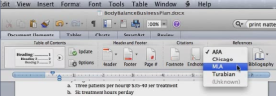
Citations and a Bibliography
For citations, position the insertion point at the end of the sentence. In the References group on the Document Elements tab, choose the style of citations.
Add a citation by clicking the Manage button in the References group. Click the plus sign to add a new source.
For a bibliography, go to the References group on the Document Elements tab, click Bibliography.
Skills > Word for Mac 2011 > Academic Publishing Tools > Citations and a Bibliography

Slide 21
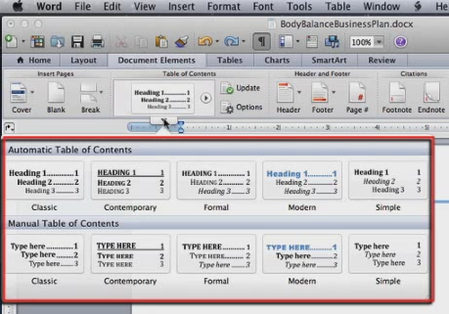
Table of Contents
Since a table of contents usually requires its own page numbering and formatting, it must be set apart as its own section.
Go to the Document Elements tab. The Table of Contents group contains the Table of Contents gallery. Click the gallery handle to see a menu with options for inserting a table of contents in a variety of formats.
Skills > Word for Mac 2011 > Academic Publishing Tools > Table of Contents

Slide 22
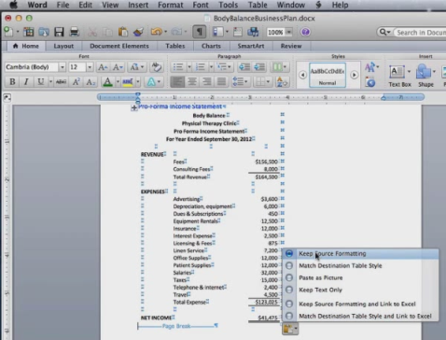
Integration: Inserting Spreadsheet Data
Open both the Word document and the Excel Worksheet containing information you need.
In Excel, highlight and copy the content.
In Word, choose Paste and select “Keep Source Formatting” option listed in the paste option menu.
Skills > Word for Mac 2011 > Academic Publishing Tools > Integration: Inserting Spreadsheet Data

