Slide 1
Other Office 2013 Applications
In addition to Word, Excel, PowerPoint, and Access, Microsoft Office® 2013 includes additional applications, including Outlook, OneNote, and Office Web Apps.
In this section:
Outlook
OneNote
Office Web Apps
Skills > Other Office 2013 Apps

Slide 2
Outlook 2013
Microsoft Outlook 2013 is more than just an email management program. With over 500 million Office users globally, this application offers communication tools that range from message organization and search to calendaring, meeting scheduling, connection with social networks, and more.
In this section:
Email
Calendaring and Tasks
Social Connector
Skills > Other Office 2013 Apps > Outlook 2013

Slide 3
Email
To use Outlook, you first need an email account.
Outlook has the same general layout as other Office applications, with a ribbon and multiple tabs at the top.
Create a new message in the New group, Home tab.
Click Attach File button, Include group, to add an attachment.
If message is urgent, click High Importance button, Tags group.
When complete, click Send button.
Create folders to keep messages organized.
Skills > Other Office 2013 Apps > Outlook 2013 > Email
Notes:
Bullet 2 modified

Slide 4
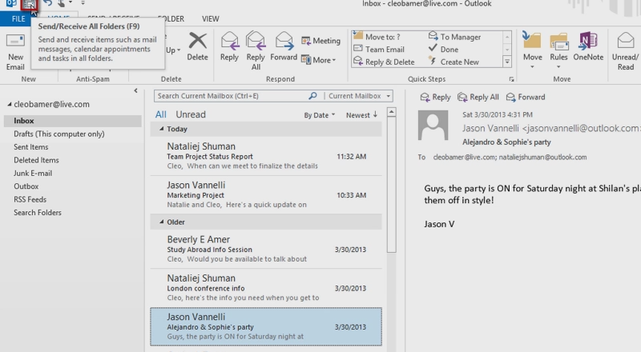
Email
Skills > Other Office 2013 Apps > Outlook 2013 > Email
Notes:
Bullet 2 modified

Slide 5
Calendaring & Tasks
In addition to using Outlook for email communications, the application also has tools for managing your calendar and scheduling tasks.
There are several ways to add an appointment.
To schedule an activity that involves others, schedule a meeting. Outlook makes it easy to schedule a meeting so everyone’s calendars reflect the shared appointment.
To create tasks for your to-do list, choose Task from the drop-down menu of New Items button, New group, Home tab.
Skills > Other Office 2013 Apps > Outlook 2013 > Calendaring & Tasks
Notes:
Bullet 2 modified

Slide 6
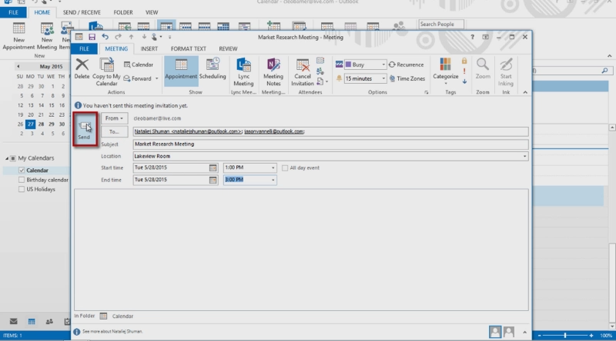
Calendaring & Tasks
Skills > Other Office 2013 Apps > Outlook 2013 > Calendaring & Tasks
Notes:
Bullet 2 modified

Slide 7
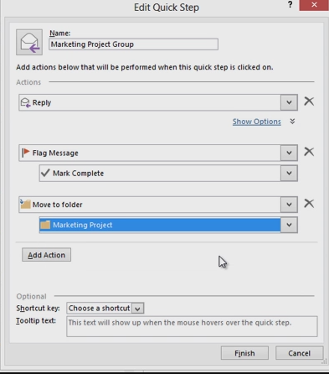
Calendaring & Tasks
The Quick Steps group lets you store a sequence of clicks under a custom button, so that you can easily perform frequently repeated actions with a single click.
Skills > Other Office 2013 Apps > Outlook 2013 > Calendaring & Tasks
Notes:
Bullet 2 modified

Slide 8
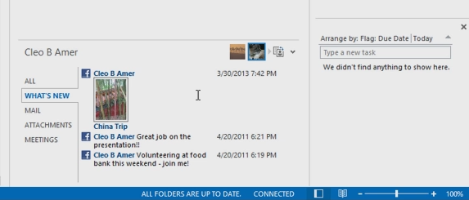
Social Connector
Microsoft’s Outlook email program now has the ability to integrate the display of social networks directly in Outlook. Simply download and install a Social connector add-in program for each network you want to be able to display in Outlook.
Skills > Other Office 2013 Apps > Outlook 2013 > Social Connector
Notes:
Bullet 2 modified

Slide 9
OneNote 2013
OneNote is Microsoft’s solution for collecting and organizing digital content in one location. OneNote notebooks make it easy to organize, search, and even share web screen clippings, emails, text notes, images, videos, or handwritten notes.
In this section:
Collecting Content into Notebooks
Organizing and Finding Content in Notebooks
Shared Notebooks Online
Skills > Other Office 2013 Apps > OneNote 2013

Slide 10
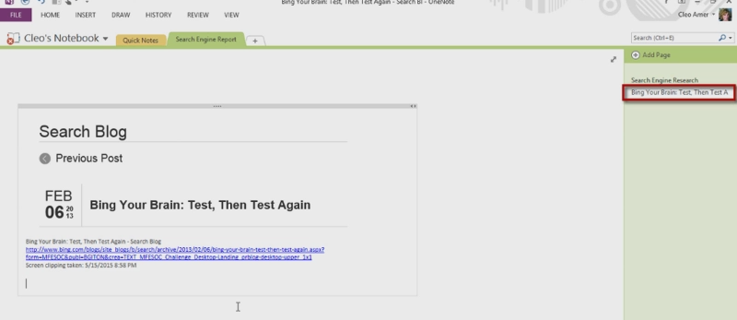
Collecting Content into Notebooks
Microsoft OneNote allows you to create a digital collection of resources that’s easily searchable and stored right in your cloud-based SkyDrive account.
Skills > Other Office 2013 Apps > OneNote 2013 > Collecting Content into Notebooks
Notes:
Bullet 2 modified

Slide 11
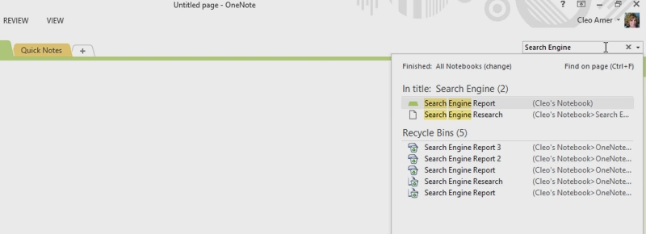
Organizing and Finding Content in Notebooks
A OneNote notebook is the digital equivalent of a physical notebook with tabbed dividers (tabs) and pages.
Skills > Other Office 2013 Apps > OneNote 2013 > Organizing and Finding Content in Notebooks
Notes:
Bullet 2 modified

Slide 12
Shared Notebooks Online
Create notebooks for sharing as part of a collaborative team effort.
OneNote doesn’t lock online shared notebooks, so share with your entire work team and everyone can work on content at the same time.
Changes automatically synchronize so the notebook is always up-to-date.
Skills > Other Office 2013 Apps > OneNote 2013 > Shared Notebooks Online
Notes:
Bullet 2 modified

Slide 13
Office Web Apps
Microsoft offers online versions of Word, Excel, OneNote and PowerPoint for Windows Live members, called Web Apps, at live.com. This lets you use your web browser to view, edit, and share these Office documents when connected to the Internet.
In this section:
Overview of Web Apps
Word
Excel
PowerPoint
Skills > Other Office 2013 Apps > Office Web Apps

Slide 14
Overview of Web Apps
You can use Office Web Apps to edit documents created in earlier versions of Office.
The apps also have been updated to support touch screen capabilities.
You can easily set up a group to keep in touch with and share files with.
You can transition from editing within SkyDrive directly to the corresponding Office application on your computer simply by clicking a button in the Web App’s Ribbon.
Skills > Other Office 2013 Apps > Office Web Apps > Overview of Web Apps
Notes:
Bullet 2 modified

Slide 15
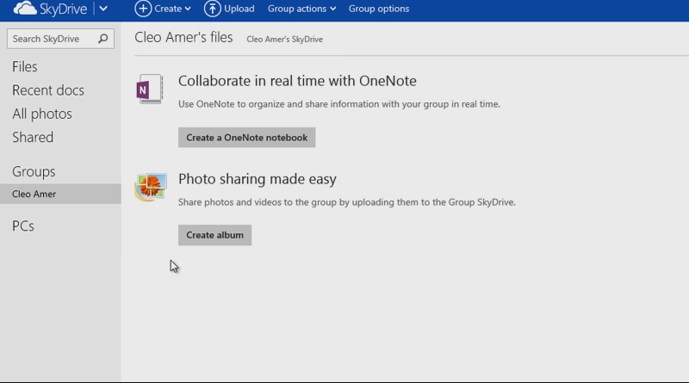
Overview of Web Apps
Skills > Other Office 2013 Apps > Office Web Apps > Overview of Web Apps
Notes:
Bullet 2 modified

Slide 16
Word
First log into your Windows Live account.
Click the Create option and choose Word Document.
The Web App version of Word has a limited set of tabs.
Quick changes can easily be made using the Web App.
The SHARE link allows you to:
Send a link via email
Post the document to a social media account.
Use a web link to generate a URL to copy and paste.
Skills > Other Office 2013 Apps > Office Web Apps > Word
Notes:
Bullet 2 modified

Slide 17
Excel
The Excel Web App in the Windows Live environment makes it possible to create a workbook in Excel, and then share it online so others can work with the live data, making changes to that data as necessary.
First log into your Windows Live account.
Like Word, the Web App version has limited tabs.
The Share button allows you to either share the workbook with others or embed it in a blog or website.
When file sharing, multiple people can work in the online file at the same time.
All changes are saved back to SkyDrive location where file is stored.
Skills > Other Office 2013 Apps > Office Web Apps > Excel
Notes:
Bullet 2 modified

Slide 18
Excel
Skills > Other Office 2013 Apps > Office Web Apps > Excel
Notes:
Bullet 2 modified

Slide 19
PowerPoint
PowerPoint Web App in Windows Live allows you to create or edit a presentation in PowerPoint, and then make simple changes to the presentation right in the Web App.
Because creating a PowerPoint presentation often involves importing photo and video files, it’s more likely that you’ll want to create the presentation on your own computer, and then store it to your SkyDrive under the FILE tab.
SHARE option lets you send presentation file via email; share it by posting to Facebook, Twitter, or LinkedIn’ or get a web link.
Skills > Other Office 2013 Apps > Office Web Apps > PowerPoint
Notes:
Bullet 2 modified

Slide 20
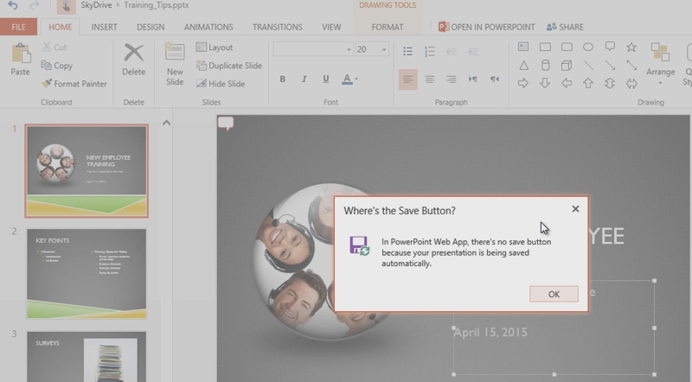
PowerPoint
Skills > Other Office 2013 Apps > Office Web Apps > PowerPoint
Notes:
Bullet 2 modified

