Slide 1
PowerPoint 2013
Microsoft PowerPoint 2013 is presentation software application that is ideal for creating, editing, formatting, and sharing professional-looking presentations that include text, graphics, videos, music, and much more!
In this section:
Overview of PowerPoint
Working with Slides and Text
Using Graphics Objects
Formatting a Slide Show
Presenting and Publishing
Skills > PowerPoint 2013

Slide 2
Overview of PowerPoint
The video lessons in this section are designed to introduce the power and versatility of PowerPoint 2013 to you. If you’re like many students, you’ve probably already used PowerPoint for school assignments. Yet most people only scratch the surface when it comes to the features contained in the software that can make a presentation really stand out from the crowd.
In this section:
PowerPoint Tools and Features
Effective PowerPoint Presentations
PowerPoint Presentation Uses
Skills > PowerPoint 2013 > Overview of PowerPoint

Slide 3
PowerPoint Tools and Features
The Ribbon has familiar (Home, Insert, and Review) and unique (Design, Transitions, Animations, and Slide Shows) tabs.
The View tab also has groups and buttons unique to PowerPoint.
Skills > PowerPoint 2013 > Overview of PowerPoint > PowerPoint Tools and Features
Notes:
Bullet 2 modified

Slide 4
PowerPoint Tools and Features
Previous Slide and Next Slide buttons (lower-right corner) make it easy to move between slides.
“Fit slide to current window” is on status bar.
View buttons (status bar) switch between views.
Skills > PowerPoint 2013 > Overview of PowerPoint > PowerPoint Tools and Features
Notes:
Bullet 2 modified

Slide 5
PowerPoint Tools and Features
Status bar in lower-left corner displays current slide number and total number of slides.
Notes pane underneath the slide pane can be used to enter notes for use when presenting.
Next to Notes button is a button for inserting comments on slides.
Slides tab reveals thumbnail images of each slide.
Skills > PowerPoint 2013 > Overview of PowerPoint > PowerPoint Tools and Features
Notes:
Bullet 2 modified

Slide 6
Effective PowerPoint Presentations
Four steps to preparing and delivering an effective PowerPoint presentation include:
Plan
Prepare
Practice
Present
Skills > PowerPoint 2013 > Overview of PowerPoint > Effective PowerPoint Presentations
Notes:
Bullet 2 modified

Slide 7
Effective PowerPoint Presentations
Keep graphics simple and relevant.
Sound and animations should not detract.
Use a clean text font, no smaller than 24 or 28 point.
Dark text on a light background is easier to read.
Remember the “7 by 7” Rule!
Underlying effective presentations is a really good story – inject some humor, tell a good story, and have fun.
Have a backup plan in case something goes wrong.
Skills > PowerPoint 2013 > Overview of PowerPoint > Effective PowerPoint Presentations
Notes:
Bullet 2 modified

Slide 8
Effective PowerPoint Presentations
Practice in front of a mirror
How much energy do you convey?
What does your posture and body language say?
This may be the only impression people will have, so convey that you really care.
Dress in business attire/appropriate style.
Make eye contact, take a deep breath, relax, and smile.
Skills > PowerPoint 2013 > Overview of PowerPoint > Effective PowerPoint Presentations
Notes:
Bullet 2 modified

Slide 9
PowerPoint Presentation Uses
Marketing presentations
Sales presentations
Classroom use
Corporate training
Fundraising appeals
Sermons and worship events
Outreach activities
Professional speakers use PowerPoint to engage, inspire, and motivate listeners.
PowerPoint is often “go to” program for business users for internal and external updates and reports.
Skills > PowerPoint 2013 > Overview of PowerPoint > PowerPoint Presentation Uses
Notes:
Bullet 2 modified

Slide 10
Working with Slides and Text
The video lessons in this section are designed to show how a simple text-based outline can be used to populate slides and form the foundation for an organized presentation. There are additional tips for efficiently working with slide content to make the process of slide set-up go as smoothly as possible.
In this section:
Creating and Editing Presentations
Working with Slides
Entering and Formatting Text and Hyperlinks
Inserting Symbols and Equations
Presentation Views
Using the Ruler and Gridlines
Skills > PowerPoint 2013 > Working with Slides and Text

Slide 11
Creating and Editing Presentations
By default, PowerPoint starts with a title slide containing two text placeholders: title and subtitle.
Skills > PowerPoint 2013 > Working with Slides and Text > Creating and Editing Presentations
Notes:
Bullet 2 modified

Slide 12
Creating and Editing Presentations
Another way to enter text is with Outline View in the View tab’s Presentation Views group.
Skills > PowerPoint 2013 > Working with Slides and Text > Creating and Editing Presentations
Notes:
Bullet 2 modified

Slide 13
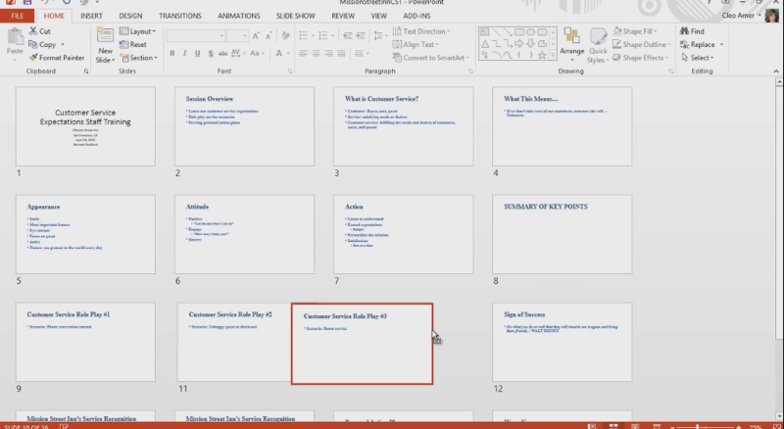
Working with Slides
To make adjustments to the content, order, and layout of the slides, view your presentation in Slide Sorter view where you can drag slides to reorder them and delete slides.
Skills > PowerPoint 2013 > Working with Slides and Text > Working with Slides
Notes:
Bullet 2 modified

Slide 14
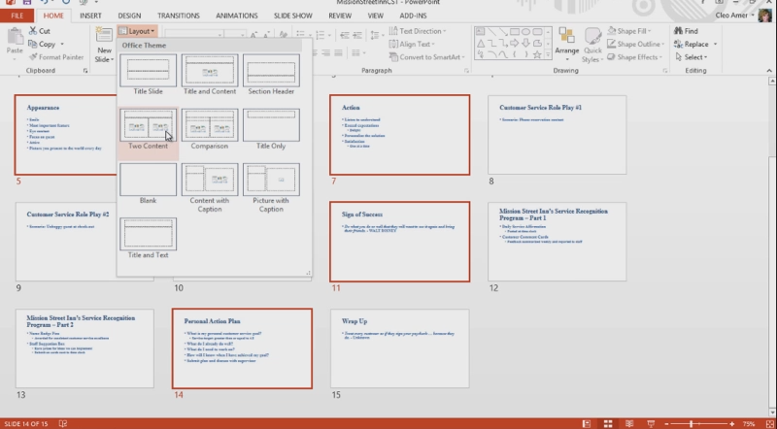
Working with Slides
The default layout is Title and Text. In the Slides group on the Home tab, click the Layout button to change the slide layout.
Skills > PowerPoint 2013 > Working with Slides and Text > Working with Slides
Notes:
Bullet 2 modified

Slide 15
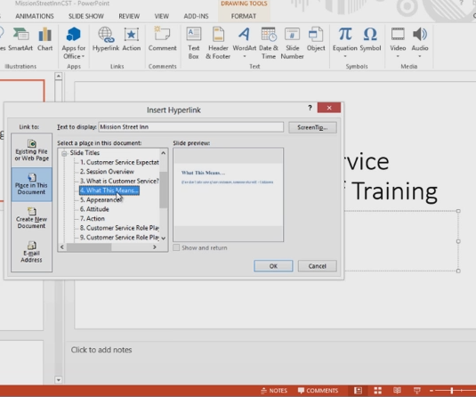
Entering and Formatting Text and Hyperlinks
Tools on Home tab change formatting.
Adding a hyperlink can connect to a web site or another slide.
Skills > PowerPoint 2013 > Working with Slides and Text > Entering and Formatting Text and Hyperlinks
Notes:
Bullet 2 modified

Slide 16
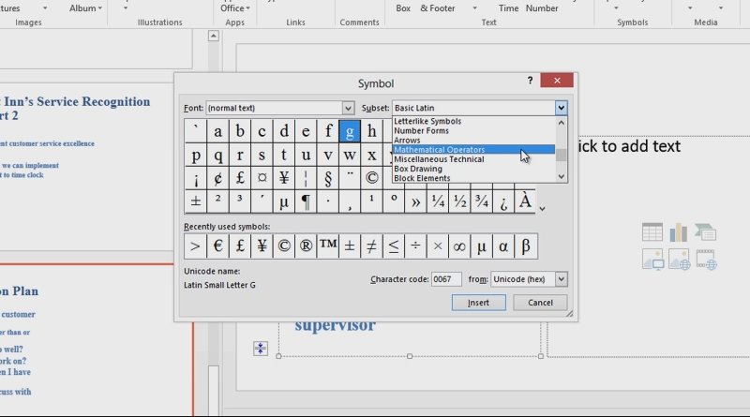
Inserting Symbols and Equations
Use Symbols group, Insert tab, to insert symbols.
Skills > PowerPoint 2013 > Working with Slides and Text > Inserting Symbols and Equations
Notes:
Bullet 2 modified

Slide 17
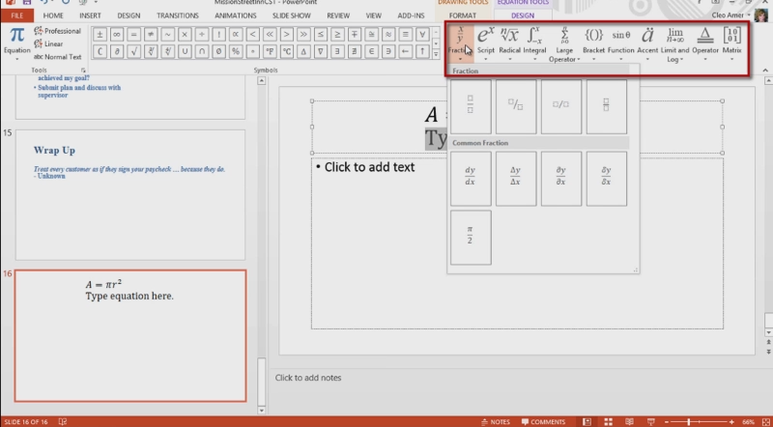
Inserting Symbols and Equations
Insert equation in similar manner, or type your own equation.
Skills > PowerPoint 2013 > Working with Slides and Text > Inserting Symbols and Equations
Notes:
Bullet 2 modified

Slide 18
Presentation Views
PowerPoint presentation first opens in default, Normal view.
At bottom of slide pane is section for typing notes: reminder notes, talking points, or anything else associated with the slide.
Skills > PowerPoint 2013 > Working with Slides and Text > Presentation Views
Notes:
Bullet 2 modified

Slide 19
Presentation Views
Presentation Views group on left side of View tab.
Current view indicated by gold highlighting.
Three of the options match buttons in lower-right corner of status bar: Normal, Slide Sorter, Reading View.
Skills > PowerPoint 2013 > Working with Slides and Text > Presentation Views
Notes:
Bullet 2 modified

Slide 20
Presentation Views
Notes button hides or reveals notes on slide.
Comments button is used to add comments.
Skills > PowerPoint 2013 > Working with Slides and Text > Presentation Views
Notes:
Bullet 2 modified

Slide 21
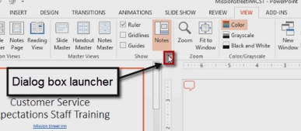
Using the Ruler and Gridlines
Show group contains three
alignment tool options:
Ruler
Gridlines
Guides
Rulers are useful to make sure content is lined up consistently across all slides in presentation.
Skills > PowerPoint 2013 > Working with Slides and Text > Using the Ruler and Gridlines
Notes:
Bullet 2 modified

Slide 22
Using the Ruler and Gridlines
Gridlines overlays a grid of one-inch squares over each slide.
Guides partition each slide into four quadrants.
Skills > PowerPoint 2013 > Working with Slides and Text > Using the Ruler and Gridlines
Notes:
Bullet 2 modified

Slide 23
Using Graphics Objects
The video lessons in this section are designed to enhance your ability to provide strong visual support to a slide show presentation. The best presentations are not packed with text; they’re visual and engaging. It’s worth the time to see just how far a little knowledge about PowerPoint’s graphics objects tools will take you. You’ll learn about object animation, and how to create tables and SmartArt graphics.
In this section:
Inserting Graphics
Adjusting Object Properties
Layering and Grouping Objects
Animating Objects
Working with Tables and SmartArt
Inserting Video and Music
Inserting a Spreadsheet Table
Skills > PowerPoint 2013 > Using Graphics Objects

Slide 24
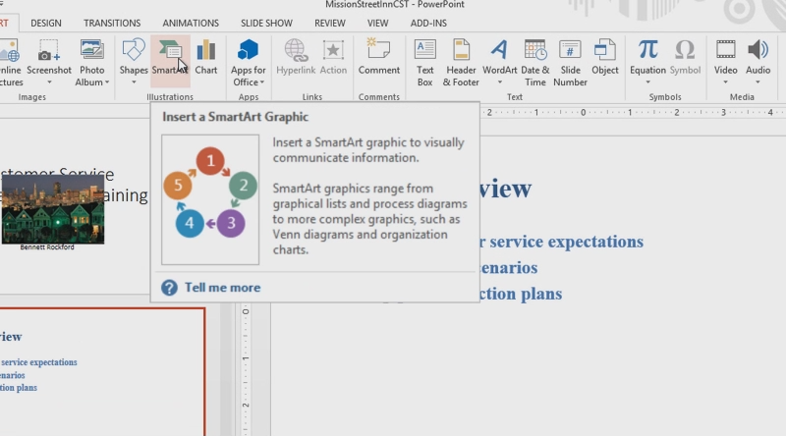
Inserting Graphics
Use Insert tab to insert graphics, including pictures.
Smart Art is in the Illustrations group, and you can convert text to SmartArt.
Clip Art is in the Images group.
You can also insert a hyperlink on a graphic.
Skills > PowerPoint 2013 > Using Graphics Objects > Inserting Graphics
Notes:
Bullet 2 modified

Slide 25
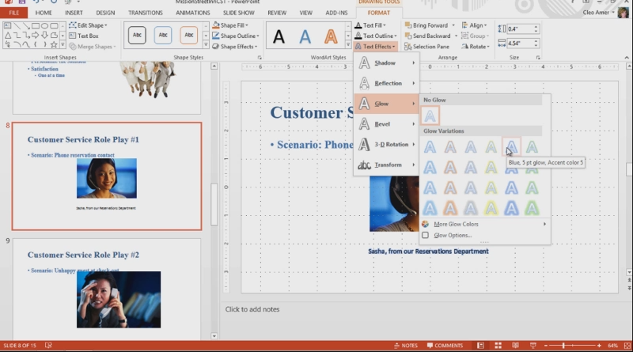
Adjusting Object Properties
Once you have inserted an object, you can modify it by moving, resizing, aligning, and adding effects.
Skills > PowerPoint 2013 > Using Graphics Objects > Adjusting Object Properties
Notes:
Bullet 2 modified

Slide 26
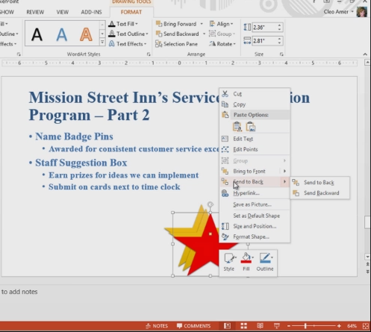
Layering and Grouping Objects
Occasionally, objects on a slide may need to be layered or grouped in order to get them to display the way you want.
To display layer and group options, right-click the object.
Skills > PowerPoint 2013 > Using Graphics Objects > Layering and Grouping Objects
Notes:
Bullet 2 modified

Slide 27
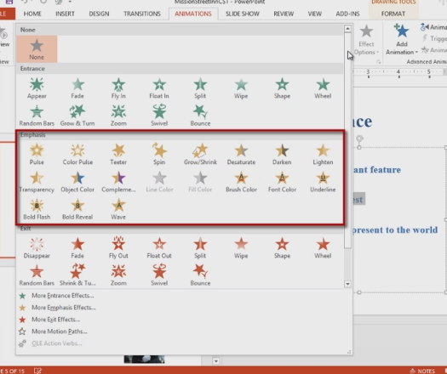
Animating Objects
Adding animation to a presentation can really make it come alive!
Effects are grouped according to use: Entrance, Emphasis, or Exit.
Effect Options change the sequence in which animations appear.
Skills > PowerPoint 2013 > Using Graphics Objects > Animating Objects
Notes:
Bullet 2 modified

Slide 28
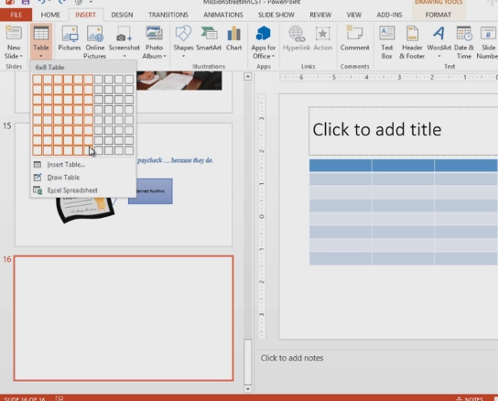
Working with Tables and SmartArt
PowerPoint offers a variety of options for adding visual elements.
You can insert a table using the Ribbon or clicking Table icon in a content placeholder.
Skills > PowerPoint 2013 > Using Graphics Objects > Working with Tables and SmartArt
Notes:
Bullet 2 modified

Slide 29
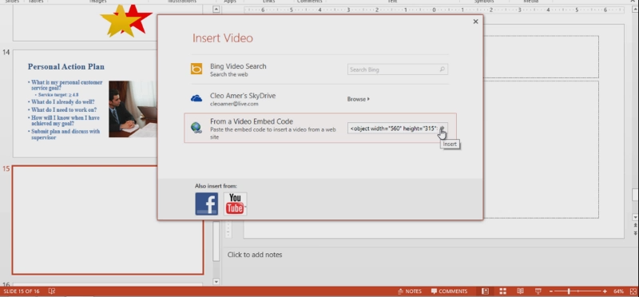
Inserting Video and Music
One sure way to get the attention of your audience is to use video and music!
Use Insert tab in insert music or video clips.
Skills > PowerPoint 2013 > Using Graphics Objects > Inserting Video and Music
Notes:
Bullet 2 modified

Slide 30
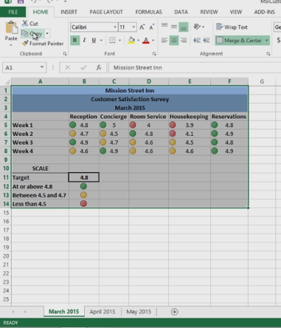
Inserting a Spreadsheet Table
One way to include quantitative data is to insert a table from an Excel spreadsheet directly onto a slide.
You can simply copy the data from Excel and paste it in PowerPoint.
Skills > PowerPoint 2013 > Using Graphics Objects > Inserting a Spreadsheet Table
Notes:
Bullet 2 modified

Slide 31
Formatting a Slide Show
The video lessons in this section are designed to provide the essential “behind the scenes” skills every slide show requires. Most users never venture onto the slide masters or change the underlying slide designs to customize the format of their slide shows. Yet these, and other, skills can help provide consistency and ease of navigation so you can focus on the message and not the mechanics of the presentation.
In this section:
Slide Header and Footer
Inserting Date & Time and Slide Numbers
Working with a Slide Master
Working with Slide Design
Working with Slide Transitions
Setting Up a Slide Show
Skills > PowerPoint 2013 > Formatting a Slide Show

Slide 32
Slide Header and Footer
A header is text that appears at the top of every page in a document. In PowerPoint you can’t insert a header onto slides, but you can insert a header on items for printing (e.g., handouts, notes pages, and speaker’s notes).
Click the Header & Footer button, Text group, on Insert tab.
PowerPoint does permit a footer on presentation slides.
Click Footer check box on Slide tab in Header and Footer dialog box.
Skills > PowerPoint 2013 > Formatting a Slide Show > Slide Header and Footer
Notes:
Bullet 2 modified

Slide 33
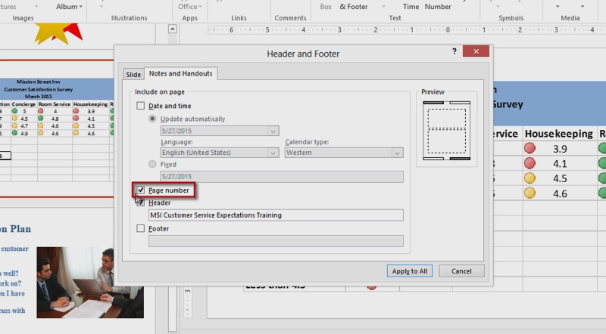
Slide Header and Footer
Skills > PowerPoint 2013 > Formatting a Slide Show > Slide Header and Footer
Notes:
Bullet 2 modified

Slide 34
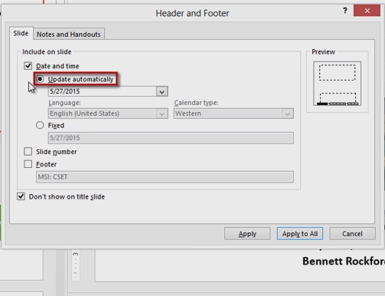
Inserting Date & Time and Slide Numbers
To add date and time, click Header & Footer button in Text group, Insert tab. On Slide tab in Header and Footer dialog box, check the box to add the date and time.
To see different date options, click down arrow next to default date.
In the same dialog box is an option to add slide numbers.
Skills > PowerPoint 2013 > Formatting a Slide Show > Inserting Date & Time and Slide Numbers
Notes:
Bullet 2 modified

Slide 35
Working with a Slide Master
The purpose of slide masters is to assure that all slides have a consistent look with similar elements.
Master Views group on View Tab has three buttons:
Slide Master
Handout Master
Notes Master
As you hold the mouse over each thumbnail, a ScreenTip tells you how many slides in the current presentation use that layout.
The very first slide is the master for the entire theme.
Skills > PowerPoint 2013 > Formatting a Slide Show > Working with a Slide Master
Notes:
Bullet 2 modified

Slide 36
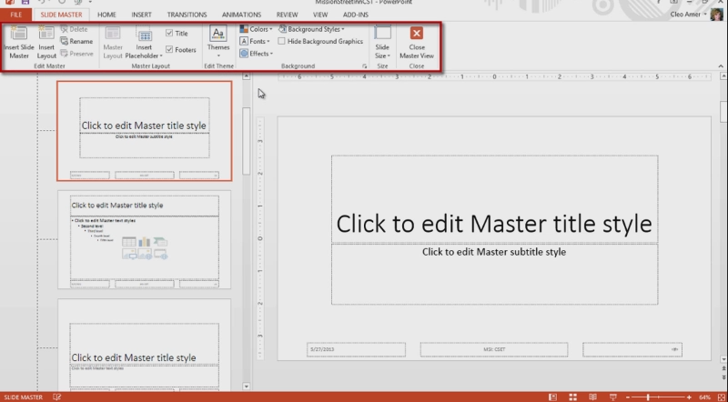
Working with a Slide Master
Skills > PowerPoint 2013 > Formatting a Slide Show > Working with a Slide Master
Notes:
Bullet 2 modified

Slide 37
Working with a Slide Design
Another way to modify slides is to use tools found on Design tab.
The Slide Size option, in Customize group, lets you change the orientation of the slides’ contents.
Themes group offers quick and easy options for dressing up a slide show.
You can add a colored background to all slides by clicking Format Background button.
Skills > PowerPoint 2013 > Formatting a Slide Show > Working with Slide Design
Notes:
Bullet 2 modified

Slide 38
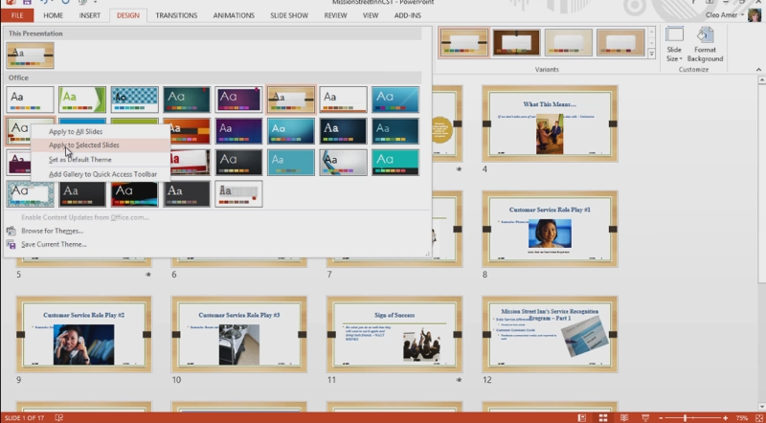
Working with a Slide Design
Skills > PowerPoint 2013 > Formatting a Slide Show > Working with Slide Design
Notes:
Bullet 2 modified

Slide 39
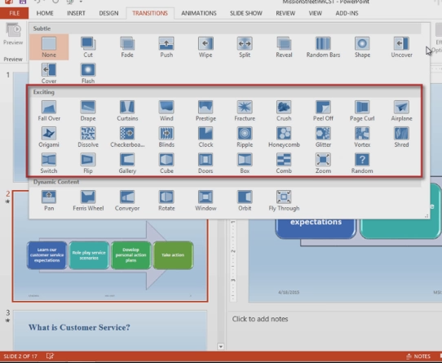
Working with Slide Transitions
A transition is a type of special effect between slides.
When a transition is applied to a single slide, it occurs when that slide first appears.
You can apply a single transition to all slides by clicking Apply to All in the Timing group on the Ribbon.
Skills > PowerPoint 2013 > Formatting a Slide Show > Working with Slide Transitions
Notes:
Bullet 2 modified

Slide 40
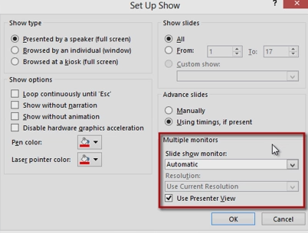
Setting Up a Slide Show
Set Up group, View tab, has several useful buttons for preparing a slide show.
Click the Set Up Slide Show button to display the Set Up Show dialog box, with a variety of options.
Skills > PowerPoint 2013 > Formatting a Slide Show > Setting Up a Slide Show
Notes:
Bullet 2 modified

Slide 41
Presenting and Publishing
Once your presentation is complete, you’ll have different options for actually presenting your slide show. From the traditional in-person delivery to print and online choices, the lessons in this section will acquaint you with how to confidently use each one. PowerPoint 2013 includes the option to broadcast your presentation live over the Web, which opens even more options for reaching your audience, no matter where they are.
In this section:
Presenting a Slide Show
Printing Slides
Publishing a Presentation
Presenting Online
Skills > PowerPoint 2013 > Presenting and Publishing

Slide 42
Presenting a Slide Show
Start Slide Show group holds buttons for starting a slide show from the beginning and from a selected slide.
From Current Slide button is useful if you make a last-minute change to a slide and want to verify that the slide show works from that point forward.
Custom Slide Show button allows you to create several versions of a slide show for different audiences.
In Define Custom Show dialog box, you can click to add slides from the current presentation to a new custom one.
Skills > PowerPoint 2013 > Presenting and Publishing > Presenting a Slide Show
Notes:
Bullet 2 modified

Slide 43
Printing Slides
You might need to print slides for a class, as audience handouts, or for inclusion in a packet of materials.
First check print options in Backstage View, File tab.
In Print Layout section are three options:
Default option is Full Page Slides.
Second option is for printing notes pages, which prints one slide per page with any speaker’s notes.
The third option is for printing a text-only outline.
If you prefer to print slide thumbnails for your audience, look under the Handouts section.
Skills > PowerPoint 2013 > Presenting and Publishing > Printing Slides
Notes:
Bullet 2 modified

Slide 44
Printing Slides
Skills > PowerPoint 2013 > Presenting and Publishing > Printing Slides
Notes:
Bullet 2 modified

Slide 45
Publishing a Presentation
PowerPoint also supports saving to the cloud, sending via e-mail, publishing online, or publishing to a shared location. All are found on File tab, Share option.
Computer & HD Displays button allows you to select the type of display.
Use Recorded Timings and Narrations button allows you to choose pre-set timings and narrations.
Create Video button allows you to make a video of your presentation.
Package for CD button allows you to create a CD version of your slide show.
Skills > PowerPoint 2013 > Presenting and Publishing > Publishing a Presentation
Notes:
Bullet 2 modified

Slide 46
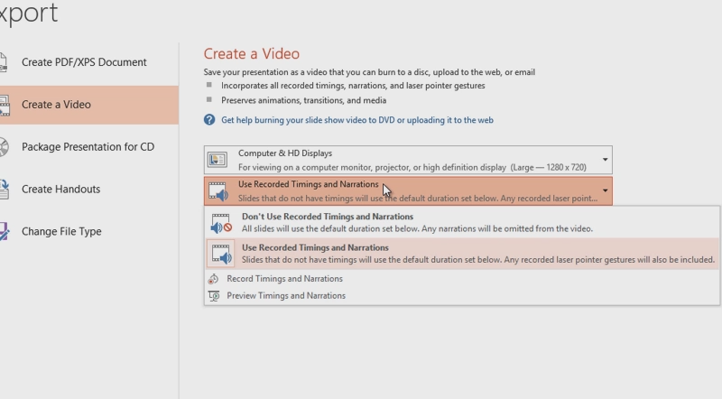
Publishing a Presentation
Skills > PowerPoint 2013 > Presenting and Publishing > Publishing a Presentation
Notes:
Bullet 2 modified

Slide 47
Presenting Online
Presenting online is a type of publishing. With the presentation service, you can create a presentation, run it live over the Web, and have others in remote locations watch it online as you present it.
Skills > PowerPoint 2013 > Presenting and Publishing > Presenting Online
Notes:
Bullet 2 modified

Slide 48
Presenting Online
Remember when presenting online:
First, the only transition effect the online audience will see is a Fade transition.
Second, animations are limited, so not all advanced special effects will be viewable to the online audience.
Third, videos won’t play and will result in an error for the audience. This means that YouTube and other videos won’t work in the broadcast.
Fourth, you need to be signed onto live.com using your Windows Live account credentials.
Skills > PowerPoint 2013 > Presenting and Publishing > Presenting Online
Notes:
Bullet 2 modified

