Slide 1
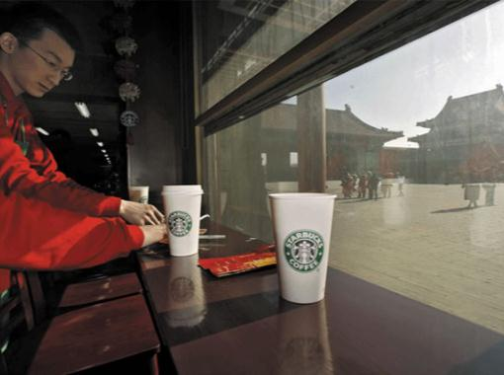
Globalization
…refers to changes in societies and the world economy resulting from dramatically increased international trade and cultural exchange.
In this section:
Distributed Workforce
Outsourcing
Offshoring
International Business Models
Links:
Video: Globalization
Issues > Globalization

Slide 2
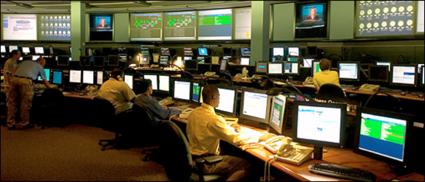
Distributed Workforce
The distributed workforce requires professionals to adapt to a new work environment and routine. Knowledge workers must be fluent with communication technologies and able to collaborate well with others from diverse cultural backgrounds.
A distributed workforce combines the talents of individuals from different businesses and locations to work together on a common product or project.
Links:
Video: Microsoft CIO Tony Scott on Distributed Workforce
Issues > Globalization > Distributed Workforce

Slide 3
Outsourcing
Outsourcing refers to a business’ use of an outside company to take over portions of its workload.
Many businesses are finding that they can save significant amounts of time, effort, and money by hiring outside businesses to perform specialized tasks.
Links:
Video: Pros and Cons of Outsourcing
Issues > Globalization > Outsourcing

Slide 4
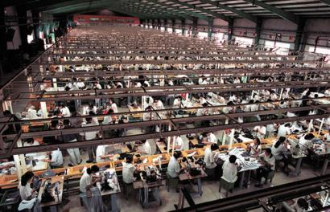
Offshoring
Offshoring is a business practice that relocates an entire production line to another location, typically in another country, in order to enjoy cheaper labor, lower taxes, and other forms of lower overhead.
Offshoring is somewhat different from outsourcing. With outsourcing, a portion of a work process is hired out. With offshoring, entire production lines are relocated to another country.
Links:
Video: No Logo: Brands, Globalization & Resistance
Issues > Globalization > Offshoring

Slide 5
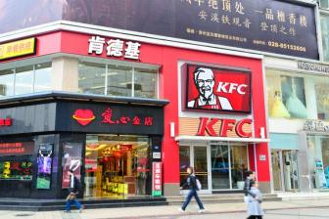
International Business Models
International business models include methods of engaging in international business ranging from basic import/export to fully transnational businesses.
Company Type | Description
International | Maintains management and operations in its home country, exporting or importing products to and from other countries.
Multinational | Maintains management in its home country and is supported by operations distributed across several countries. Typically market products specifically to satisfy the needs of their customers in different countries.
Global | Similar to a multinational company except markets its brand and products in the same way across all countries, regardless of cultural differences.
Transnational | Has complex management distributed across multiple countries and operations. Often it is difficult to name a home country.
Links:
Video: Learning Global Business Working at Intel in Shanghai
Issues > Globalization > International Business Models

Slide 6
Globalization
Terms
Globalization
Distributed workforce
Outsourcing
Insourcing
Offshoring
International Business Models
International company
Multinational company
Global company
Transnational company
Issues > Globalization > See your eBook for more information about these terms

