Slide 1
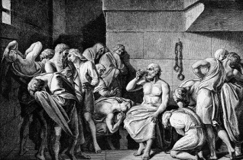
Ethics
…is a branch of philosophy that deals with issues of morality—consideration of which human actions and reactions are morally right and wrong.
In this section:
Personal Computer Ethics | Accessible Computing
Professional Computer Ethics | Green Computing
Governmental Computer Ethics | Digital Divide
Links:
Video: Anonymous vs North Korea
Issues > Ethics

Slide 2
Personal Computer Ethics
Personal computer ethics refers to the responsible use of computers by individuals outside of professional environments.
Computer users face many ethical choices in their casual use of today’s technologies – it is important to consider actions carefully and intelligently to determine the course of action that best matches their own code of ethics and sense of responsibility.
Links:
Video: Digital Smarts: Behaving Ethically Online
Issues > Ethics > Personal Computer Ethics

Slide 3
Professional Computer Ethics
The ethical issues faced by professionals who use computer systems as part of their jobs include a responsibility to customers, coworkers, employers, and others with whom they interact and who are impacted in some way by their computer use on the job.
Professional computer ethics involves the ethical issues faced by professionals in their use of computer systems as part of their jobs.
Links:
Video: Google Glass Already Banned ...
Issues > Ethics > Professional Computer Ethics

Slide 4
Governmental Computer Ethics
Governmental computer ethics refers to a government’s responsibility to create laws to protect citizens from unethical computer use and provide citizens with equal access to computers and information technologies as well as their benefits.
Governments face many of the same ethical considerations as businesses with respect to their use of computers and information systems. However, governments have the added responsibility of guiding the influence of technology on their population.
Links:
Video: How FaceBook Changed the World The Arab Spring
Issues > Ethics > Governmental Computer Ethics

Slide 5
Accessible Computing
Computer and information technologies must be designed in a manner that is easily accessible to all users.
Accessible computing refers to the provision of equal access to computers and information technology for individuals with disabilities.
Links:
Video: Why Learn Web Accessibility?
Issues > Ethics > Accessible Computing

Slide 6
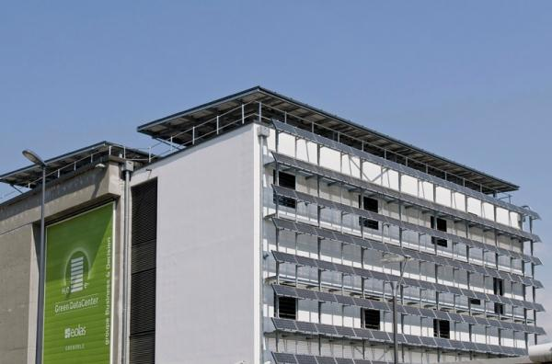
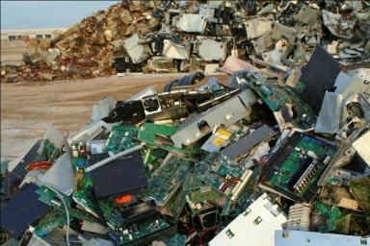
Green Computing
Green computing refers to the efforts of individuals, businesses, and governments to utilize environmentally conscious practices in the manufacturing and use of digital technologies.
Links:
Video: Computer Recycling - Intercon Solutions
Issues > Ethics > Green Computing

Slide 7
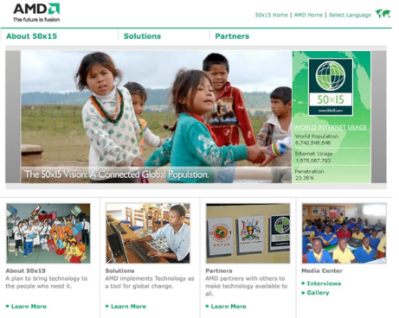
Digital Divide
The digital divide refers to the social and economic gap between those who have access to computers and the Internet and those who do not.
There are digital divides based on gender, ethnicity, race, age, income, location, and disability.
Links:
Video: What is the "digital divide?"
Issues > Ethics > Digital Divide

Slide 8
Ethics
Terms
Ethics
Hactivists
Personal Computer Ethics
Professional Computer Ethics
Governmental Computer Ethics
Accessible Computing
Green Computing
E-waste
Digital Divide
Issues > Ethics > See your eBook for more information about these terms

