Slide 1
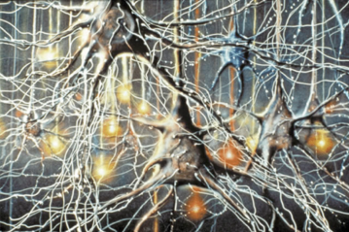
Artificial Intelligence
… (AI) refers to the art and science of creating computer systems that simulate human thought and behavior.
In this section:
AI Methodologies
AI Applications
Links:
Video: A: This Computer Could Defeat You at 'Jeopardy!'
Concepts > Artificial Intelligence

Slide 2
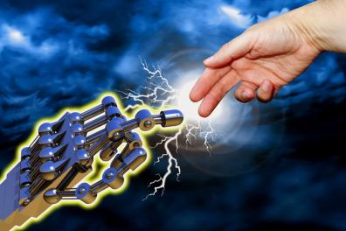
AI Methodologies
… consist of the various approaches to AI research that generally fall under one of two categories: conventional AI or computational intelligence.
In this section:
Conventional AI | Neural Network
Expert System (ES) | Turing Test
Computational Intelligence | Singularity
Links:
Video: Michio Kaku on AI
Concepts > Artificial Intelligence > AI Methodologies

Slide 3
Conventional AI
Conventional AI—also called symbolic AI, logical AI, or neat AI—uses programming that emphasizes statistical analysis to calculate the probability of various outcomes in order to find the best solution.
Conventional AI techniques are embedded in many of today’s popular software applications making them easier to use, and more useful.
Links:
Video: NAO Next Gen
Concepts > Artificial Intelligence > AI Methodologies > Conventional AI

Slide 4
Expert System (ES)
An expert system (ES) is a form of conventional AI that is programmed to function like a human expert in a particular field or area.
Many professional activities are tedious, redundant, and sometimes dangerous. Expert systems can assist human professionals.
Concepts > Artificial Intelligence > AI Methodologies > Expert System (ES)

Slide 5
Computational Intelligence
Computational intelligence is an offshoot of AI that employs methodologies such as neural networks, fuzzy systems, and evolutionary computation to set up a system whereby the software can develop intelligence through an iterative learning process.
Links:
Video: Honda Unveils All-new ASIMO
Concepts > Artificial Intelligence > AI Methodologies > Computational Intelligence

Slide 6
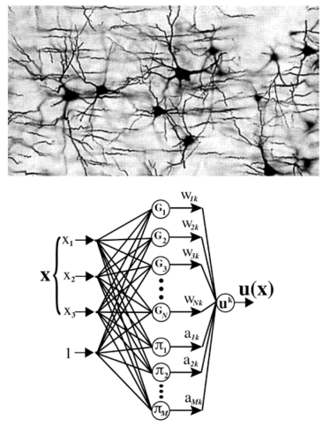
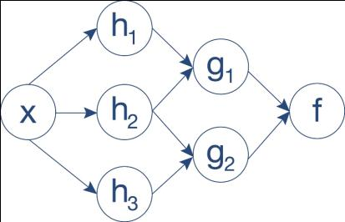
Neural Network
A neural network, or neural net, uses software to simulate the functioning of the neurons in a human brain.
Simulating a human brain in a neural network may result in a deeper understanding of how the human mind functions. Advances in neural networks are providing insight into treatment for mental illness and other brain-related diseases.
Links:
Video: Global neural network cloud service for breast cancer detection
Concepts > Artificial Intelligence > AI Methodologies > Neural Network

Slide 7
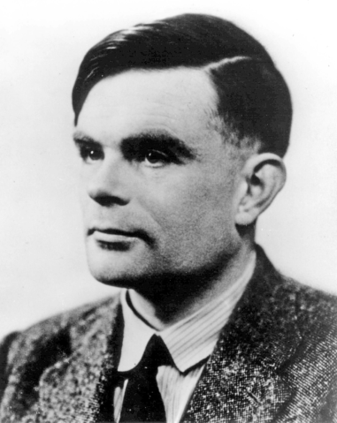
Turing Test
The Turing Test was devised by Alan Turing as a method of determining if a machine exhibits human intelligence.
Turing believed that thinking machines were just around the corner. Researchers today, over 60 years later, are thinking the same thing.
Concepts > Artificial Intelligence > AI Methodologies > Turing Test

Slide 8
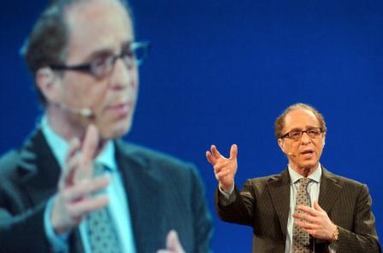
Singularity
The Singularity, or more specifically, the technological Singularity, is the point in time at which computers exceed humans in intelligence, launching a new era of innovation.
Should it come to pass, a technological Singularity could completely change life as we know it by ushering in an era of deeper understanding and rapid advancement.
Links:
Video: Ray Kurzweil: The Coming Singularity
Concepts > Artificial Intelligence > AI Methodologies > Singularity

Slide 9
AI Methodologies
Terms
Artificial Intelligence (AI)
Machine Learning
AI Methodologies
Conventional AI
Heuristics
Case-Based Reasoning
Bayesian Network
Behavior-Based AI
Expert System (ES)
Computational Intelligence
Fuzzy Logic
Fuzzy Control System
Evolutionary Computation
Genetic Algorithm
Neural Network
Turing Test
Singularity
Strong AI
Concepts > Artificial Intelligence > AI Methodologies > See your eBook for more information about these terms

Slide 10
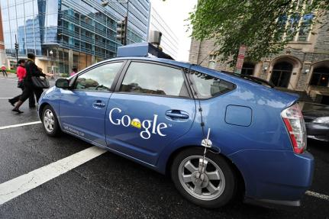
AI Applications
… are ways in which AI methodologies are applied to solve problems and provide services.
In this section:
Robotics | Pattern Recognition
Computer Vision | Intelligent Agent
Natural Language Processing | Artificial Creativity
Concepts > Artificial Intelligence > AI Applications

Slide 11
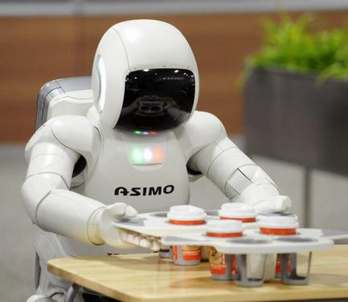
Robotics
Robotics involves developing mechanical or computer devices to perform tasks that require a high degree of precision or are tedious or hazardous for humans.
Honda’s ASIMO is the world’s most advanced humanoid robot.
Links:
Video: Ball-catching robot
Concepts > Artificial Intelligence > AI Applications > Robotics

Slide 12
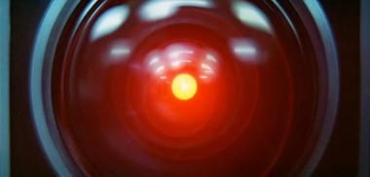
Computer Vision
Computer vision combines hardware (cameras and scanners) and AI software that permit computers to capture, store, and interpret visual images and pictures.
Computer vision enables software to react to visual input. Computer vision systems are also being developed to assist in human sight.
Links:
Video: Link not working!!!
Concepts > Artificial Intelligence > AI Applications > Computer Vision

Slide 13
Natural Language Processing
Natural language processing uses AI techniques to enable computers to generate and understand natural human languages, such as English.
Natural language processing has become popular in collecting user input over phone systems, in mobile phones for automatic dialing and issuing commands, and for individuals who cannot use a keyboard and mouse because they are disabled or because their hands are needed for other work.
Links:
Video: Dragon 11 in action
Concepts > Artificial Intelligence > AI Applications > Natural Language Processing

Slide 14
Pattern Recognition
Pattern recognition is an area of AI that develops systems that are trained to recognize patterns in data.
Types of Pattern Recognition
Speech Recognition
Handwriting Recognition
Facial Recognition
Links:
Video: Facial recognition camera that tracks your shopping habits
Concepts > Artificial Intelligence > AI Applications > Pattern Recognition

Slide 15
Intelligent Agent
An intelligent agent, digital assistant, or bot, consists of programs and a knowledge base used to perform a specific task for a person, a process, or another program.
Intelligent agents often include a human persona and animated avatar form.
Links:
Video: Apple - Introducing Siri on iPhone 4S
Concepts > Artificial Intelligence > AI Applications > Intelligent Agent

Slide 16
Artificial Creativity
Artificial creativity is a branch of AI that works to program computers to express themselves through art, music, poetry, and other outlets.
AI software has become quite talented at creating works of art. The most useful output, however, is the insight it gives us into the workings of human creativity.
Links:
Video: AI in the Art World
Concepts > Artificial Intelligence > AI Applications > Artificial Creativity

Slide 17
AI Applications
Terms
AI Applications
Robotics
Computer Vision
Natural Language Processing
Speech Recognition
Pattern Recognition
Handwriting Recognition
Facial Recognition
Intelligent Agent
Digital Assistant
Bot
Artificial Creativity
Concepts > Artificial Intelligence > AI Applications > See your eBook for more information about these terms

