Slide 1
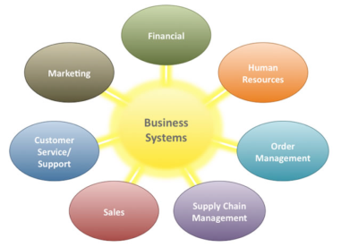
Business Systems
… are computer-based information systems that provide organizations with valuable information in a timely and effective manner to allow the functional areas of the enterprise to work together to achieve goals.
Business systems are designed to collect, store, and disseminate information needed to make good business decisions in all types of jobs and all types of professions.
In this section:
Information Management
Enterprise Systems
Links:
Video: Predictive Analytics: Using Real-Time Data
Concepts > Business Systems

Slide 2
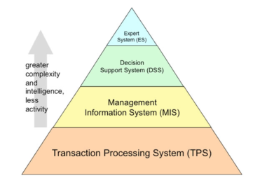
Information Management
… refers to software and computer- based systems dedicated to collecting, storing, and manipulating data in a manner that produces useful information on which to base decisions.
In this section:
Transaction Processing System | Business Intelligence
Management Information System | Decision Support Systems
Decision Making | Geographic Information System
MIS Reports | Informatics
Links:
Video: Business Analytics - Turning Data Into Insight
Concepts > Business Systems > Information Management

Slide 3
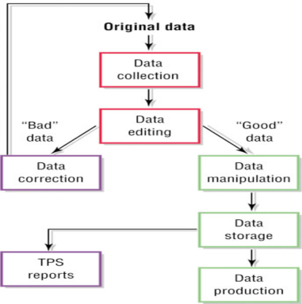
Transaction Processing System
A transaction processing system (TPS) is an information system used to support and record transactions such as paying for products or paying an employee.
Links:
Video: iPad Cash Register from ShopKeep POS
Concepts > Business Systems > Information Management > Transaction Processing System

Slide 4
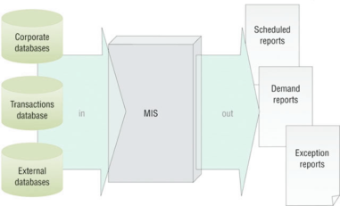
Management Information System
A management information system or MIS provides routine business information to decision makers in a useful and convenient format.
Links:
Video: Concordia MIS Student Success
Concepts > Business Systems > Information Management > Management Information System

Slide 5
Decision Making
Decision making is the key component of the problem-solving process that takes place in three stages: intelligence, design, and choice.
Problem-Solving Approach
Problem Type
Problem-Solving Method
Links:
Video: Invalid Link - needs fixed!
Concepts > Business Systems > Information Management > Decision Making

Slide 6
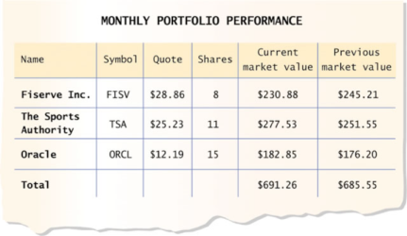
MIS Reports
MIS reports present useful information for management, often compiled by querying a database.
Links:
Video: IBM Cognos Express
Concepts > Business Systems > Information Management > MIS Reports

Slide 7
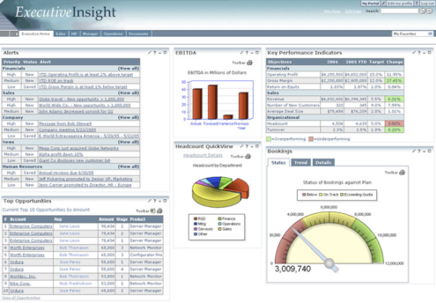
Business Intelligence
Business intelligence (BI) refers to technologies that are used to gather and report information that supports intelligent business decision making.
BI has become a buzzword in business because of its ability to propel a company forward.
Links:
Video: A SAS Overview - Proven
Concepts > Business Systems > Information Management > Business Intelligence

Slide 8
Decision Support System
The DSS approach realizes that people, not machines, make decisions.
A decision support system (DSS) is an information system used to support problem-specific decision making.
Links:
Video: Why Data Matters: Context Reveals Ansers
Concepts > Business Systems > Information Management > Decision Support System

Slide 9
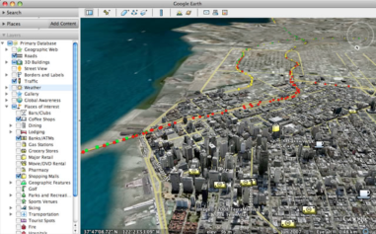
Geographic Information System
A geographic information system (GIS) captures, manages, analyzes, and displays geographically referenced information, often utilizing maps with overlaid data.
GISs are particularly useful to professionals, such as urban planners, social workers, law enforcement personnel, sociologists, geologists, meteorologists, civil engineers, and those who work in government agencies.
Links:
Video: GIS
Concepts > Business Systems > Information Management > Geographic Information System

Slide 10
Informatics
Informatics applies computer-based information system technologies to support traditional disciplines such as science and medicine.
Links:
Video: The Epocrates iOS user experience
Concepts > Business Systems > Information Management > Informatics

Slide 11
Information Management
Decision Making
Reactive Problem Solving
Proactive Problem Solving
Programmed Decisions
Structured Problems
Nonprogrammed Decisions
Unstructured Problems
Optimization Model
Heuristics
MIS Reports
Scheduled Reports
Key-Indicator Report
Demand Reports
Exception Reports
Business Intelligence (BI)
Key Performance Indicators (KPIs)
Executive Dashboard
Decision Support System (DSS)
What-If Analysis
Goal-Seeking Analysis
Geographic Information System (GIS)
Informatics
Bioinformatics
Medical Informatics
Terms
Business Systems
Information Management
Transaction Processing System (TPS)
Transaction
Batch Processing
Real-Time Transaction Processing
Transaction Processing Cycle
Order Processing System
Purchasing System
Management Information System (MIS)
Concepts > Business Systems > Information Management > See your eBook for more information about these terms

Slide 12
Enterprise Systems
… are information systems designed to support the functions of an enterprise, as well as the integration of such systems into enterprise resource planning systems.
In this section:
Knowledge Management
Customer Relationship Management | Systems Development
Enterprise Resource Planning | Project Management
Concepts > Business Systems > Enterprise Systems

Slide 13
Knowledge Management
A knowledge management (KM) system assists an organization in capturing, storing, and distributing knowledge for use and reuse by the organization and, sometimes, its partners and customers.
Knowledge is much more valuable to the world when it is shared. Knowledge management systems allow people to share and disperse their knowledge.
Links:
Video: Discover What You Know
Concepts > Business Systems > Enterprise Systems > Knowledge Management

Slide 14
Customer Relationship Management
Customer relationship management (CRM) refers to the use of information systems to store detailed information on prospective, current, and past customers to improve customer service and support targeted marketing.
Links:
Video: Microsoft CRM 3.0: Lemonade Stand
Concepts > Business Systems > Enterprise Systems > Customer Relationship Management
Notes:
Bullet 2 modified

Slide 15
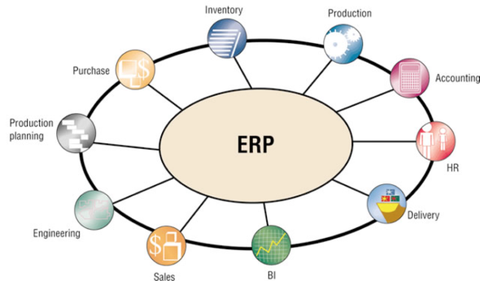
Enterprise Resource Planning
An enterprise resource planning (ERP) system integrates all data processing in a corporation (enterprise) into one unified system that draws from a central database system to streamline the flow of information throughout an enterprise and provide greater efficiencies and savings.
Links:
Video: LG Electronics Builds Global ERP
Concepts > Business Systems > Enterprise Systems > Enterprise Resource Planning

Slide 16
Systems Development
Systems development … is the activity of creating new or modifying existing information systems.
Everyone who interacts with software and information systems should be involved with the process of systems development so that new systems are effective and efficient.
Concepts > Business Systems > Enterprise Systems > Systems Development

Slide 17
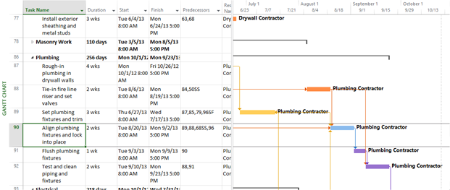
Project Management
Project management is the process of planning, monitoring, and controlling the sequence of events and resources required in a project, often using software tools.
Studies show that college students graduating with project management skills find better-paying jobs more easily than those without such skills.
Links:
Video: Microsoft Project 2010: Creating a Task List
Concepts > Business Systems > Enterprise Systems > Project Management

Slide 18
Enterprise Systems
Terms
Enterprise Systems | Systems Analyst
Enterprise | Project Management
Knowledge Management (KM) | PERT
Knowledge Worker | Gantt Chart
Customer Relationship Management (CRM)
Enterprise Resource Planning (ERP)
Supply Chain Management (SCM)
Systems Development
Systems Development Life Cycle (SDLC)
Concepts > Business Systems > Enterprise Systems > See your eBook for more information about these terms

