Slide 1
Database
… is a collection of data organized to meet users’ needs.
Database System Advantages
Reduced data redundancy | Improved data integrity | Easier modification & updating of data
Easier access to reports & data; shared data access | Better data security | More efficient data storage
In this section:
Database Structure
Database Tools
Industrial Databases
Links:
Video: Big Data - Fidelity Investments: Thinking Big
Concepts > Database

Slide 2
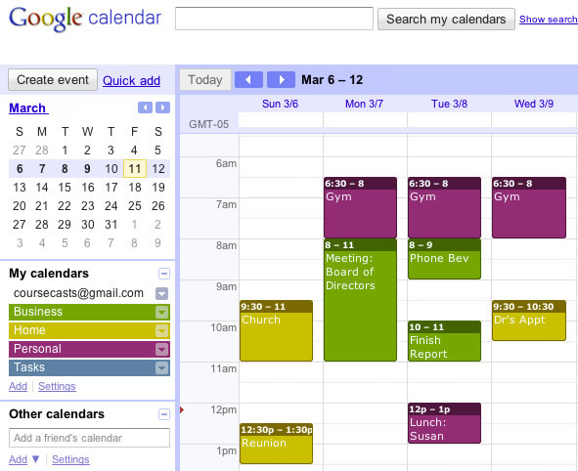
Database Structure
… refers to the manner in which data is organized and stored.
In this section:
Database Management System
Data Hierarchy
Database Key
Relational Database
Concepts > Database > Database Structure

Slide 3
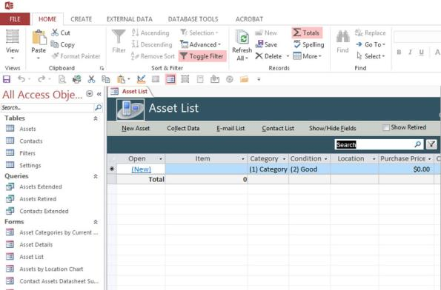
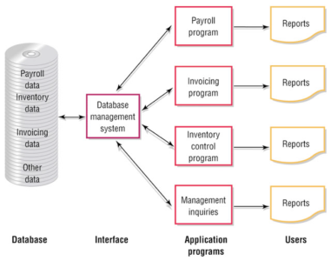
Database Management System
A database management system or DBMS consists of a group of programs that manipulate the data within a database. It provides an interface between the database and the user, or between the database and application programs.
We all interact with databases over the Internet. In fact, the web itself could be viewed as the world’s largest database management system.
Links:
Video: Announcing Oracle Database 11g
Concepts > Database > Database Structure > Database Management System

Slide 4
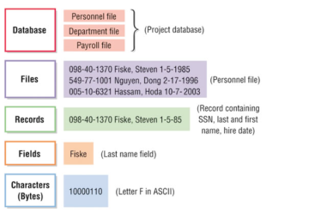
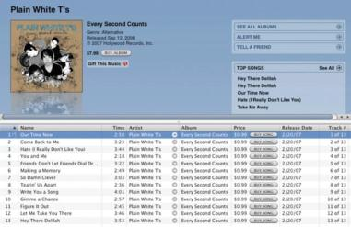
Data Hierarchy
The hierarchy that is defined for data within a database makes it possible for a database management system to manipulate the data to produce useful information.
Data hierarchy refers to the manner in which data in a database is organized into sequential levels of detail.
Concepts > Database > Database Structure > Data Hierarchy

Slide 5
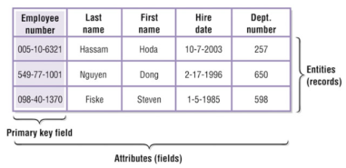
Database Key
Record: A collection of fields about a specific entity.
Key: A field in a record that is used to identify the record.
Primary key: A field within a database table that uniquely identifies the record.
A database key is a field in a table used to identify a record, such as EmployeeNumber.
Concepts > Database > Database Structure > Database Key

Slide 6
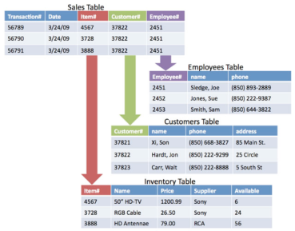
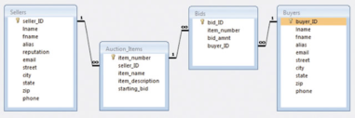
Relational Database
In a relational database, all data elements are placed in two-dimensional tables organized in rows and columns, simplifying data access and manipulation.
A relational database organizes data into multiple tables that are related by common fields.
Concepts > Database > Database Structure > Relational Database

Slide 7
Database Structure
Instances
Attribute
Data Item
Database Key
Primary Key
Relational Database
Selecting
Joining
Relationship
Entity Relationship Diagram
Terms
Database
Big Data
Data Redundancy
Database Structure
Database Management System (DBMS)
Flat File Database
Comma-Separated Values (CSV)
Special-Purpose Databases
Database Development Platforms
General-Purpose Databases
Data Hierarchy
Field
Record
Table
File
Entity
Concepts > Database > Database Structure > See your eBook for more information about these terms

Slide 8
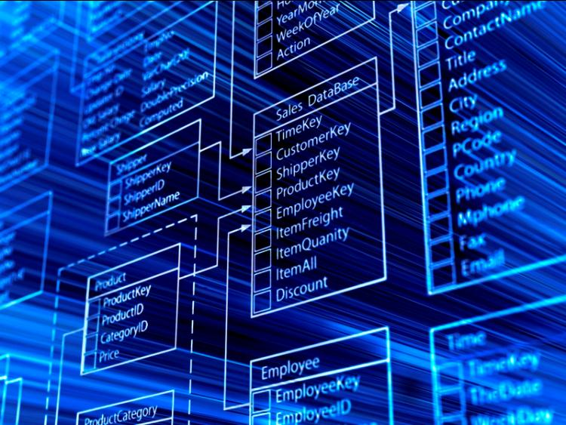
Database Tools
… include software and techniques for analyzing, maintaining, and manipulating data in a database.
In this section:
Schema
Data Dictionary
Structured Query Language
Concepts > Database > Database Tools

Slide 9
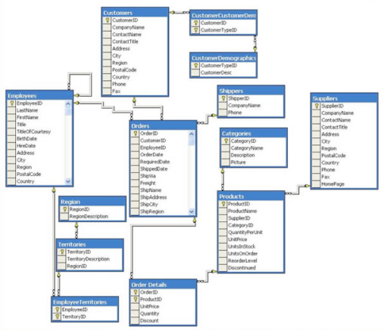
Schema
A database schema is a graphical representation of the structure of a database.
Schemas allow database administrators and users to visualize the structure of a database and understand the relationships between data and tables.
Concepts > Database > Database Tools > Schema

Slide 10
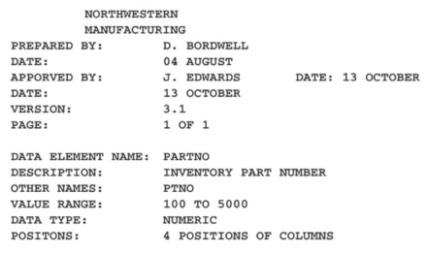
Data Dictionary
A data dictionary provides a detailed description of each field and table in a database.
A data dictionary provides specific details on the requirements of each field and table in a database, how they may be accessed, and the specific parameters and requirements imposed on the data they hold.
Concepts > Database > Database Tools > Data Dictionary

Slide 11
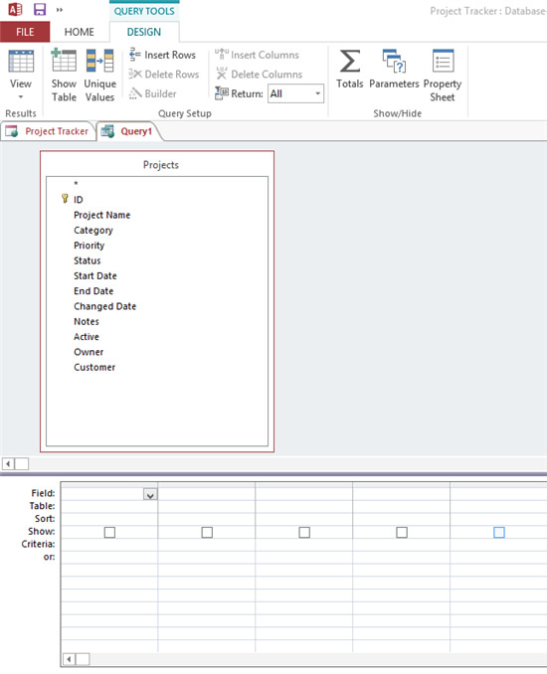
Structured Query Language
Structured Query Language (SQL) is a popular data manipulation language used by the vast majority of database programmers and administrators for manipulating data to meet the needs of the users.
The Microsoft Access Query feature automates the process of building SQL queries.
Links:
Video: SQL tutorial - What is SQL?
Concepts > Database > Database Tools > Structured Query Language

Slide 12
Database Tools
Terms
Database Tools
Data Analysis
Normalization
Data Integrity
Garbage In/Garbage Out (GIGO)
Schema
Data Definition Language (DDL)
Data Dictionary
Structured Query Language (SQL)
Data Manipulation Language (DML)
Query by Example (QBE)
Concepts > Database > Database Tools > See your eBook for more information about these terms

Slide 13
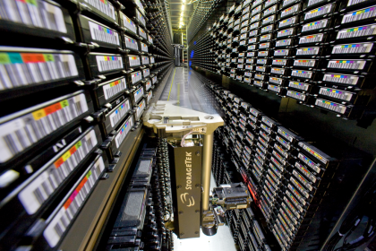
Industrial Databases
… are large databases that function as the cornerstone of information systems in businesses and enterprises.
In this section:
Data Warehouse | Data Center
Data Mining | Database Administration
Distributed Database
Concepts > Database > Industrial Databases

Slide 14
Data Warehouse
A data warehouse is a very large database that holds important information from a variety of sources.
Links:
Video: IBM DB2 Data Warehousing - Convergence CT
Concepts > Database > Industrial Databases > Data Warehouse

Slide 15
Data Mining
Data mining refers to the process of extracting information from a data warehouse or data mart.
The amount of data collected by today’s corporations is far too huge to be interpreted solely by humans. Computerized tools are needed to discover irregularities and trends in data. Data mining is the application of such tools.
Links:
Video: Manage the Data Deluge with Data Mining
Concepts > Database > Industrial Databases > Data Mining

Slide 16
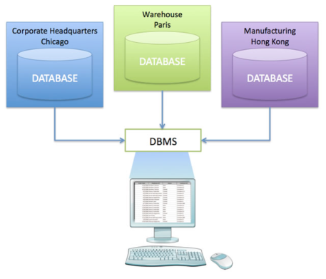
Distributed Database
A distributed database takes available data stored in multiple locations and makes it appear as a single collection.
Distributed databases enable users from various locations to benefit from a universal view of corporate data.
Links:
Video: Distributed Database for Fish Ticket Processing
Concepts > Database > Industrial Databases > Distributed Database
Notes:
Bullet 2 modified

Slide 17
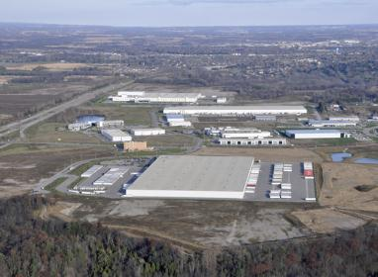
Data Center
A data center is a climate-controlled building or set of buildings that house servers that store and deliver mission-critical information and services.
New green technologies are being applied to help decrease the size and energy demands of the data centers that store our rapidly increasing amounts of data.
Links:
Video: Microsoft Generation 4.0 Data Center Vision
Concepts > Database > Industrial Databases > Data Center

Slide 18
Database Administrator
A database administrator or DBA is a skilled and trained computer professional who directs all activities related to an organization’s database, including providing security from intruders.
Data has become the most valuable property of a business. Maintaining data, getting it to the people who need it, and keeping it safe are the responsibilities of a database administrator.
Concepts > Database > Industrial Databases > Database Administrator

Slide 19
Industrial Databases
Terms
Industrial Databases
Data Warehouse
Data Mart
Data Mining
Business Intelligence (BI)
Distributed Database
Virtualized Database
Replicated Database
Data Center
Database Administrator (DBA)
Concepts > Database > Industrial Databases > See your eBook for more information about these terms

