Slide 1
Telecommunications
… refers to the electronic transmission and reception of signals for voice and data communications.
In this section:
Infrastructure | Wireless Data Communications
Cellular Network | Computer Network
Links:
Video: CNN: Obama promotes broadband expansion
Concepts > Telecommunications

Slide 2
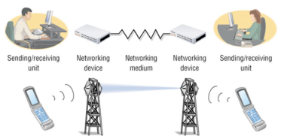
Infrastructure
… refers to the hardware, software, and protocols that support telecommunications.
In this section:
Telecommunications Signals | Telecommunications Devices
Telecommunications Media | Telecommunications Software
Radio Spectrum
Links:
Video: Visual History of Telecommunications
Concepts > Telecommunications > Infrastructure

Slide 3
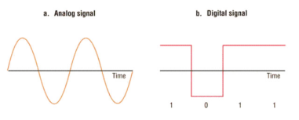
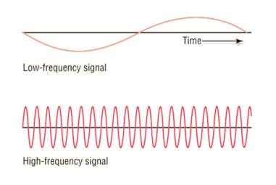
Telecommunications Signals
Telecommunications signals are analog or digital electronic transmissions for the purpose of communication.
The signals used to send information over voice and data networks can vary in speed and strength.
Links:
Video: Tower Climbers Working
Concepts > Telecommunications > Infrastructure > Telecommunications Signals
Notes:
Bullet 2 modified

Slide 4
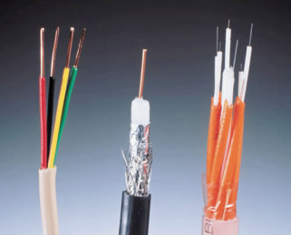
Telecommunications Media
Telecommunications media include anything that carries a signal and creates an interface between a sending device and a receiving device.
Twisted pair: telephone and computer networks.
Coaxial: cable TV and other applications.
Fiber-optic: backbones of telecom networks and in some local area networks.
Links:
Video: Fiber Optics
Concepts > Telecommunications > Infrastructure > Telecommunications Media

Slide 5
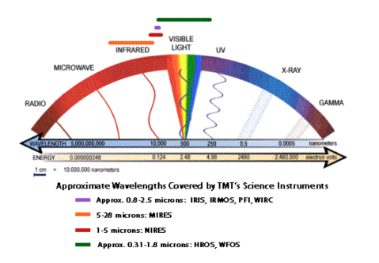
Radio Spectrum
Radio spectrum, part of the electromagnetic spectrum, refers to all of the frequencies available for radio waves from about 10 KHz to 300 GHz and their assigned uses.
The radio spectrum allows for many different uses of radio signals and attempts to safeguard those uses from interference.
Links:
Video: Electromagnetic Spectrum
Concepts > Telecommunications > Infrastructure > Radio Spectrum

Slide 6
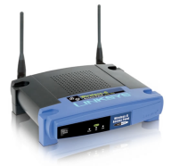
Telecommunications Devices
Telecommunications devices include the wide variety of computer hardware designed to support telecommunications activities for individuals and businesses.
Home networking and wireless networks provide a reason for everyone to acquire a basic understanding of modems, network adapters, access points, and others.
Links:
Video: Sprint Mifi Commercial
Concepts > Telecommunications > Infrastructure > Telecommunications Devices

Slide 7
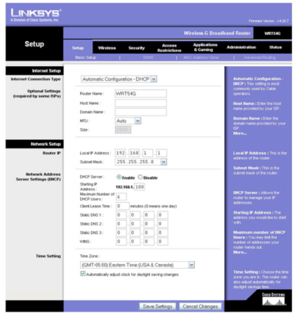
Telecommunications Software
Telecommunications software is software based on telecommunications protocols used to control, monitor, and troubleshoot data traveling over a telecommunications network.
Hardware is useless without the software necessary to drive it—and so it is with telecommunications and computer networks.
Links:
Video: GetConnected - Secure Wireless Router Set Up
Concepts > Telecommunications > Infrastructure > Telecommunications Software

Slide 8
Infrastructure
Broadband/High-speed Internet
Narrowband
Telecommunications media
Twisted pair
Coaxial
Fiber-optic
Radio spectrum
Microwaves
Telecommunications devices
Modem
Line-of-sight medium
Communications satellite
T1 and T3 lines
Telecommunications software
Network operating system (NOS)
Protocol
Standard
Ethernet
Terms
Telecommunications
Infrastructure
Telecommunications signals
Analog signal
Digital signal
Frequency
Hertz (Hz)
Bandwidth
Bits per second (bps)
Concepts > Telecommunications > Infrastructure > See your eBook for more information about these terms

Slide 9
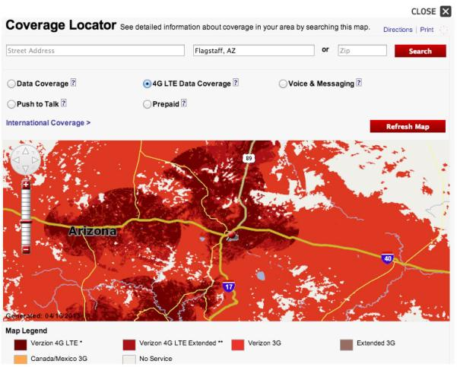
Cellular Network
… is a radio network in which a geographic area is divided into cells with a transceiver antenna (tower) and station at the center of each cell, to support wireless mobile communications.
In this section:
Cellular Carrier | Cellular Services
Cellular Plans | Mobile Phone
Links:
Video: AT&T TV Commercial - It's Not Complicated
Concepts > Telecommunications > Cellular Network

Slide 10
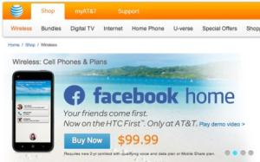
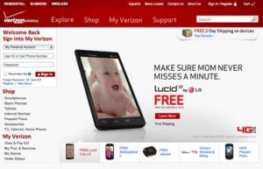
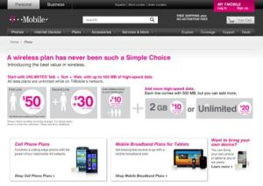
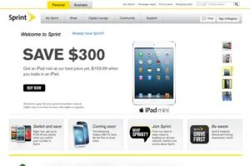
Cellular Carrier
A cellular carrier is a company that builds and maintains a cellular network and provides cell phone service to the public.
Global System for Mobile Communications (GSM) is the most popular international standard for mobile phones, used by over a billion people across more than 200 countries.
The Code Division Multiple Access (CDMA) networking standard is used in the United States, where it is in equal competition with GSM.
Concepts > Telecommunications > Cellular Network > Cellular Carrier

Slide 11
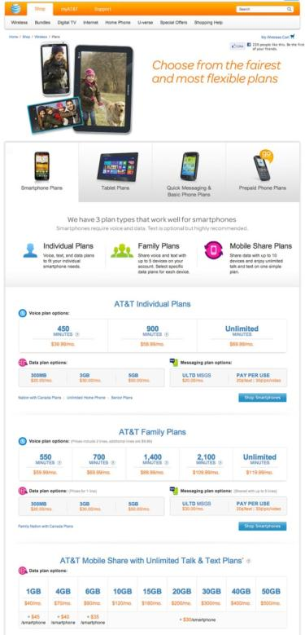
Cellular Plans
A cellular plan defines the terms of service provided by a cellular carrier to which a cellular user subscribes.
Cellular carriers offer service plans for every type of phone and cell-network-enabled tablet user. The plan you select defines your terms of service for cell phone or tablet usage.
Links:
Video: Verizon Powerful Answers - "Attendance :60"
Concepts > Telecommunications > Cellular Network > Cellular Plans

Slide 12
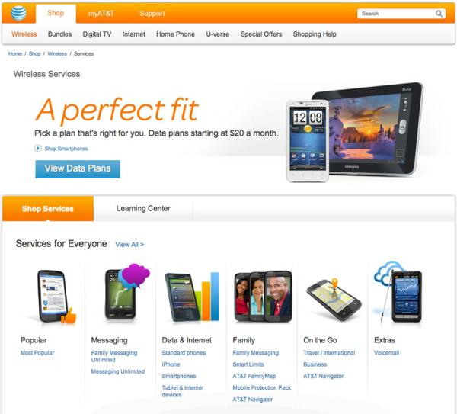
Cellular Services
Cellular services include specific features of a cell phone plan beyond voice communication, such as text messaging, high-speed Internet, and streamed media.
Cellular Service Options:
Data plan
Text messaging
Picture & video messaging
Push to talk
Maps & navigation
Links:
Video: Nexus 7: Curious
Concepts > Telecommunications > Cellular Network > Cellular Services

Slide 13
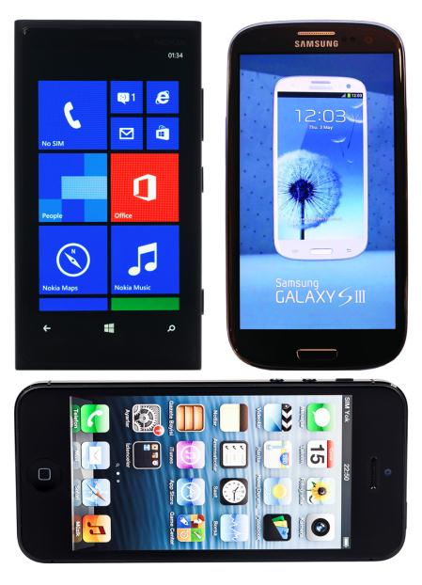
Mobile Phone
Mobile phone refers to the handset used by the subscriber to communicate on the cellular network.
Cell phone handsets range in price from free (with service subscription) to more than $500 for the latest and greatest smart phones. Determining which phone best suits your needs requires some time and consideration.
Links:
Video: Introducing Samsung GALAXY S4
Video: Apple iPhone 5
Video: Windows Phone Challenge
Video: BlackBerry 10
Concepts > Telecommunications > Cellular Network > Mobile Phone
Notes:
Bullet 2 modified

Slide 14
Cellular Network
Terms
Cellular network
Cellular carrier
Global system for mobile communications (GSM)
Code division multiple access (CDMA)
Cellular plans
Cellular services
Mobile phone
Concepts > Telecommunications > Cellular Network > See you eBook for more information about these terms

Slide 15
Wireless Data Communications
… refers to telecommunications that take place over the air for data and Internet access.
In this section:
Wi-Fi | Bluetooth
WiMAX | Radio Frequency Identification (RFID)
Long Term Evolution (LTE) | Global Positioning System (GPS)
Concepts > Telecommunications > Wireless Data Communications

Slide 16
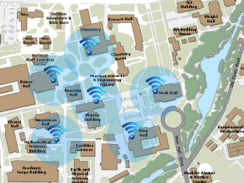
Wi-Fi
Wi-Fi (short for wireless fidelity) is wireless networking technology that uses access points to wirelessly connect users to networks within a range of 250–1000 feet (75–300 meters).
Wi-Fi is the dominant technology that provides wireless Internet access in households and businesses. Understanding Wi-Fi enables users to make the best use of the technology and make wise decisions in choosing an Internet service provider.
Links:
Video: The Early Show - Dangers of public Wi-Fi
Concepts > Telecommunications > Wireless Data Communications > Wi-Fi

Slide 17
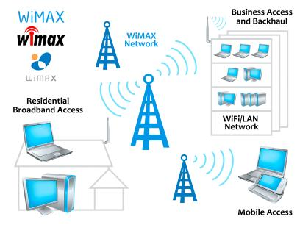
WiMAX
WiMAX has a 31-mile (50-kilometer) range, making it the perfect technology for providing citywide high-speed Internet access.
WiMAX, which stands for Worldwide Interoperability for Microwave Access, also known as IEEE 802.16, is a fourth-generation wireless broadband technology that evolved from Wi-Fi to provide faster Internet access at a longer range.
Links:
Video: WiMax: Next Generation Internet Revolution
Concepts > Telecommunications > Wireless Data Communications > WiMAX

Slide 18
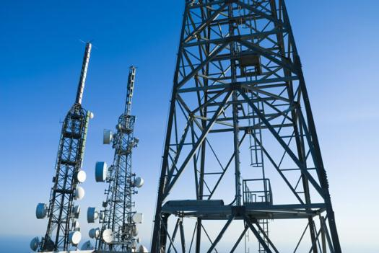
Long Term Evolution (LTE)
Long Term Evolution (LTE) is a fourth-generation wireless broadband technology that was developed to allow GSM cellular technology to evolve to provide very high-speed Internet access.
Links:
Video: LTE 101
Concepts > Telecommunications > Wireless Data Communications > Long Term Evolution (LTE)

Slide 19
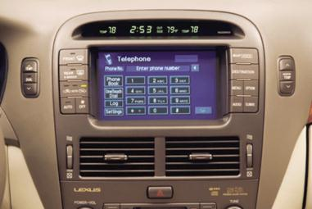
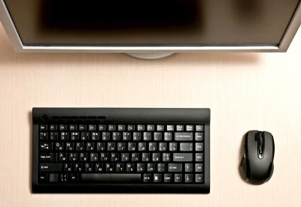
Bluetooth
Bluetooth (named after a 10th-century Danish king) enables a wide assortment of digital devices to communicate directly with each other wirelessly over short distances.
Links:
Video: Fancy Parrot Zik wireless Bluetooth headphones
Concepts > Telecommunications > Wireless Data Communications > Bluetooth
Notes:
Bullet 2 modified

Slide 20
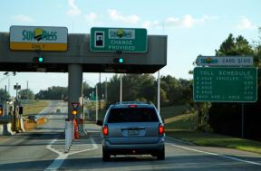
Radio Frequency Identification (RFID)
RFID, or radio frequency identification, uses tiny transponders in tags that can be attached to merchandise or other objects and read wirelessly using an RFID reader, typically for inventory and supply chain management or to facilitate commercial transactions.
RFID is embedded in products for identification and tracking purposes, and in credit cards, cell phones, and other devices for enabling wireless transactions at checkout counters and vending machines.
Links:
Video: RFID - Technology Video
Concepts > Telecommunications > Wireless Data Communications > Radio Frequency Identification (RFID)

Slide 21
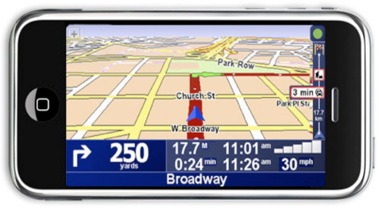
Global Positioning System (GPS)
Available in mobile phones, cars, aircraft, ships, and elsewhere, GPS provides a range of uses from necessary functions, such as staying on course at sea, to fun utilities, such as keeping track of where your friends are.
A GPS, or global positioning system, uses satellites to pinpoint the location of objects on earth.
Links:
Video: Google Maps Navigation (Beta)
Concepts > Telecommunications > Wireless Data Communications > Global Positioning System (GPS)

Slide 22
Wireless Data Communications
Long Term Evolution (LTE)
Last mile
Bluetooth
Radio frequency identification (RFID)
Contactless payment systems
Near field communications (NFC)
Global positioning system (GPS)
Geotagging
Terms
Wireless data communications
Wi-Fi
820.11 family
Access points
Hotspots
WiMAX
Municipal wireless/muniwireless
Concepts > Telecommunications > Wireless Data Communications > See your eBook for more information about these terms

Slide 23
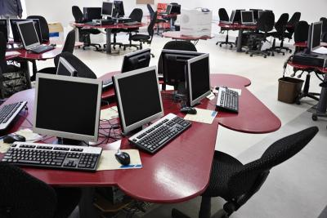
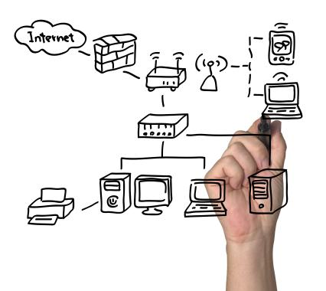
Computer Network
… is a collection of computing devices connected together to share resources such as files, software, processors, storage, printers, and Internet connections.
In this section:
Personal Area Network (PAN) | Local Area Network (LAN)
Home Network | Wide Area Network (WAN)
Concepts > Telecommunications > Computer Network

Slide 24
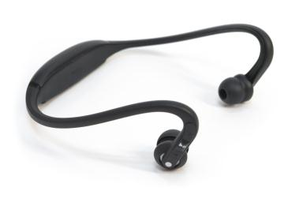
Personal Area Network (PAN)
A personal area network (PAN) is the interconnection of personal information technology devices, typically wirelessly, within the range of an individual.
Personal area network technologies allow personal devices to communicate with or without wires, sharing data, media streams, phone conversations, and all types of information.
Links:
Video: SCOTTEVEST/SeV Travel Vest
Concepts > Telecommunications > Computer Network > Personal Area Network (PAN)
Notes:
Bullet 2 modified

Slide 25
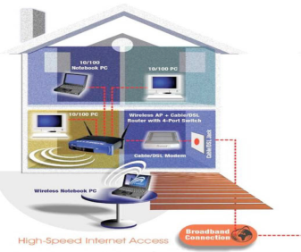
Home Network
A home network is a local area network designed for personal or business use in the home.
Home networks are used to share Internet access, media, files, printers, and other computing and media resources.
Links:
Video: Bill Gates Home
Concepts > Telecommunications > Computer Network > Home Network

Slide 26
Local Area Network (LAN)
A local area network (LAN) is a privately owned computer network that connects computers and devices within the same building or local geographic area.
Local area networks are used in most businesses and organizations to provide network and Internet connectivity.
Concepts > Telecommunications > Computer Network > Local Area Network (LAN)

Slide 27
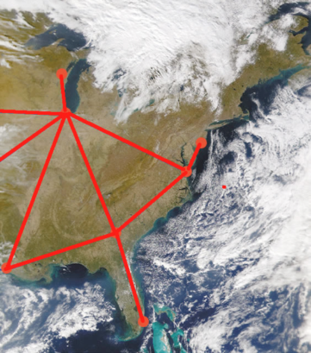
Wide Area Network (WAN)
A wide area network (WAN) connects LANs and MANs between cities, across countries, and around the world, using microwave and satellite transmission or telephone lines.
A LAN becomes a WAN when it extends beyond one geographic location to another geographic location.
Concepts > Telecommunications > Computer Network > Wide Area Network (WAN)

Slide 28
Computer Network
Terms
Computer network
Distributed network
Nodes
Workstations
Local resources
Network/remote resources
Network/system administrator
Personal area network (PAN)
Home network
Phone-line networking/HomePNA
Power-line networking/HomePLC
Local area network (LAN)
Intranet
Virtual private network (VPN)
Tunneling
Extranet
Enterprise service provider (ESP)
Network access server (NAS)
Metropolitan area networks (MANs)
Wide area network (WAN)
Electronic data interchange (EDI)
Data havens
Concepts > Telecommunications > Computer Network > See your eBook for more information about these terms

