Slide 1
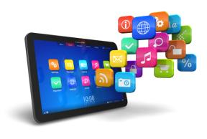
Software
… refers to the electronic instructions that govern a computer’s actions to provide a computing service.
In this section:
Software Development | Application Software
System Software | Managing Software
Links:
10 Best Android Apps
Concepts > Software

Slide 2
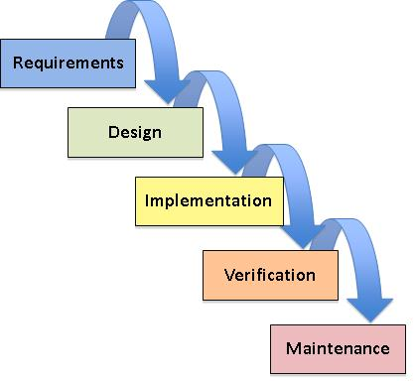
Software Development
… is the systematic process of transforming a software idea into functional software.
In this section:
Computer Programming
Programming Languages
Application Programming Interface (API)
Links:
How to Make an iPhone 5 App in Xcode 4.5
Concepts > Software > Software Development

Slide 3
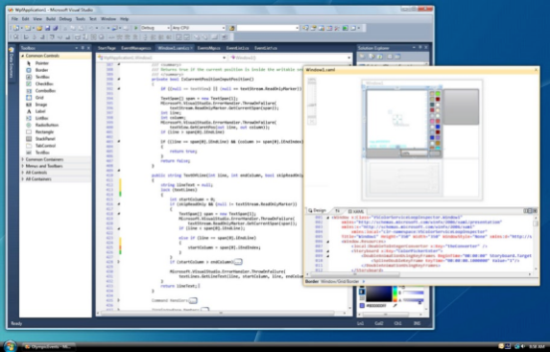
Computer Programming
Computer programming, or coding, is the process of creating software through the use of logic, algorithms, and programming languages.
Computer programming has gotten substantially easier over the years, making it increasingly accessible to people in every profession.
Links:
Video: What Most Schools Don't Teach
Concepts > Software > Software Development > Computer Programming

Slide 4
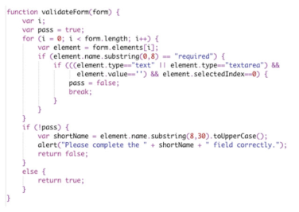
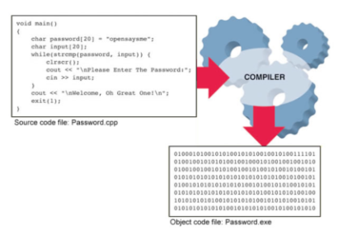
Programming Languages
Programming languages provide a set of symbols, commands, and rules (syntax) used to write program code.
Programming languages automate the tedious process of creating the detailed step-by-step machine instructions used in software, transforming the programming process from tedious labor to a creative intellectual endeavor for problem solving.
Links:
Video: Computer Programming for Beginners
Concepts > Software > Software Development > Programming Languages

Slide 5
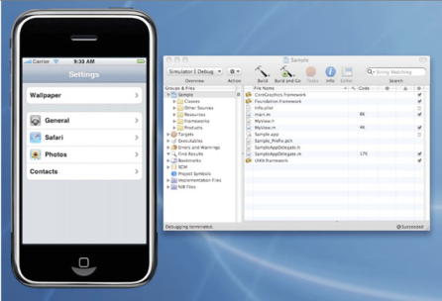
Application Programming Interface (API)
An application programming interface (API) is a set of programming tools specifically designed for developing apps for a particular platform.
An API allows others besides the manufacturer to develop software to run on the system or device. APIs provide users with a rich variety of software and provide an opportunity for less experienced programmers to make valuable software contributions.
Links:
Video: Developing Apps for iPhone
Concepts > Software > Software Development > Application Programming Interface (API)
Notes:
Bullet 2 modified

Slide 6
Software Development
Software engineers
Integrated development environment (IDE)
Programming languages
Syntax
Object-oriented programming (OOP)
Objects
Source code
Object code
Compiler
Interpreter
Application programming interface (API)
Software development kit (SDK)
Terms
Software
Software development
Software development life cycle (SDLC)
Computer programming
Program code
Computer programmers/coders
Concepts > Software > Software Development > See your eBook for more information about these terms

Slide 7
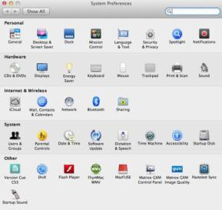
System Software
… is any software that coordinates the activities of the hardware and assists the computer in functioning safely, effectively, and efficiently.
In this section:
Boot Process | Microsoft Windows | Mobile Operating Systems
Operating System | Mac OS | Industrial Operating Systems
User Interface | Linux | Embedded Operating Systems
File Management | Virtual Machine Software | Utility Software
Links:
Video: Setting up face unlock - Samsung GALAXY S3
Concepts > Software > System Software

Slide 8
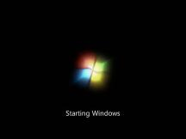
Boot Process
The boot process, also known as booting, booting up, or bootstrapping, is the sequence of instructions in the BIOS that is executed when a computer is powered on to check the system and load the operating system into memory.
The boot process instructions are part of the BIOS (the basic input/output system), which is burned into ROM so it is always ready for the processor to execute when the computer is powered on.
Links:
Video: MacBook Pro: Boot Up, ...
Concepts > Software > System Software > Boot Process

Slide 9
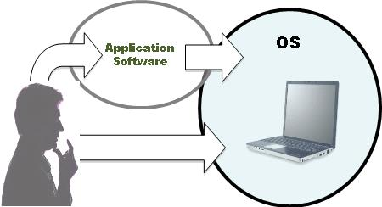
Operating System
An operating system (OS) is a set of computer programs that runs or controls the computer hardware, and acts as a user interface.
Operating systems run on most digital devices and perform certain similar tasks, such as controlling computer hardware, managing RAM, managing the processor(s), controlling input and output devices, storing and managing files, providing a user interface, and providing networking functionality.
Links:
Video: Mac vs PC vs Linux #1
Concepts > Software > System Software > Operating System

Slide 10
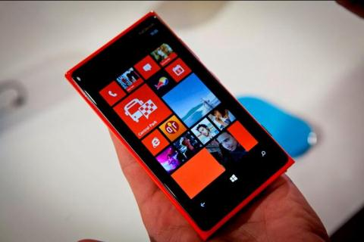
User Interface
A user interface (UI) allows one or more people to have access to and command of a computer system or computer software.
One of the most important functions of any operating system is providing a user interface. The user interface defines the computing experience for the user.
Links:
Video: BlackBerry Flow & Peek
Video: Ubuntu for Phones vs Android Jelly Bean
Concepts > Software > System Software > User Interface

Slide 11
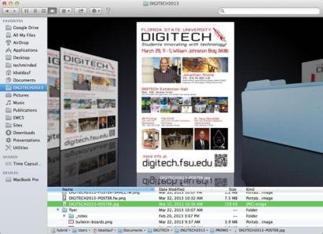
File Management
File management refers to the physical and logical storage system and practices provided for managing data on a computer.
When you save a file to your hard drive or flash drive, or burn it to a CD or DVD, the operating system finds space on the device to store the file in an efficient manner and records the location so the file can be accessed.
Links:
Video:Windows 8 File Management
Concepts > Software > System Software > File Management

Slide 12
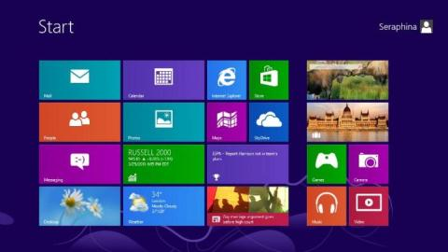
Microsoft Windows
Microsoft Windows is the most popular operating system for personal computers.
Microsoft Windows runs on roughly 82% of all personal computers. It is useful for everyone to be fluent in its use.
Links:
Video: Windows 8 Demo
Concepts > Software > System Software > Microsoft Windows

Slide 13
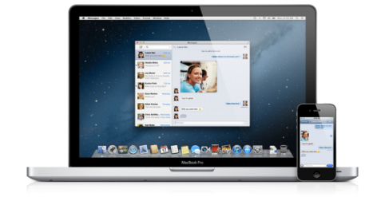
Mac OS
Mac OS is the native operating system for Apple PCs.
The most recent version of the Mac OS is called OS X Mountain Lion, and it is competitive with Windows 8 in terms of performance and capabilities.
Links:
Video: Mac OS X Mountain Lion
Concepts > Software > System Software > Mac OS

Slide 14
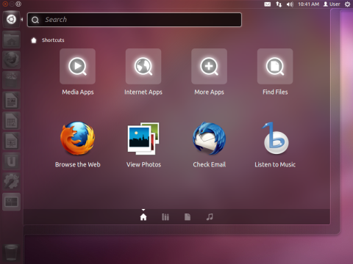
Linux
Linux is a free, open-source operating system for PCs, servers, and other types of computers.
Linux is growing in popularity as a lightweight and inexpensive operating system for mobile computing devices such as netbooks, tablets, and smart phones. Google’s Android OS is based on Linux.
Links:
Video: Linux vs Windows
Video: Ubuntu Touch is a touch of class
Concepts > Software > System Software > Linux

Slide 15
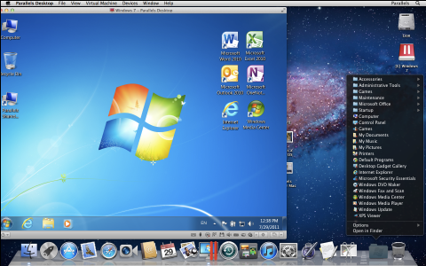
Virtual Machine Software
Virtual machine software, also referred to as virtualization software, allows one operating system to run on top of another by creating a virtual machine on which the guest operating system can run.
Links:
Video: Seamless Windows 8 on Mac
Concepts > Software > System Software > Virtual Machine Software

Slide 16
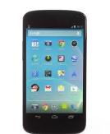
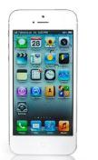
Mobile Operating Systems
Mobile operating systems are lightweight operating systems designed for mobile devices such as smart phones and tablets.
Today’s mobile phones have become information and entertainment centers—handheld computers with access to the Internet and hundreds of thousands of software applications.
Concepts > Software > System Software > Mobile Operating Systems

Slide 17
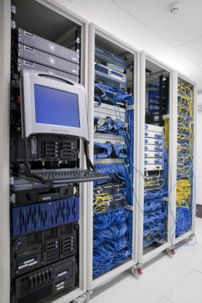
Industrial Operating Systems
Industrial operating systems control large networked systems and servers.
Industrial computers operate in a much more complex manner than PCs and require an operating system that can manage multiple processors—sometimes hundreds or even thousands of processors—and many users.
Concepts > Software > System Software > Industrial Operating Systems

Slide 18
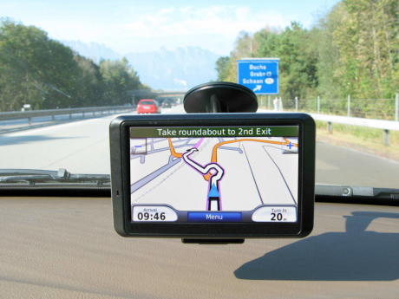
Embedded Operating Systems
Because embedded systems are developed for specific tasks, they can be optimized more easily, which increases reliability and performance, and reduces size and cost.
Embedded operating systems, or just embedded systems, are hardwired into a computer component, such as ROM or flash memory, to control a special-purpose computer.
Concepts > Software > System Software > Embedded Operating Systems

Slide 19
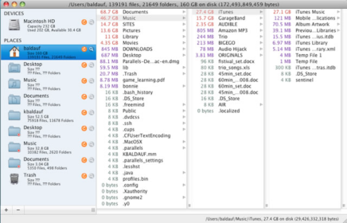
Utility Software
Protect & keep computer systems running smoothly
Assist in managing & transferring files
Customize computing environment & make resources more convenient to access
Utility software is any system software besides the OS that assists in maintaining, managing, and protecting computer system resources.
Links:
Video: How to Clean Your Registry with CCleaner
Concepts > Software > System Software > Utility Software

Slide 20
System Software
Graphical user interface (GUI)
File management
Logical view
Physical view
File system
New technology file systems (NTFS)
Microsoft Windows
Mac OS
Linux
Linux distributions/distros
Virtual machine (VM)
Mobile operating systems
Industrial operating systems
Embedded operating systems
Real-time operating system (RTOS)
Utility software
Terms
System software
Software platform
Boot process
Operating system (OS)
Multitask
Device driver
User interface (UI)
Command-based user interface
Concepts > Software > System Software > See your eBook for more information about these terms

Slide 21
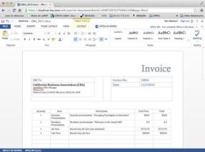
Application Software
… consists of programs written to perform tasks or solve problems for people, groups, and organizations.
In this section:
Business Software
Personal Software
Mobile Apps
Concepts > Software > Application Software

Slide 22
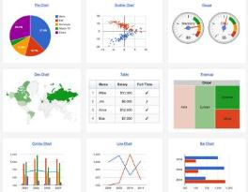
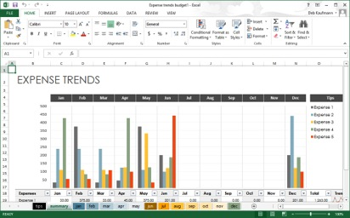
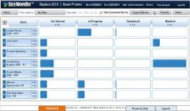
Business Software
Business software is any software designed to assist individuals and groups to be more productive at work and is often used in reference to software suites that include word processing, spreadsheet, database, and presentation software.
Links:
Video: Imagination's story
Concepts > Software > Application Software > Business Software

Slide 23
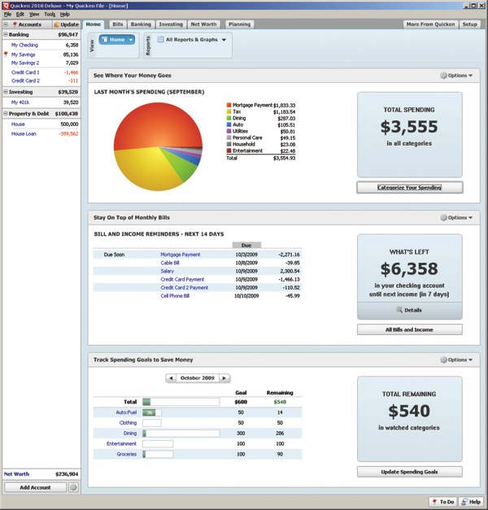
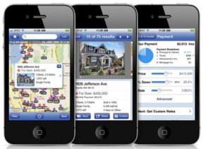
Personal Software
Personal software is any software designed for personal benefit, including home management, entertainment, and education.
Concepts > Software > Application Software > Personal Software

Slide 24
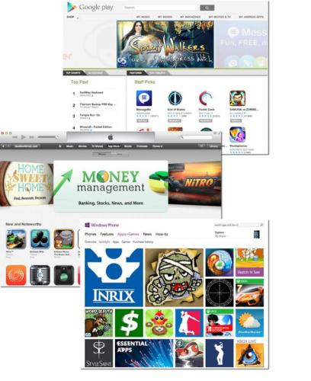
Mobile Apps
Mobile apps are software that is designed for smart phones and tablets.
Consider what computing activities are appropriate for each device size: PC, tablet, and mobile phone. Also consider apps that can work across devices with slight modifications, and which are best suited for a single size and/or environment.
Links:
Video: Apple iPhone 5 - Brilliant!
Concepts > Software > Application Software > Mobile Apps

Slide 25
Application Software
Terms
Application software
Collaborative software
Gadget/widget
Business software
Software suite
Personal software
Mobile software/apps
Concepts > Software > Application Software > See your eBook for more information about these terms

Slide 26
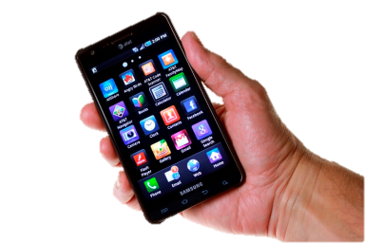
Managing Software
… refers to activities required to acquire, install, maintain, and remove software from a computer system.
In this section:
Acquiring Software | Maintaining Software
Software Licensing | Uninstalling Software
Installing Software
Links:
Video: What's On My iPhone 5?
Concepts > Software > Managing Software

Slide 27
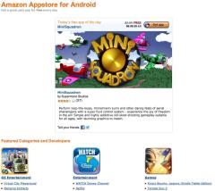
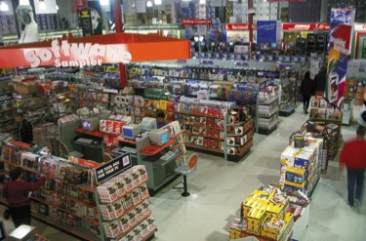
Acquiring Software
Acquiring software refers to the several methods by which software can be purchased or accessed, including packaged software, downloaded software, cloud apps, and custom designed software.
Links:
Video: Meet Gwen Stefani and her Windows Phone
Concepts > Software > Managing Software > Acquiring Software

Slide 28
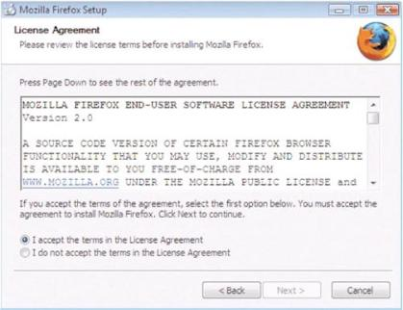
Software Licensing
Software licensing defines the permissions, rights, and restrictions assigned to the person who purchases a copy of software.
Software may be protected by a traditional license, may incorporate a more liberal license policy like Creative Commons or the General Public License (GPL), or may be freeware.
Links:
Video: Creative Commons - Get Creative
Concepts > Software > Managing Software > Software Licensing

Slide 29
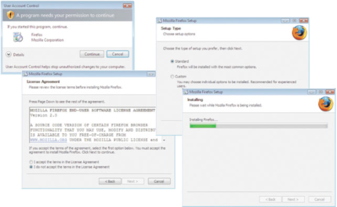
Installing Software
Installing software is the process by which software is added to a computer so that it is available for use.
Installing software on PCs, tablets, and smart phones is a common activity for computer users, allowing computers to be customized to meet the user’s needs. All computer users should be familiar with the process.
Links:
Video: Windows 8 Installation Guide
Concepts > Software > Managing Software > Installing Software

Slide 30
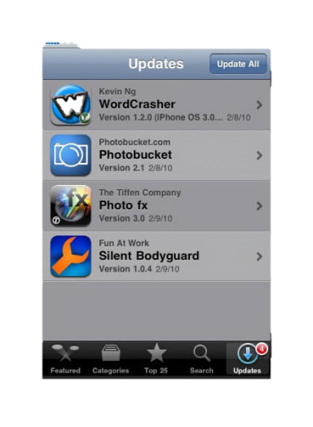
Maintaining Software
Maintaining software involves applying software updates to correct software bugs, improve the software, or add new features.
To get the most out of your software investment, and to keep your computer safe and secure, it is wise to update both system software and application software as soon as updates are made available.
Concepts > Software > Managing Software > Maintaining Software

Slide 31
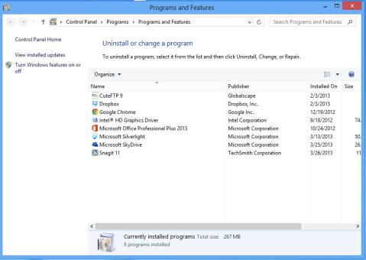
Uninstalling Software
Removing software requires a special process that deletes all files and references related to the software.
Uninstalling software refers to the process of completely removing software from a computer.
Concepts > Software > Managing Software > Uninstalling Software

Slide 32
Managing Software
Terms
Managing software
Acquiring software
Software licensing
Copyright
Creative Commons license
Freeware
Free software
Open-source software
GNU General Public License (GPL)
Installing software
Maintaining software
Software patches
Software bugs
Uninstalling software
Concepts > Software > Managing Software > See your eBook for more information about these terms

