Slide 1
Digital Technology
… and digital electronics allow us to manipulate all types of information as digits (1s and 0s) in order to store and manage the information more efficiently and effectively.
In this section:
Digital Literacy
Computing Platforms
Links:
Video: What sets Curosity apart from other Mars Rovers?
Concepts> Digital Technology

Slide 2
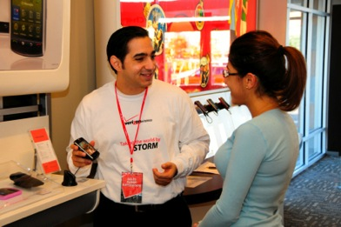
Digital Literacy
… refers to an understanding of how computers represent different types of data with digits and how the usefulness of that representation assists people in leading productive lives.
In this section:
Computer | Character Encoding
Computer Literacy | Value Encoding/Binary Number System
Bits and Bytes | Digital Convergence
Digitization
Links:
Video: One Laptop per Child
Concepts> Digital Technology > Digital Literacy

Slide 3
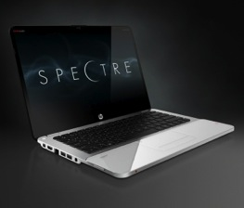
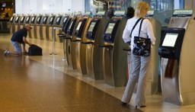
Computer
A computer is a digital electronics device that combines hardware and software to accept the input of data and then process and store the data to produce some useful output.
5 Primary Functions:
Computation
Automation
Communication
Entertainment
Managing Information
Links:
Video: Introducing Nokia Lumia 900
Concepts> Digital Technology > Digital Literacy > Computer

Slide 4
Computer Literacy
Computer literacy refers to a functional understanding of the fundamentals of computers and their uses.
Today’s college graduates are entering the workforce as knowledge workers expected to add value to the information economy. Computer fluency captures the essence of business expectations.
Concepts> Digital Technology > Digital Literacy > Computer Literacy
Notes:
Bullet 2 modified

Slide 5
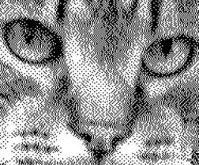
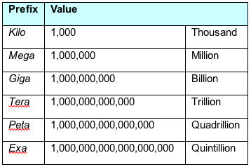
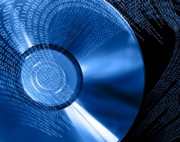
Bits and Bytes
Understanding bits and how they represent information is key to understanding the workings of computers and other digital electronic devices.
KB = Kilobyte
Kb = Kilobit
Bits are stored on CDs and DVDs by burning pits in the disk surface
A bit—short for binary digit—is a digit that can be 1 or 0. A bit is the smallest unit of information that a digital electronics device can manipulate. A group of eight bits is called a byte.
Concepts> Digital Technology > Digital Literacy > Bits and Bytes

Slide 6
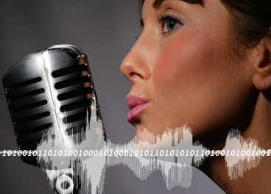
Digitization
Digitization, also called digitizing, is the process of transforming information, such as text, images, and sounds, into digital representation (1s and 0s) so that it can be stored and processed by computers.
The reason that computers have become a part of so many things that people do is because we have learned how to digitize so many different types of information.
Links:
Video: UP by Jawbone
Concepts > Digital Technology > Digital Literacy > Digitization

Slide 7
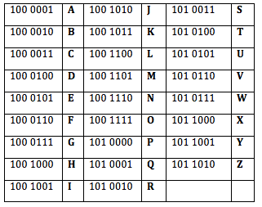
Character Encoding
Several standards have been designed for character encoding – the representation of characters on the keyboard with bytes, most having roots in the earliest standard, ASCII (American Standard Code for Information Interchange).
Links:
Video: Ascii Art Mandelbrot Fractal Zoom
Concepts > Digital Technology > Digital Literacy > Character Encoding

Slide 8
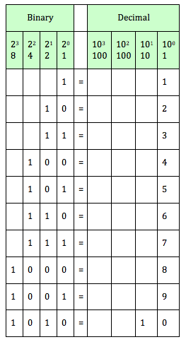
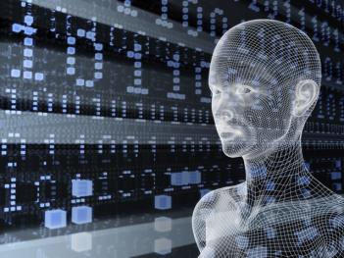
Value Encoding/Binary Number System
Many number systems are used for value encoding - the representation of values with numbers. The binary number system, which uses only two digits, 1 and 0, is commonly used for representing values in computers.
Links:
Video: Converting Binary to Decimal
Concepts > Digital Technology > Digital Literacy > Value Encoding/Binary Number System

Slide 9
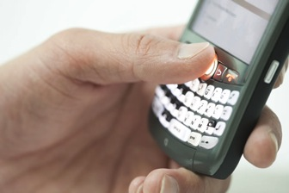
Digital Convergence
Digital convergence takes advantage of the fact that digitization standardizes all types of data to 1s and 0s to create devices that combine the functionality of several digital electronics devices.
As processors become smaller and faster and telecommunications networks become increasingly pervasive, we can combine the functionality of several devices and technologies, providing convenience and power at a lower price.
Links:
Video: How to multitask using the Samsung GALAXY Note II
Concepts > Digital Technology > Digital Literacy > Digital Convergence

Slide 10
Digital Literacy
Entertainment
Managing Information
Computer Literacy
Computer Fluency
Binary Digits (Bits)
Bytes
Kilobytes (KB)
Megabytes (MB)
Gigabytes (GB)
Terabytes (TB)
Petabytes (PB)
Exabytes (EB)
Digitization
Analog
Character Encoding
American Standard Code for Information Interchange (ASCII)
Unicode
Value Encoding/Binary Number System
Hexadecimal Number System
Octal Number System
Digital Convergence
Terms
Digital Technology
Digital Literacy
Computer
Data
Information
General-Purpose Computer
Computation
Automation
Communication
Concepts > Digital Technology > Digital Literacy > See your eBook for more information about these terms

Slide 11
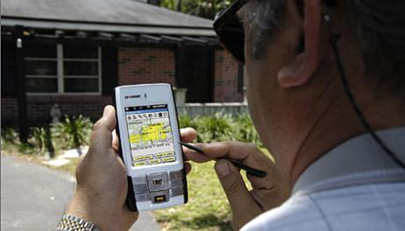
Computing Platforms
…. describes a computer’s architecture in terms of hardware and software.
In this section:
Personal Computer | Server
Mobile Computing | Supercomputer
Synchronization | Special-Purpose Computer
Links:
Video: Ford Work Solutions
Concepts > Digital Technology > Computing Platforms

Slide 12
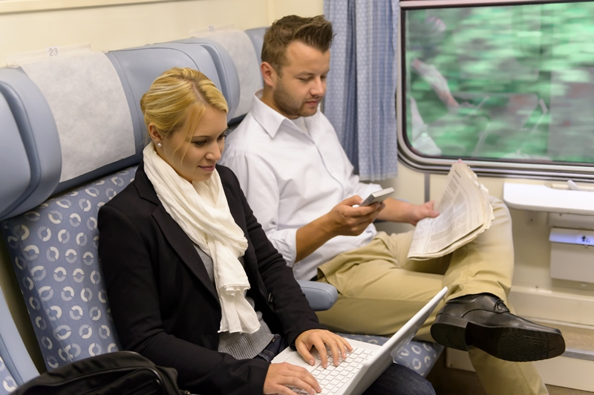
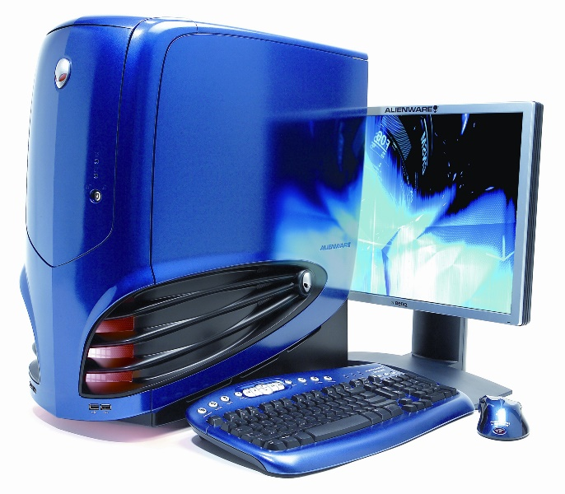
Personal Computer
A personal computer, or PC, is any general-purpose computer designed to meet the many computing needs of one individual.
Links:
Video: Apple - iPad
Concepts > Digital Technology > Computing Platforms > Personal Computer

Slide 13
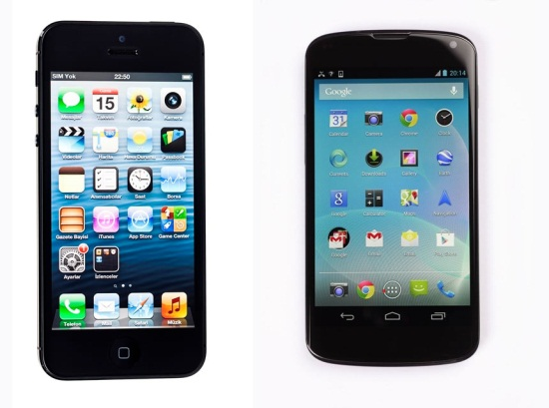
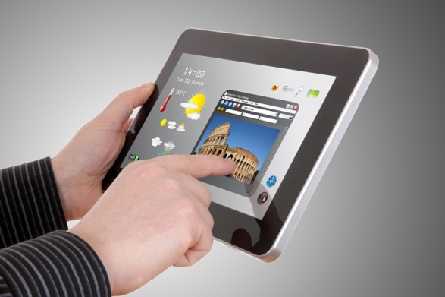
Mobile Computing
Mobile computing refers to the use of battery-powered mobile devices that provide access to computing, communication, information, and/or entertainment anywhere, anytime.
Mobile Computing Technologies are dependent on:
Wireless Networks | Storage | Rechargeable Batteries
Servers | Syncing
Links:
Video: Productivity Future Vision (2011)
Concepts > Digital Technology > Computing Platforms > Mobile Computing

Slide 14
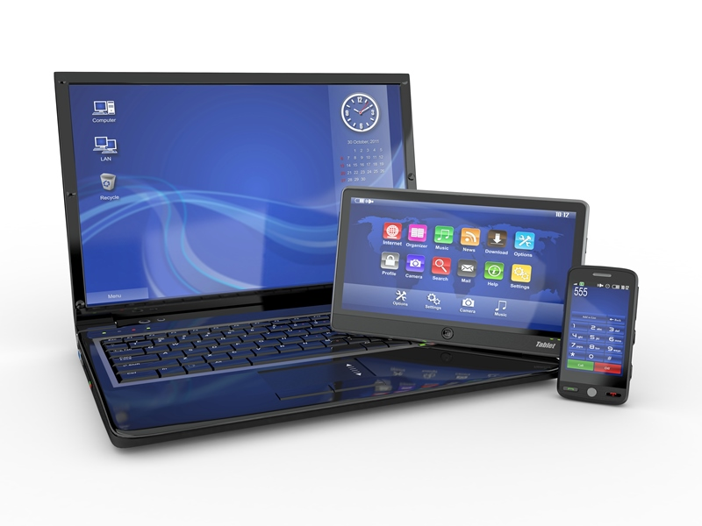
Synchronization
A big challenge for today’s “technorati” (technology enthusiasts) is keeping the data synchronized across all their devices.
Synchronization is the process of maintaining common files and data across multiple devices so that all copies are up to date.
Links:
Video: Introducing iCloud
Concepts > Digital Technology > Computing Platforms > Synchronization

Slide 15
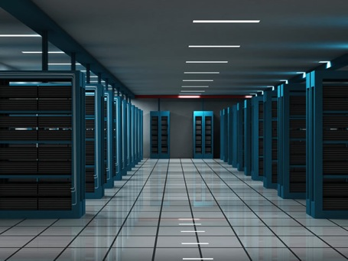
Server
Application server
Communications server
Database server
Email server
File server
Print server
Game server
Web server
A server is a powerful computer that often utilizes many processors to provide services to many users simultaneously over a network.
Links:
Video: Intel Greenfield Data Center Tour
Concepts > Digital Technology > Computing Platforms > Server

Slide 16
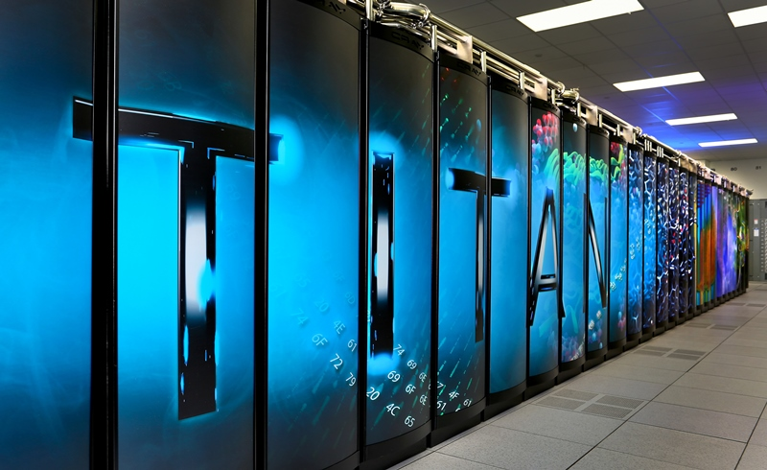
Supercomputer
Supercomputers are the most powerful type of computer, often utilizing thousands or even tens of thousands of processors to solve the world’s most difficult problems.
The U.S. Department of Defense uses supercomputers for simulating atomic explosions and researching advanced weapons systems design.
Links:
Video: Supercomputers Accelerating Innovation
Concepts > Digital Technology > Computing Platforms > Supercomputers

Slide 17
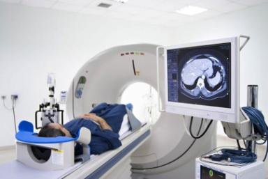
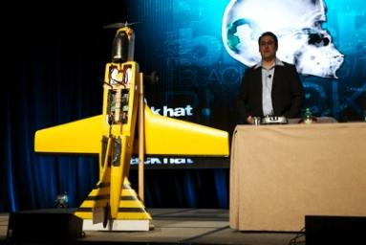
Special-Purpose Computer
Special-purpose computers are computers designed to meet a specific need and are more prevalent, yet less noticeable, than general-purpose computers.
Special-purpose computers are embedded in consumer electronics, appliances, medical equipment, and a host of other devices.
Concepts > Digital Technology > Computing Platforms > Special-Purpose Computer

Slide 18
Computing Platforms
Terms
Computing Platforms
Personal Computer (PC)
Netbook
Ultrabooks
Tablet
Smart Phones
Mobile Computing
Synchronization
Server
Mainframe Servers
Blade Server
Supercomputer
Special-Purpose Computer
Kiosk
Embedded Systems
Microcontrollers
Concepts > Digital Technology > Computing Platforms > See your eBook for more information about these terms

