Slide 1
Implementing Virtual Private Networks

Slide 2
VPN Terminology

Slide 3
Cryptosystem
A system to accomplish the encryption/decryption, user authentication, hashing, and key-exchange processes.
A cryptosystem may use one of several different methods, depending on the policy intended for various user traffic situations.

Slide 4
Encryption / Decryption
Encryption transforms information (clear text) into ciphertext which is not readable by unauthorized users.
Decryption transforms ciphertext back into clear text making it readable by authorized users.
Popular encryption algorithms include:
  DES
  3DES
  AES

Slide 5
Authentication / Hashing
Guarantees message integrity by using an algorithm to convert a variable length message and shared secret key into a single fixed-length string.
Popular hashing methods include:
  SHA (Cisco default)
  MD5

Slide 6
Non-repudiation
Is the ability to prove a transaction occurred.
  Similar to a signed package received from a shipping company.
This is very important in financial transactions and similar data transactions.

Slide 7
Diffie-Hellman Key Exchange
How do the encrypting and decrypting devices get the shared secret key?
  The easiest method is Diffie-Hellman public key exchange.
Used to create a shared secret key without prior knowledge.
This secret key is required by:
  The encryption algorithm (DES, 3DES, AES)
  The authentication method (MD5 and SHA-1)

Slide 8
Pre-Shared Key
Identifies a communicating party during a phase 1 IKE negotiation.
The key must be pre-shared with another party before the peers routers can communicate.

Slide 9
IPsec - Internet Protocol Security
A “framework” of open standards developed by the IETF to create a secure tunnel at the network (IP) layer.
  It spells out the rules for secure communications.
IPsec is not bound to any specific encryption or authentication algorithms, keying technology, or security algorithms.

Slide 10
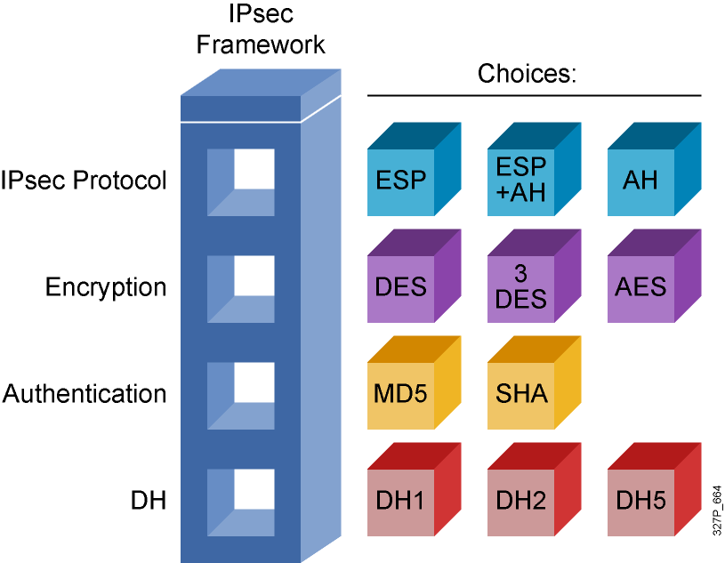
IPsec Protocol Framework

Slide 11
Crypto Map
A Cisco IOS software configuration entity that performs two primary functions.
  First, it selects data flows that need security processing.
  Second, it defines the policy for these flows and the crypto peer that traffic needs to go to.
A crypto map is applied to an interface.

Slide 12
SA - Security Association
Is a contract between two parties indicating what security parameters, such as keys and algorithms will be used.
A Security Parameter Index (SPI) identifies each established SA.

Slide 13
Cryptography Names
Alice and Bob
  Are commonly used placeholders in cryptography.
  Better than using Person A and Person B
  Generally Alice wants to send a message to Bob.
Carol or Charlie
  A third participant in communications.
Dave is a fourth participant, and so on alphabetically.
Eve
  An eavesdropper, is usually a passive attacker.
  She can listen in on messages but cannot modify them.
Mallory or Marvin or Mallet
  A malicious attacker which is more difficult to monitor.
  He/She can modify and substitute messages, replay old messages, etc.
Walter
  A warden to guard Alice and Bob depending on protocol used.

Slide 14
VPNs

Slide 15
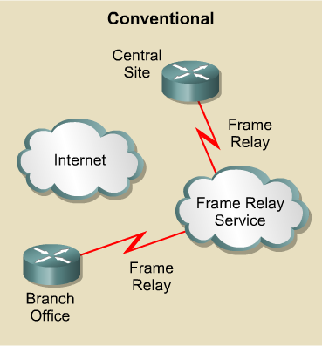
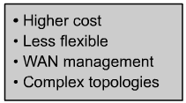
Conventional Private Networks

Slide 16
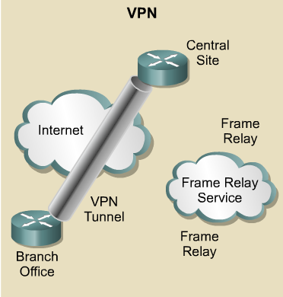
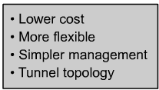
Virtual Private Networks

Slide 17
VPNs
A Virtual Private Network (VPN) provides the same network connectivity for remote users over a public infrastructure as they would have over a private network.
VPN services for network connectivity include:
  Authentication
  Data integrity
  Confidentiality

Slide 18
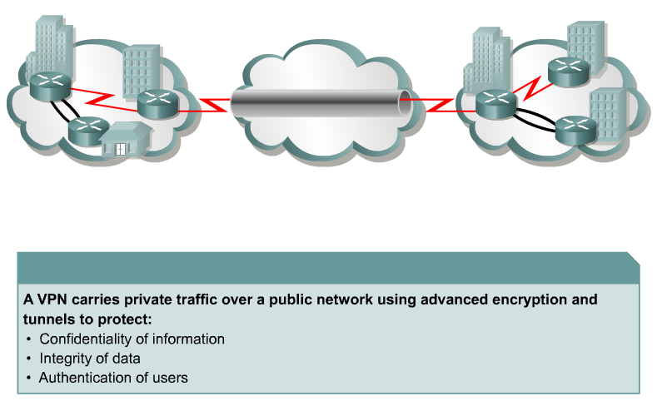
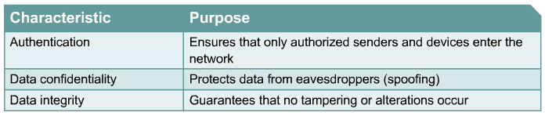
Characteristics of VPNs

Slide 19
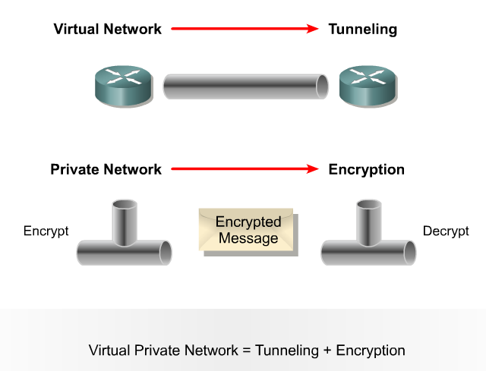
VPN Concepts
A secure VPN is a combination of concepts:

Slide 20
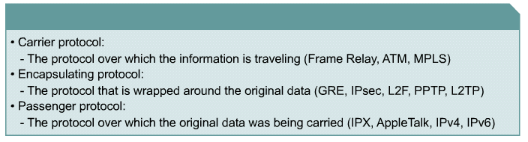
VPN Packet Encapsulation

Slide 21
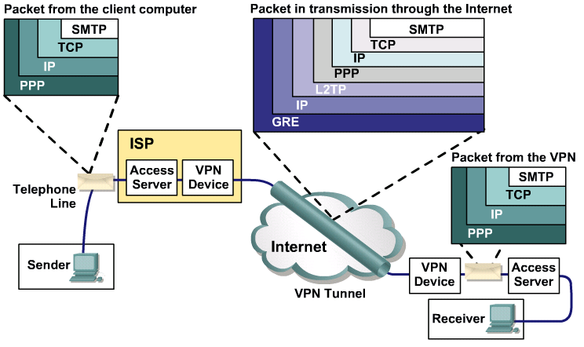
VPN Packet Encapsulation

Slide 22
VPN
Topologies

Slide 23
Two Types of VPNs
Site-to-Site VPNs:
  Intranet VPNs connect corporate headquarters, remote offices, and branch offices over a public infrastructure.
  Extranet VPNs link customers, suppliers, partners, or communities of interest to a corporate Intranet over a public infrastructure.
Remote Access VPNs:
  Which securely connect remote users, such as mobile users and telecommuters, to the enterprise.

Slide 24
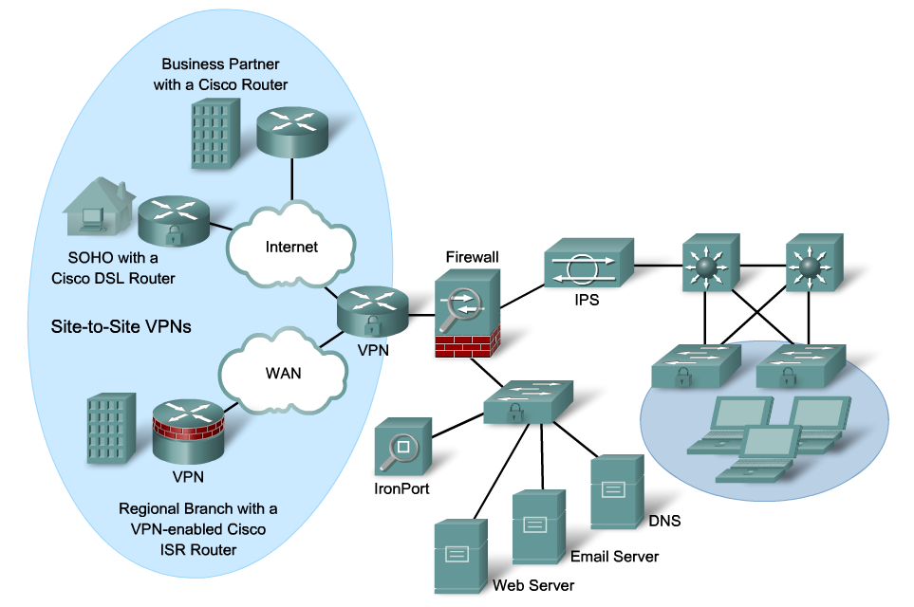
Site-to-Site VPNs
Notes:
Site-to-site VPNs provide cost benefits relative to private WANs and also enable new applications like extranets. However, site-to-site VPNs are still an end-to-end network and are subject to the same scalability, reliability, security, multi-protocol, etc. requirements that exist in the private WAN. In fact, since VPN are built on a public network infrastructure, they have additional requirements such as heightened security, advanced QoS capabilities, and a set of policy management tools to manage these additional features.
Cisco provides a suite of VPN-optimized routers. Cisco IOS software running in Cisco routers combines rich VPN services with industry-leading routing, thus delivering a comprehensive solution. Cisco routing software adds scalability, reliability, multi-protocol, multi-service, management, Service Level Agreement monitoring, and QoS to site-to-site applications. The Cisco VPN software adds strong security via encryption and authentication. This Cisco VPN-based products provide high performance for site-to-site, intranet and extranet, VPN solutions.

Slide 25
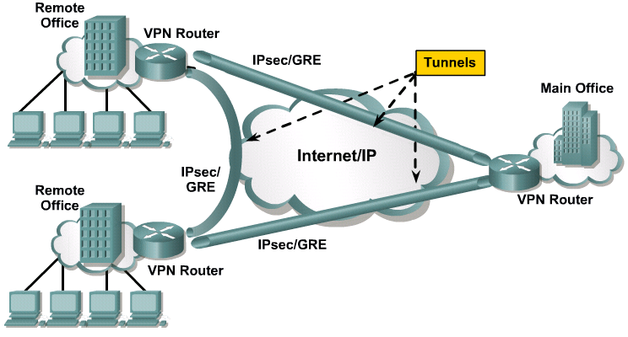
Site-to-Site VPNs

Slide 26
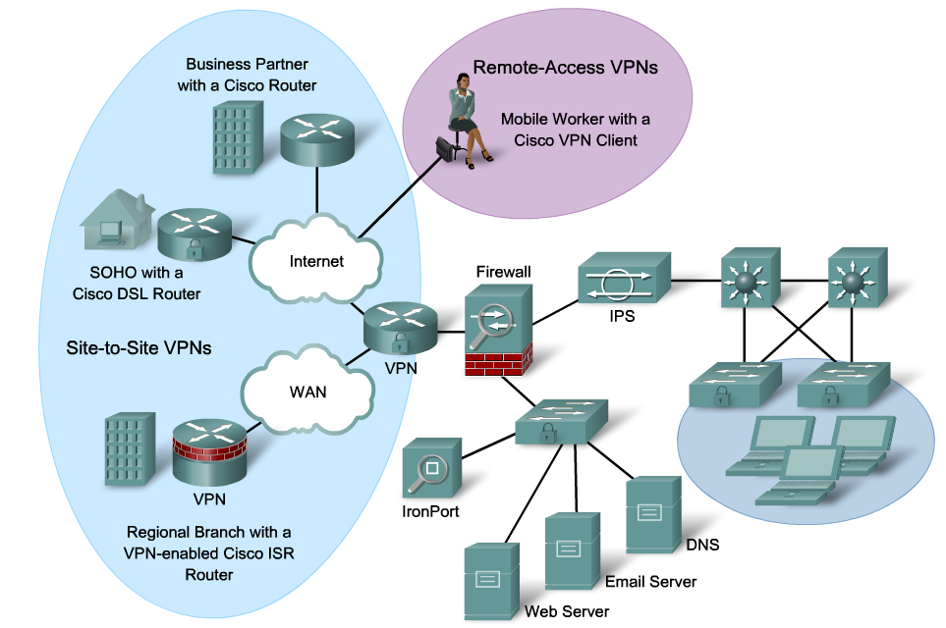
Remote Access VPNs

Slide 27
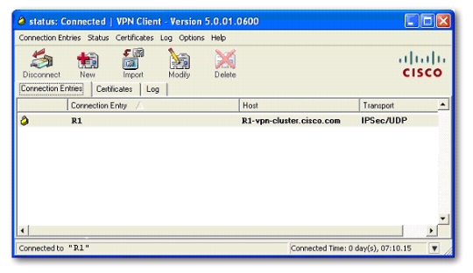
Remote Access VPNs

Slide 28
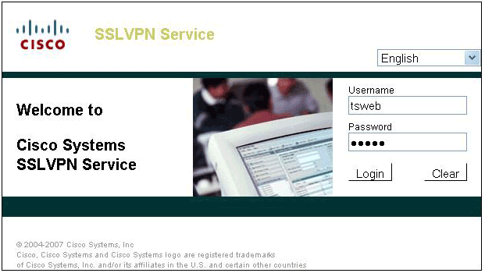
Remote Access VPNs

Slide 29
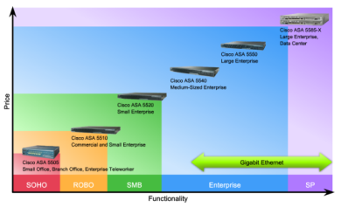
Cisco VPN Product Line
Product Choice
Remote-Access VPN
Site-to-Site VPN
Cisco VPN-Enabled Router
Secondary role
Primary role
Cisco PIX 500 Series Security Appliances (Legacy)
Secondary role
Primary role
Cisco ASA 5500 Adaptive Security Appliances
Primary role
Secondary role
Cisco VPN 3000 Series Concentrators
Primary role
Secondary role
Home Routers (Linksys, D-Link, …)
Primary role
Secondary role

Slide 30
GRE
Tunnel

Slide 31
Layer 3 Tunneling
There are 2 popular site-to-site tunneling protocols:
  Cisco Generic Routing Encapsulation (GRE)
  IP Security Protocol (IPsec)
When should you use GRE and / or IPsec?
IP Only?
User Traffic
Yes
No
Unicast Only?
Use GRE Tunnel
Use IPsec VPN
No
Yes

Slide 32

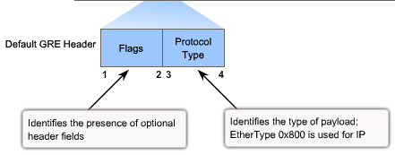
Generic Routing Encapsulation (GRE)
GRE can encapsulate almost any other type of packet.
  Uses IP to create a virtual point-to-point link between Cisco routers
  Supports multiprotocol (IP, CLNS, …) and IP multicast tunneling (and therefore routing protocols)
  Best suited for site-to-site multiprotocol VPNs
  RFC 1702 and RFC 2784
GRE header adds 24 bytes of additional overhead

Slide 33
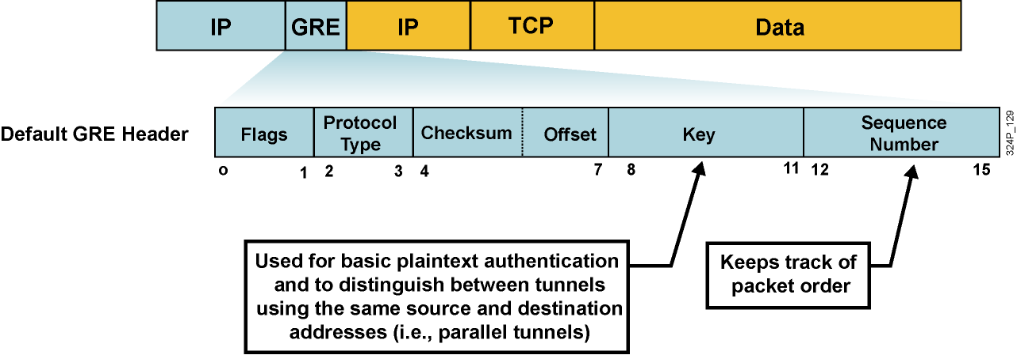
Optional GRE Extensions
GRE can optionally contain any one or more of these fields:
  Tunnel checksum
  Tunnel key
  Tunnel packet sequence number
GRE keepalives can be used to track tunnel path status.

Slide 34
Generic Routing Encapsulation (GRE)
GRE does not provide encryption!
  It can be monitored with a protocol analyzer.
However, GRE and IPsec can be used together.
IPsec does not support multicast / broadcast and therefore does not forward routing protocol packets.
  However IPsec can encapsulate a GRE packet that encapsulates routing traffic (GRE over IPsec).

Slide 35
Five Steps to Configuring a GRE Tunnel
Create a tunnel interface: interface tunnel 0
Assign the tunnel an IP address.
Identify the source tunnel interface: tunnel source
Identify the tunnel destination: tunnel destination
(Optional) Identify the protocol to encapsulate in the GRE tunnel: tunnel mode gre ip
  By default, GRE is tunneled in an IP packet.

Slide 36
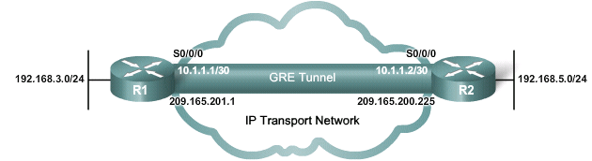
Five Steps to Configuring a GRE Tunnel
R1(config)# interface tunnel 0
R1(config–if)# ip address 10.1.1.1 255.255.255.252
R1(config–if)# tunnel source serial 0/0
R1(config–if)# tunnel destination 209.165.200.225
R1(config–if)# tunnel mode gre ip
R1(config–if)#
R2(config)# interface tunnel 0
R2(config–if)# ip address 10.1.1.2 255.255.255.252
R2(config–if)# tunnel source serial 0/0
R2(config–if)# tunnel destination 209.165.201.1
R2(config–if)# tunnel mode gre ip
R2(config–if)#

Slide 37
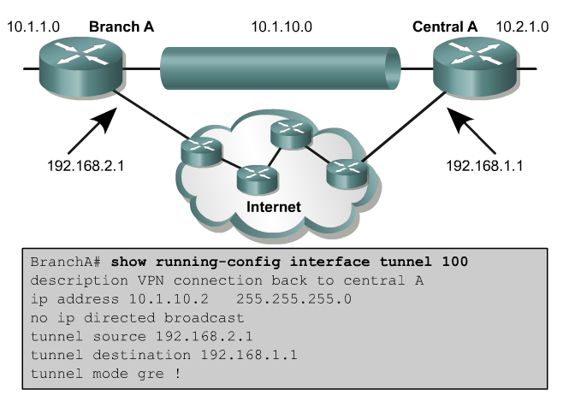
GRE Tunnel Example

Slide 38
IPsec

Slide 39
IPsec - Internet Protocol Security
A “framework” of open standards developed by the IETF to create a secure tunnel at the network (IP) layer.
  It spells out the rules for secure communications.
  RFC 2401 - RFC 2412
IPsec is not bound to any specific encryption or authentication algorithms, keying technology, or security algorithms.
IPsec allows newer and better algorithms to be implemented without patching the existing IPsec standards.

Slide 40
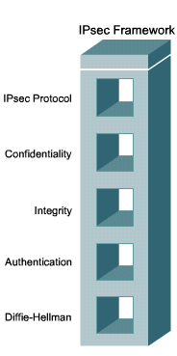
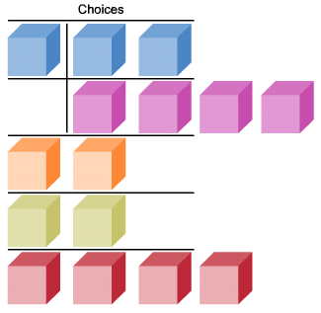
IPsec Protocol Framework
AH
ESP
ESP + AH
DES
3
DES
AES
SEAL
MD5
SHA
PSK
RSA
DH1
DH2
DH5
DH7

Slide 41
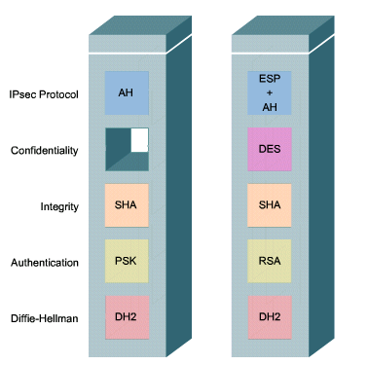
IPsec Protocol Framework

Slide 42
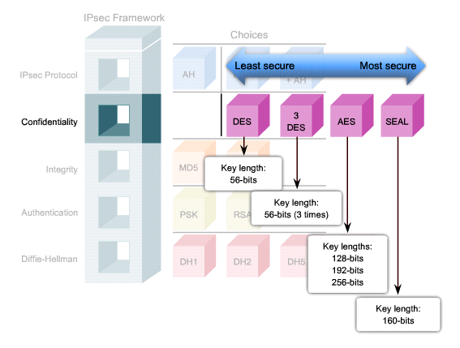
Confidentiality

Slide 43
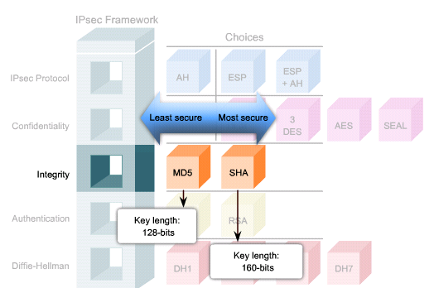
Integrity

Slide 44
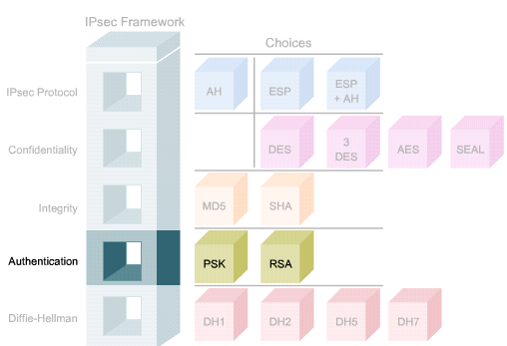
Authentication

Slide 45
Secure Key Exchange
AH
ESP
ESP + AH
DES
3
DES
AES
SEAL
MD5
SHA
PSK
RSA
DH1
DH2
DH5
DH7
768 bits
1024 bits
1536 bits
Used by DES and 3DES
Used by AES

Slide 46
IPsec Framework Protocols
IPsec uses two main protocols to create a security framework:
  AH: Authentication Header
  ESP: Encapsulating Security Payload

Slide 47
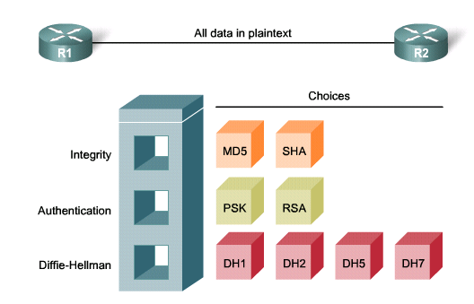
Authentication Header (AH)
AH provides authentication and optional replay-detection services.
  It authenticates the sender of the data.
  AH operates on protocol number 51.
  AH supports the HMAC-MD5 and HMAC-SHA-1 algorithms.

Slide 48
Authentication Header (AH)
AH does not provide confidentiality (encryption).
  It is appropriate to use when confidentiality is not required or permitted.
  All text is transported unencrypted.
It only ensures the origin of the data and verifies that the data has not been modified during transit.
If the AH protocol is used alone, it provides weak protection.
AH can have problems if the environment uses NAT.

Slide 49
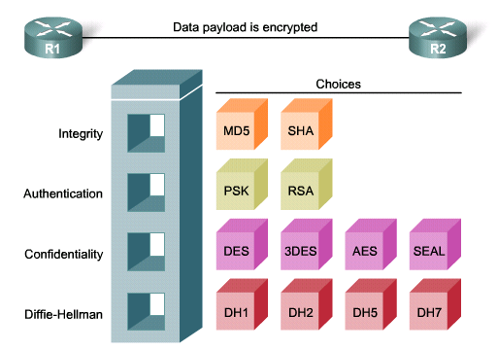
Encapsulating Security Payload (ESP)
ESP provides the same security services as AH (authentication and integrity) AND encryption service.
  It encapsulates the data to be protected.
  It operates on protocol number 50.

Slide 50
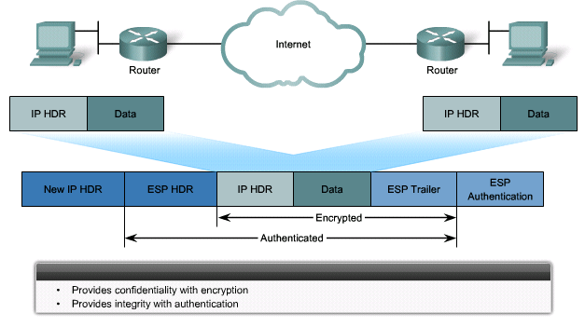
Encapsulating Security Payload (ESP)
ESP can also provide integrity and authentication.
  First, the payload is encrypted using DES (default), 3DES, AES, or SEAL.
  Next, the encrypted payload is hashed to provide authentication and data integrity using HMAC-MD5 or HMAC-SHA-1.

Slide 51

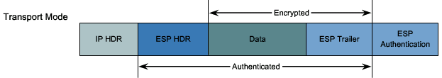
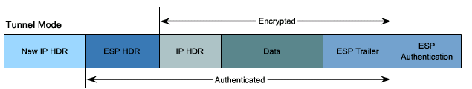
Transport Mode and Tunnel Mode
ESP and AH can be applied to IP packets in two different modes.

Slide 52
Transport Mode
Security is provided only for the Transport Layer and above.
  It protects the payload but leaves the original IP address in plaintext.
ESP transport mode is used between hosts.
Transport mode works well with GRE, because GRE hides the addresses of the end devices by adding its own IP.

Slide 53
Tunnel Mode
Tunnel mode provides security for the complete original IP packet.
  The original IP packet is encrypted and then it is encapsulated in another IP packet (IP-in-IP encryption).
ESP tunnel mode is used in remote access and site-to-site implementations.

Slide 54
Key Exchange

Slide 55
Key Exchange
The IPsec VPN solution:
  Negotiates key exchange parameters (IKE).
  Establishes a shared key (DH).
  Authenticates the peer.
  Negotiates the encryption parameters.
The negotiated parameters between two devices are known as a security association (SA).

Slide 56
Security Associations (SAs)
SAs represent a policy contract between two peers or hosts, and describe how the peers will use IPsec security services to protect network traffic.
SAs contain all the security parameters needed to securely transport packets between the peers or hosts, and practically define the security policy used in IPsec.

Slide 57
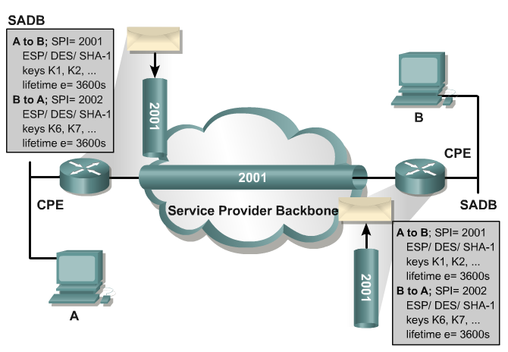
SA Security Parameters

Slide 58
IKE - Internet Key Exchange
IKE helps IPsec securely exchange cryptographic keys between distant devices.
  Combination of the ISAKMP and the Oakley Key Exchange Protocol.
Key Management can be preconfigured with IKE (ISAKMP) or with a manual key configuration.
  IKE and ISAKMP are often used interchangeably.
The IKE tunnel protects the SA negotiations.
  After the SAs are in place, IPsec protects the data that Alice and Bob exchange.

Slide 59
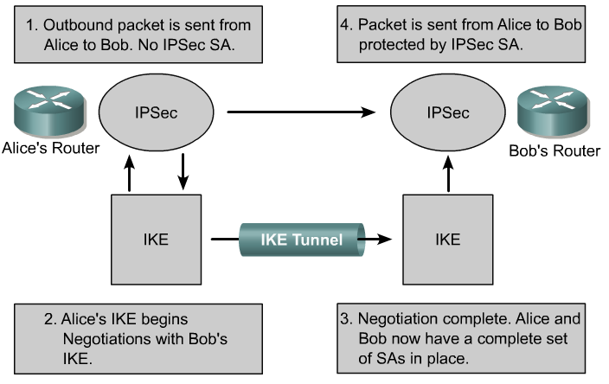
How IPsec uses IKE
Outbound packet is sent from Alice to Bob. No IPsec SA.
Packet is sent from Alice to Bob protected by IPsec SA.
IPsec
IPsec

Slide 60
IKE - Internet Key Exchange
There are two phases in every IKE negotiation
  Phase 1 (Authentication)
  Phase 2 (Key Exchange)
IKE negotiation can also occur in:
  Main Mode
  Aggressive mode
The difference between the two is that Main mode requires the exchange of 6 messages while Aggressive mode requires only 3 exchanges.

Slide 61
IKE Main Mode Phases
IKE Phase One:
  Negotiates an IKE protection suite.
  Exchanges keying material to protect the IKE session (DH).
  Authenticates each other.
  Establishes the IKE SA.
  Main Mode requires the exchange of 6 messages while Aggressive mode only uses 3 messages.
IKE Phase Two:
  Negotiates IPsec security parameters, known as IPsec transform sets.
  Establishes IPsec SAs.
  Periodically renegotiates IPsec SAs to ensure security.
  Optionally performs an additional DH exchange.

Slide 62
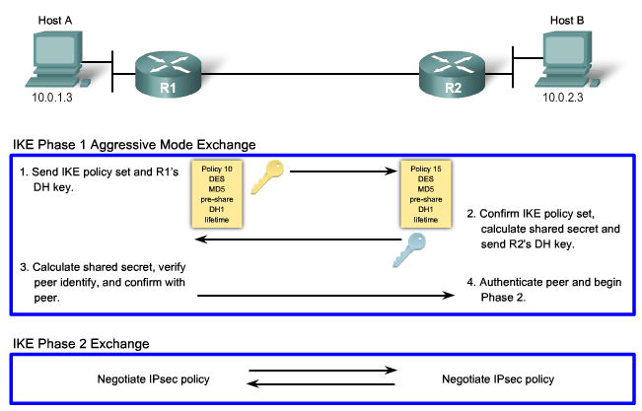
IKE Phases

Slide 63
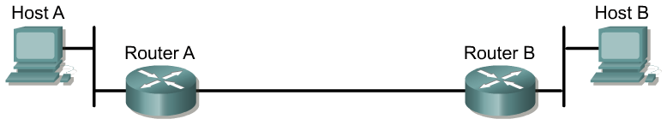



Five Steps of IPsec
Step 1
Host A sends interesting traffic destined for Host B.
Step 2
IKE Phase 1 authenticates IPsec peers and negotiates IKE SAs to create a secure communications channel for negotiating IPsec SAs in Phase 2.
Step 3
IKE Phase 2 negotiates IPsec SA parameters and creates matching IPsec SAs in the peers to protect data and messages exchanged between endpoints.
Step 4
Data transfer occurs between IPsec peers based on the IPsec parameters and keys stored in the SA database.
Step 5
IPsec tunnel termination occurs by SAs through deletion or by timing out.

Slide 64
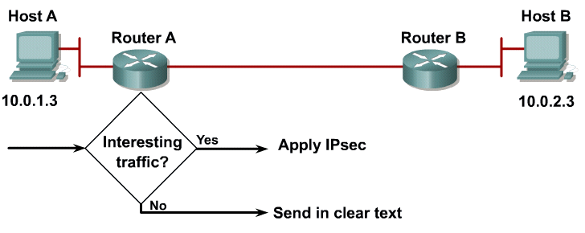
Step 1 – Interesting Traffic

Slide 65
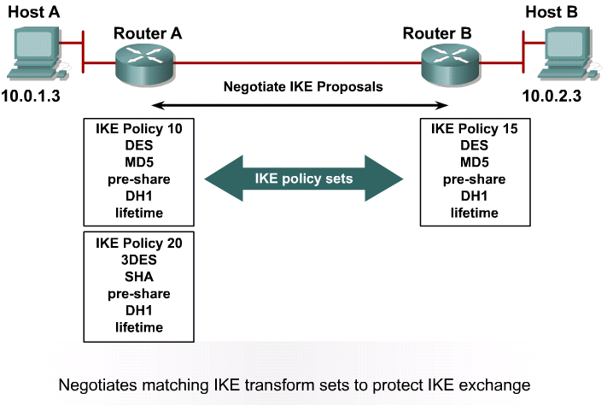
Step 2 – IKE Phase 1
IKE Policy Negotiation

Slide 66
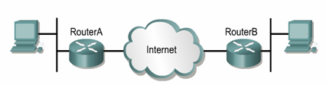
Step 2 – IKE Phase 1
DH Key Exchange
RouterA randomly chooses a string and sends it to RouterB.
RouterB hashes the received string together with the pre-shared secret and yields a hash value.
RouterA calculates its own hash of the random string, together with the pre-shared secret, and matches it with the received result from the other peer.
If they match, RouterB knows the pre-shared secret, and is considered authenticated.
RouterB sends the result of hashing back to RouterA.

Slide 67
Step 2 – IKE Phase 1
DH Key Exchange
RouterA also hashes the received string together with the pre-shared secret and yields a hash value.
Now RouterB randomly chooses a different random string and sends it to RouterA.
RouterB calculates its own hash of the random string, together with the pre-shared secret, and matches it with the received result from the other peer.
If they match, RouterA knows the pre-shared secret, and is considered authenticated.
RouterA sends the result of hashing back to RouterB.

Slide 68
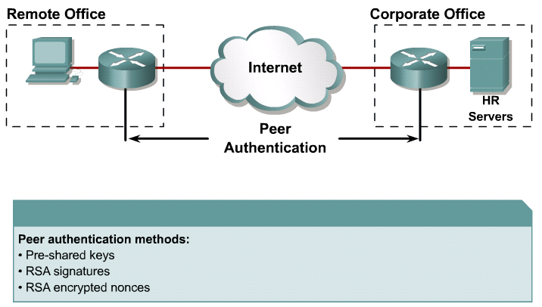
Step 2 – IKE Phase 1
Peer Authentication

Slide 69
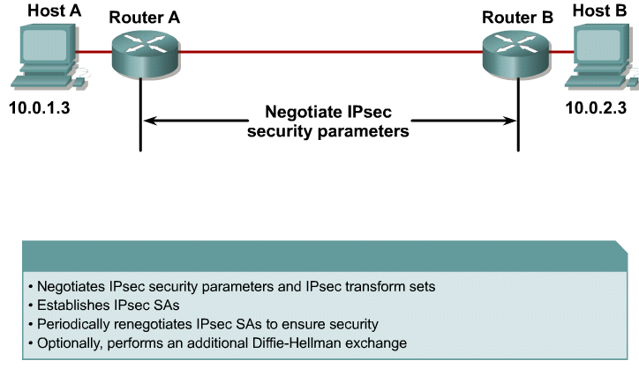
Step 3 – IKE Phase 2
IPsec Negotiation

Slide 70
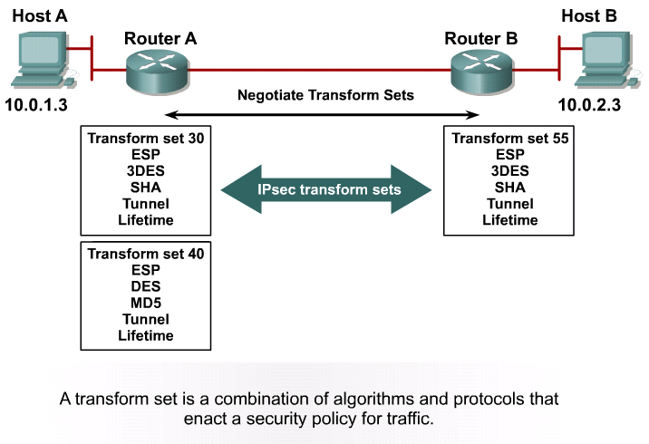
Step 3 – IKE Phase 2
Transform Set Negotiation

Slide 71
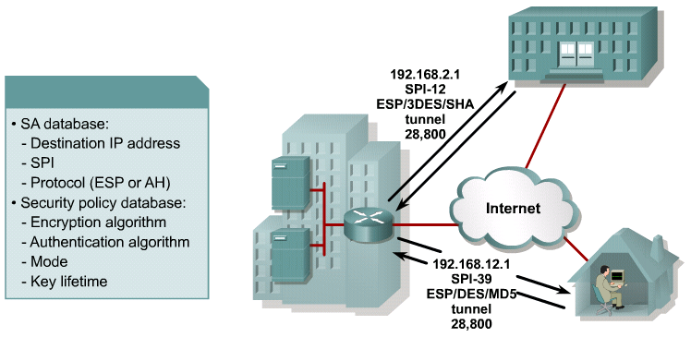
Step 3 – IKE Phase 2
Security Associations

Slide 72
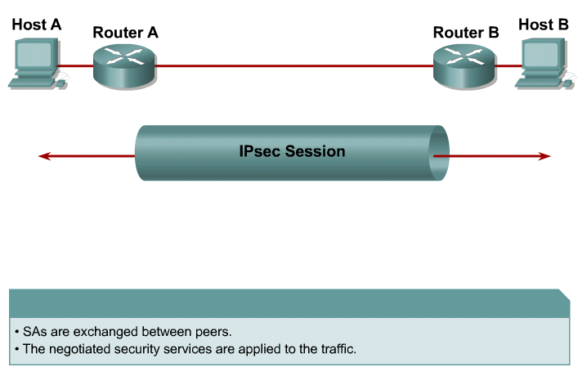
Step 4
IPsec Session

Slide 73
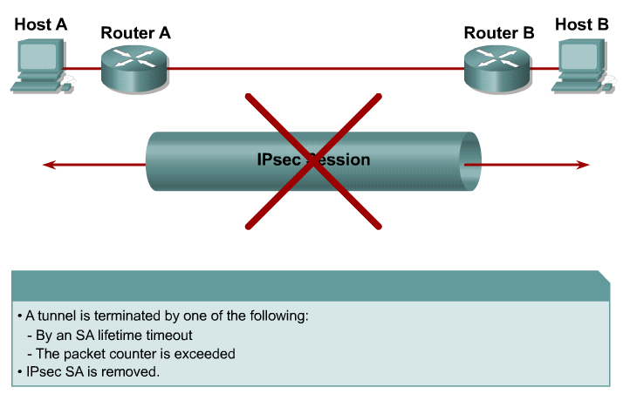
Step 5
Tunnel Termination

Slide 74
IPsec Tasks

Slide 75
IPsec Tasks
Ensure that ACLs configured on the interface are compatible with IPsec configuration.
Create an IKE policy to determine the parameters that will be used to establish the tunnel.
Configure the IPsec transform set which defines the parameters that the IPsec tunnel uses.
  The set can include the encryption and integrity algorithms.
Create a crypto ACL.
  The crypto ACL defines which traffic is sent through the IPsec tunnel and protected by the IPsec process.
Create and apply a crypto map.
  The crypto map groups the previously configured parameters together and defines the IPsec peer devices.
  The crypto map is applied to the outgoing interface of the VPN device.

Slide 76
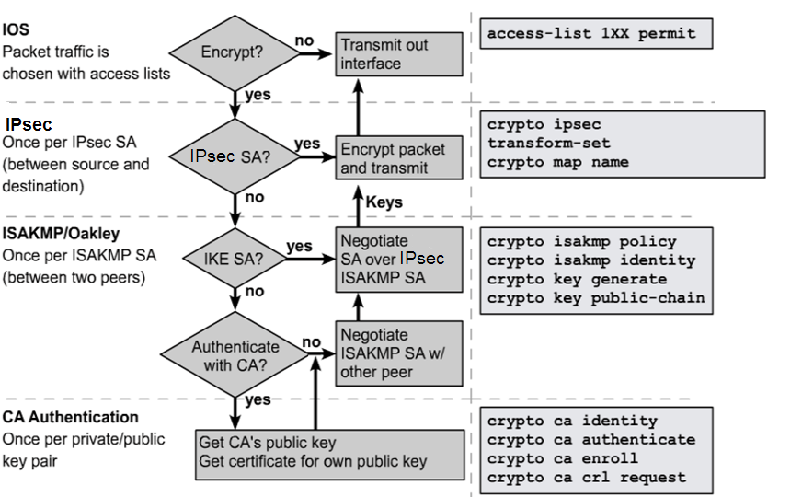
IKE and IPsec Flowchart
3
2
1

Slide 77
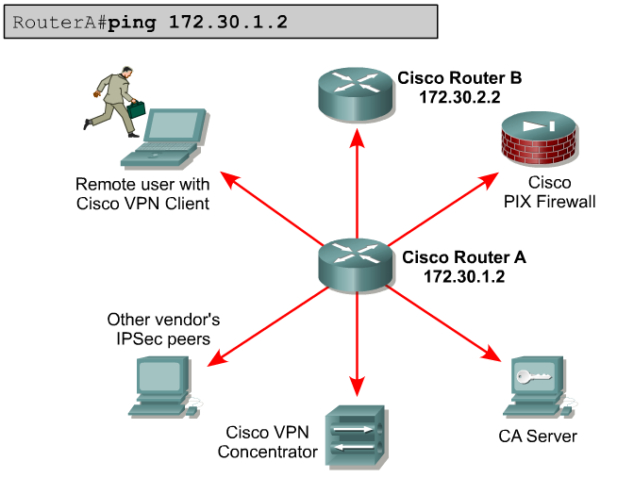
Ensure the Network Works

Slide 78
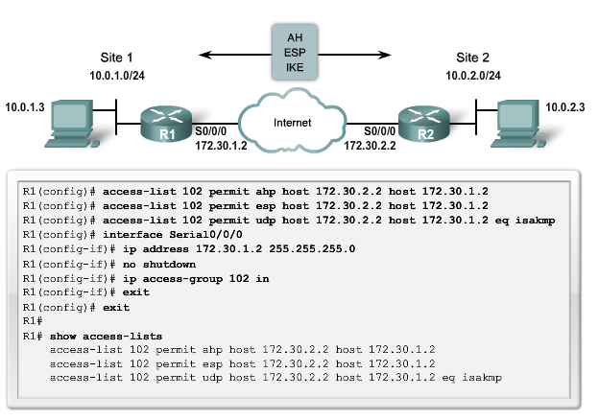
Task 1: Ensure ACLs are Compatible
ESP = protocol # 50, AH = protocol # 51, ISAKMP = UDP port 500

Slide 79
Task 2: Configure IKE
Creating a plan in advance is mandatory to configure IPsec encryption correctly to minimize misconfiguration.
Determine the following policy details:
  Key distribution method
  Authentication method
  IPsec peer IP addresses and hostnames
  IKE phase 1 policies for all peers
  Encryption algorithm, Hash algorithm, IKE SA lifetime
Goal: Minimize misconfiguration.

Slide 80
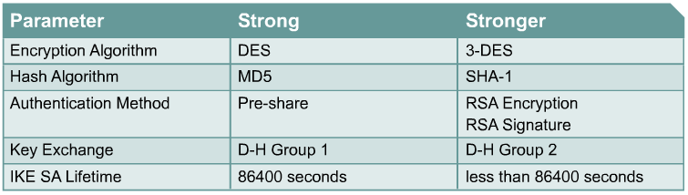
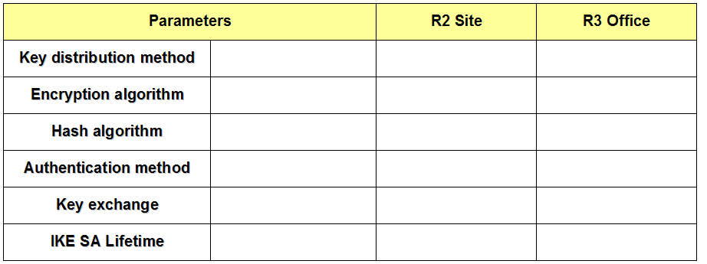

IKE Phase 1 Policy Parameters
or AES
or D-H 5

Slide 81
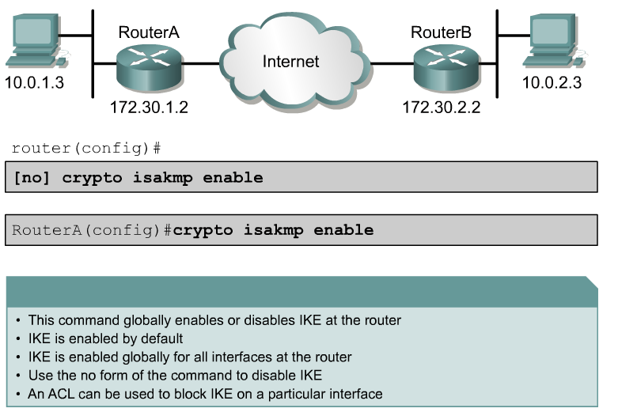
Enable IKE

Slide 82

Create an IKE Policy

Slide 83

Default ISAKMP Settings

Slide 84
Default ISAKMP Settings
RouterA# show crypto isakmp policy
Protection suite of priority 110
encryption algorithm: DES - Data Encryption Standard (56 bit keys).
hash algorithm: Message Digest 5
authentication method: Pre-Shared Key
Diffie-Hellman group: #1 (768 bit)
lifetime: 86400 seconds, no volume limit
Default protection suite
encryption algorithm: DES - Data Encryption Standard (56 bit keys).
hash algorithm: Secure Hash Standard
authentication method: Rivest-Shamir-Adleman Signature
Diffie-Hellman group: #1 (768 bit)
lifetime: 86400 seconds, no volume limit

Slide 85

Create an IKE Policy

Slide 86

ISAKMP Policy Negotiation

Slide 87

ISAKMP Policy Negotiation

Slide 88

Configure Pre-Shared Keys
By default, the ISAKMP identity is set to use the IP address.

Slide 89

Configure Pre-Shared Keys

Slide 90

Configure ISAKMP Identity
To use the hostname parameter, configure the crypto isakmp identity hostname global configuration mode command.
  In addition, DNS must be accessible to resolve the hostname.

Slide 91

Verify IKE Configuration
RouterA# show crypto isakmp policy
Protection suite of priority 110
encryption algorithm: DES - Data Encryption Standard (56 bit keys).
hash algorithm: Message Digest 5
authentication method: Pre-Shared Key
Diffie-Hellman group: #1 (768 bit)
lifetime: 86400 seconds, no volume limit
Default protection suite
encryption algorithm: DES - Data Encryption Standard (56 bit keys).
hash algorithm: Secure Hash Standard
authentication method: Rivest-Shamir-Adleman Signature
Diffie-Hellman group: #1 (768 bit)
lifetime: 86400 seconds, no volume limit

Slide 92
Task 3: Configure the Transform Sets
Determine the following policy details:
  IPsec algorithms and parameters for optimal security and performance
  Transforms sets
  IPsec peer details
  IP address and applications of hosts to be protected
  Manual or IKE-initiated SAs
Goal: Minimize misconfiguration.

Slide 93
IPsec Transforms Supported in IOS
Cisco IOS software supports the following IPsec transforms:
CentralA(config)# crypto ipsec transform-set transform-set-name ?
ah-md5-hmac AH-HMAC-MD5 transform
ah-sha-hmac AH-HMAC-SHA transform
esp-3des ESP transform using 3DES(EDE) cipher (168 bits)
esp-des ESP transform using DES cipher (56 bits)
esp-md5-hmac ESP transform using HMAC-MD5 auth
esp-sha-hmac ESP transform using HMAC-SHA auth
esp-null ESP transform w/o cipher
Note:
  esp-md5-hmac and esp-sha-hmac provide more data integrity.
  They are compatible with NAT/PAT and are used more frequently than ah-md5-hmac and ah-sha-hmac.

Slide 94

IPsec Policy Example

Slide 95
Specific IPsec show Commands
RouterA# show crypto isakmp policy
Default protection suite
encryption algorithm: DES - Data Encryption Standard (56 bit keys)
hash algorithm: Secure Hash Standard
authentication method: Rivest-Shamir-Adleman Signature
Diffie-Hellman Group: #1 (768 bit)
lifetime: 86400 seconds, no volume limit
RouterA# show crypto map
Crypto Map “MYMAP" 10 ipsec-isakmp
Peer = 172.30.2.2
Extended IP access list 102
access-list 102 permit ip host 172.30.1.2 host 172.30.2.2
Current peer: 172.30.2.2
Security association lifetime: 4608000 kilobytes/3600 seconds
PFS (Y/N): N
Transform sets={ MY-SET, }
RouterA# show crypto ipsec transform-set MY-SET
Transform set MY-SET: { esp-des }
will negotiate = { Tunnel, },

Slide 96

Configure Transform Sets

Slide 97

Transform Set Negotiation

Slide 98

Transform Set Negotiation

Slide 99

Configure Security Association Lifetimes
Configures global IPsec lifetime values used when negotiating IPsec security associations.
IPsec SA lifetimes are negotiated during IKE phase 2.

Slide 100

Task 4: Configure Crypto ACLs
tcp

Slide 101

Configure Symmetrical Peer Crypto ACL
RouterA#(config)
access-list 110 permit tcp 10.0.1.0 0.0.0.255 10.0.2.0 0.0.0.255
RouterB#(config)
access-list 110 permit tcp 10.0.2.0 0.0.0.255 10.0.1.0 0.0.0.255

Slide 102

Task 5: Apply the Crypto Map

Slide 103

Configure IPsec Crypto Maps

Slide 104

Configure IPsec Crypto Maps

Slide 105

Configure IPsec Crypto Maps

Slide 106

Example Crypto Map Commands
RouterA(config)# crypto map MYMAP 110 ipsec-isakmp
RouterA(config-crypto-map)# match address 110
RouterA(config-crypto-map)# set peer 172.30.2.2
RouterA(config-crypto-map)# set peer 172.30.3.2
RouterA(config-crypto-map)# set transform-set MINE
RouterA(config-crypto-map)# set security-association lifetime 86400

Slide 107

Applying Crypto Maps to Interfaces

Slide 108



IPsec Configuration Examples

Slide 109

Verify IPsec

Slide 110
clear commands
Clears IPsec Security Associations in the router database.
Router#
clear crypto sa
clear crypto sa peer <IP address | peer name>
clear crypto sa map <map name>
clear crypto sa entry <destination-address protocol spi>

Slide 111

View Policy
RouterA# show crypto isakmp policy
Protection suite of priority 110
encryption algorithm: DES - Data Encryption Standard (56 bit keys).
hash algorithm: Message Digest 5
authentication method: pre-share
Diffie-Hellman group: #1 (768 bit)
lifetime: 86400 seconds, no volume limit
Default protection suite
encryption algorithm: DES - Data Encryption Standard (56 bit keys).
hash algorithm: Secure Hash Standard
authentication method: Rivest-Shamir-Adleman Signature
Diffie-Hellman group: #1 (768 bit)
lifetime: 86400 seconds, no volume limit

Slide 112
View Defined Sets
A
E0/1 172.30.1.2
E0/1 172.30.2.2
RouterA# show crypto ipsec transform-set MY-SET
Transform set MY-SET: { esp-des }
will negotiate = { Tunnel, },

Slide 113
Display Phase 1 SA
QM_IDLE (quiescent state) indicates that an ISAKMP SA exists but is idle.
The router will remain authenticated with its peer and may be used for subsequent quick mode (QM) exchanges.
A
E0/1 172.30.1.2
E0/1 172.30.2.2
RouterA# show crypto isakmp sa
dst src state conn-id slot
172.30.2.2 172.30.1.2 QM_IDLE 47 5

Slide 114
View Crypto IPsec SA
A
E0/1 172.30.1.2
E0/1 172.30.2.2
RouterA# show crypto ipsec sa
interface: Ethernet0/1
  Crypto map tag: MYMAP, local addr. 172.30.1.2
  local ident (addr/mask/prot/port): (172.30.1.2/255.255.255.255/0/0)
  remote ident (addr/mask/prot/port): (172.30.2.2/255.255.255.255/0/0)
  current_peer: 172.30.2.2
  PERMIT, flags={origin_is_acl,}
  #pkts encaps: 21, #pkts encrypt: 21, #pkts digest 0
  #pkts decaps: 21, #pkts decrypt: 21, #pkts verify 0
  #send errors 0, #recv errors 0
  local crypto endpt.: 172.30.1.2, remote crypto endpt.: 172.30.2.2
  path mtu 1500, media mtu 1500
  current outbound spi: 8AE1C9C

Slide 115
View Configured Crypto Maps
A
E0/1 172.30.1.2
E0/1 172.30.2.2
RouterA# show crypto map
Crypto Map “MYMAP" 10 ipsec-isakmp
  Peer = 172.30.2.2
  Extended IP access list 102
  access-list 102 permit ip host 172.30.1.2 host 172.30.2.2
  Current peer: 172.30.2.2
  Security association lifetime: 4608000 kilobytes/3600 seconds
  PFS (Y/N): N
  Transform sets={ MINE, }

Slide 116
Crypto System Error Messages for ISAKMP
To display debug messages about all IPsec actions, use the global command debug crypto ipsec.
To display debug messages about all ISAKMP actions, use the global command debug crypto isakmp.

Slide 117
Crypto System Error Messages for ISAKMP
ISAKMP SA with the remote peer was not authenticated.
ISAKMP peers failed protection suite negotiation for ISAKMP.
%CRYPTO-6-IKMP_SA_NOT_AUTH: Cannot accept Quick Mode exchange from %15i if SA is not authenticated!
%CRYPTO-6-IKMP_SA_NOT_OFFERED: Remote peer %15i responded with attribute [chars] not offered or changed

Slide 118
Crypto System Error Messages for ISAKMP
This is an example of the Main Mode error message.
The failure of Main Mode suggests that the Phase I policy does not match on both sides.
Verify that the Phase I policy is on both peers and ensure that all the attributes match.
  Encryption: DES or 3DES
  Hash: MD5 or SHA
  Diffie-Hellman: Group 1 or 2
  Authentication: rsa-sig, rsa-encr or pre-share
1d00h: ISAKMP (0:1): atts are not acceptable. Next payload is 0 1d00h: ISAKMP (0:1); no offers accepted!
1d00h: ISAKMP (0:1): SA not acceptable!
1d00h: %CRYPTO-6-IKMP_MODE_FAILURE: Processing of Main Mode failed with peer at 150.150.150.1

Slide 119
VPN Lab

Slide 120

VPN Lab Example
Configuring a Site-to-Site IPsec VPN Using Pre-Shared Keys

Slide 121

ISP Router
hostname R1
!
interface Serial0/0
ip address 192.168.191.1 255.255.255.0
encapsulation frame-relay
!
interface Serial0/1
ip address 192.168.192.1 255.255.255.0
!
ip route 192.168.0.0 255.255.255.0 192.168.191.2
ip route 192.168.200.0 255.255.255.0 192.168.192.2

Slide 122

Lab Example
hostname R2
!
crypto isakmp policy 100
authentication pre-share
crypto isakmp key CISCO1234 address 192.168.192.2
!
crypto ipsec transform-set MYSET esp-des
!
crypto map MYMAP 110 ipsec-isakmp
set peer 192.168.192.2
set transform-set MYSET
match address 120
!
interface Serial0/0
ip address 192.168.191.2 255.255.255.0
encapsulation frame-relay
crypto map MYMAP
ip route 0.0.0.0 0.0.0.0 192.168.191.1
!
access-list 120 permit ip 192.168.0.0 0.0.0.255 192.168.200.0 0.0.0.255

Slide 123

Lab Example
hostname R3
!
crypto isakmp policy 100
authentication pre-share
crypto isakmp key CISCO1234 address 192.168.191.2
!
crypto ipsec transform-set MYSET esp-des
!
crypto map MYMAP 110 ipsec-isakmp
set peer 192.168.191.2
set transform-set MYSET
match address 120
interface Serial0/1
ip address 192.168.192.2 255.255.255.0
clockrate 56000
crypto map MYMAP
!
ip route 0.0.0.0 0.0.0.0 192.168.192.1
!
access-list 120 permit ip 192.168.200.0 0.0.0.255 192.168.0.0 0.0.0.255

Slide 124
Verify the VPN Configuration
Clear the crypto security associations.
  R2# clear crypto sa
  R2# clear crypto isakmp

Slide 125
Verify the VPN Configuration
Verify that the IPSEC SAs have been cleared.
  R2# sho crypto ipsec sa
  interface: Serial0/0
  Crypto map tag: MYMAP, local addr. 192.168.191.2
  local ident (addr/mask/prot/port): (192.168.0.0/255.255.255.0/0/0)
  remote ident (addr/mask/prot/port): (192.168.200.0/255.255.255.0/0/0)
  current_peer: 192.168.192.2
  PERMIT, flags={origin_is_acl,}
  #pkts encaps: 0, #pkts encrypt: 0, #pkts digest 0
  #pkts decaps: 0, #pkts decrypt: 0, #pkts verify 0
  #pkts compressed: 0, #pkts decompressed: 0
  #pkts not compressed: 0, #pkts compr. failed: 0, #pkts decompress failed: 0
  #send errors 0, #recv errors 0
  local crypto endpt.: 192.168.191.2, remote crypto endpt.: 192.168.192.2
  path mtu 1500, media mtu 1500
  current outbound spi: 0

Slide 126
Verify the VPN Configuration
Initiate an extended ping from each respective LAN, to test the VPN configuration.
  R2# ping
  Protocol [ip]:
  Target IP address: 192.168.200.1
  Repeat count [5]:
  Datagram size [100]:
  Timeout in seconds [2]:
  Extended commands [n]: y
  Source address or interface: 192.168.0.1
  Type of service [0]:
  Set DF bit in IP header? [no]:
  Validate reply data? [no]:
  Data pattern [0xABCD]:
  Loose, Strict, Record, Timestamp, Verbose[none]:
  Sweep range of sizes [n]:
  Type escape sequence to abort.
  Sending 5, 100-byte ICMP Echos to 192.168.200.1, timeout is 2 seconds:
  .!!!!
  Success rate is 80 percent (4/5), round-trip min/avg/max = 132/135/136 ms

Slide 127
Verify the VPN Configuration
After the extended ping, verify IPSEC SAs.
  R2# sho crypto ipsec sa
  interface: Serial0/0
  Crypto map tag: MYMAP, local addr. 192.168.191.2
  local ident (addr/mask/prot/port): (192.168.0.0/255.255.255.0/0/0)
  remote ident (addr/mask/prot/port): (192.168.200.0/255.255.255.0/0/0)
  current_peer: 192.168.192.2
  PERMIT, flags={origin_is_acl,}
  #pkts encaps: 4, #pkts encrypt: 4, #pkts digest 0
  #pkts decaps: 4, #pkts decrypt: 4, #pkts verify 0
  #pkts compressed: 0, #pkts decompressed: 0
  #pkts not compressed: 0, #pkts compr. failed: 0, #pkts decompress failed: 0
  #send errors 1, #recv errors 0
  local crypto endpt.: 192.168.191.2, remote crypto endpt.: 192.168.192.2
  path mtu 1500, media mtu 1500
  current outbound spi: 126912DC

Slide 128
Configuring IPsec VPN using CCP

Slide 129

CCP ‘Wizards’
Other intelligent Cisco wizards are available in CCP for these three tasks:
  Auto detecting misconfiguration and proposing fixes.
  Providing strong security and verifying configuration entries.
  Using device and interface-specific defaults.

Slide 130

CCP ‘Wizards’
Examples of CCP wizards include:
  Startup wizard for initial router configuration
  LAN and WAN wizards
  Policy-based firewall and access-list management to easily configure firewall settings based on policy rules
  IPS wizard
  One-step site-to-site VPN wizard
  One-step router lockdown wizard to harden the router

Slide 131

VPN Configuration Page

Slide 132

VPN Configuration Page

Slide 133
Site-to-Site VPN Components
VPN wizards use two sources to create a VPN connection:
  User input during the step-by-step wizard process
  Preconfigured VPN components
CCP provides some default VPN components:
  IPsec transform set for Quick Setup wizard
Other components are created by the VPN wizards:
  Two IKE policies
Some components (for example, PKI) must be configured before the wizards can be used.

Slide 134

VPN Configuration Page

Slide 135

Quick Setup

Slide 136

Quick Setup

Slide 137

Quick Setup

Slide 138
Step-by-Step Setup
Multiple steps are required to configure the VPN connection:
  Defining connection settings: Outside interface, peer address, authentication credentials
  Defining IKE proposals: Priority, encryption algorithm, HMAC, authentication type, Diffie-Hellman group, lifetime
  Defining IPsec transform sets: Encryption algorithm, HMAC, mode of operation, compression
  Defining traffic to protect: Single source and destination subnets, ACL
  Reviewing and completing the configuration

Slide 139

Configuring Connection Settings
Notes:
Configuring Connection Settings
The diagram shows the first task in the step-by-step setup, configuring connection settings:
Choose the outside interface that will be used for traffic going to the IPsec peer over the untrusted network.
Specify the IP address of the peer. This is the reachable next-hop address and not the address of the internal LAN interface.
Choose the authentication method (either Pre-shared keys or Digital Certificates) and specify the credentials. Use long and random pre-shared keys to prevent brute-force and dictionary attacks against IKE.
Click the Next button to proceed to the next task.

Slide 140

Configuring IKE Proposals
Notes:
Configuring IKE Proposals
The second task in the step-by-step setup is to configure IKE proposals using the screen shown:
CCP predefines a default IKE proposal. You can use this IKE proposal (and skip Step 2) or add new proposals.
If you want to use a custom IKE proposal, create one by clicking the Add button and specifying the required parameters:
IKE proposal priority
Encryption algorithm
HMAC
IKE authentication method
DH group
IKE lifetime
When you finish adding IKE policies, click the Next button to proceed to the next task.

Slide 141

Configuring the Transform Set
Notes:
Configuring the Transform Set
The third task in the step-by-step setup is configuring a transform set using the screen shown:
There is a default IPsec transform set that is predefined by CCP. You can use this transform set (and skip Step 2) or add new transform sets.
If you want to use a custom IPsec transform set, create one by clicking the Add button and specifying these parameters:
Transform set name
Encryption algorithm
HMAC
Mode of operation
Optional compression
When finished, click the Next button to proceed to the next task.

Slide 142

Defining Source and Destination Subnet
Notes:
Identifying the Traffic to Protect
There are two options available to define the traffic that you want to protect. You can use the simple mode, allowing protection of traffic between one pair of IP subnets, or you can use an ACL.
Option 1: Simple Mode (Single Source and Destination Subnet)
To protect traffic between a particular pair of IP subnets, follow these steps as shown
Click the Protect all traffic between the following subnets radio button.
Under Local Network, enter the IP address and subnet mask of the local network where IPsec traffic originates.
Under Remote Network, enter the IP address and subnet mask of the remote network where IPsec traffic is sent.

Slide 143

Defining Interesting Traffic
Notes:
Option 2: Using an ACL
Alternatively, you can use an ACL to define a more complex set of proxy identities to protect traffic, as shown:
To specify an IPsec rule that defines the traffic types to protect, follow these steps:
Click the Create/Select an access-list for IPsec traffic radio button.
Click the ... button on the right side of the ACL field to choose an existing ACL or create a new one.
If the ACL that you want to use already exists, choose Select an existing rule (ACL) option. If you want to create a new ACL, choose the Create a new rule (ACL) and select option.
When creating a new ACL to define traffic that needs protection, use the Add a Rule window shown above and follow these steps:
Give the access rule a name and description in the appropriate fields.
Click the Add button to start adding rule entries. The Add an Extended Rule Entry window appears.
The next slide shows the screen you will use to configure a new rule entry:
Under Action, select an action from the drop-down menu and write a description of the rule entry in the Description field.
Each rule entry defines one pair of source and destination addresses or networks. Enter the type, IP address, and wildcard mask for each network under the Source Host/Network and Destination Host/Network sections.
You must use wildcard bits instead of subnet masks.
Optionally, you can provide protection for individual Open Systems Interconnection (OSI) Layer 4 protocols by selecting the required protocol radio button (TCP or UDP) and the required port numbers under Protocol and Service. If the rule applies to all IP traffic, leave the default radio button setting (IP).

Slide 144

Adding Rules to ACLs

Slide 145

Configuring a New ACL Rule Entry

Slide 146

Review the Generated Configuration

Slide 147

Test Tunnel Configuration and Operation
Check VPN status.
Test the VPN configuration.
Create a mirroring configuration if no CCP is available on the peer.

Slide 148

Test Tunnel Configuration and Operation

Slide 149
Remote-Access
VPNs

Slide 150

Teleworking Benefits

Slide 151

Remote-Access Solutions
There are two primary methods for deploying remote-access VPNs:
IPsec Remote
Access VPN
SSL-Based
VPN
Any
Application
Anywhere
Access

Slide 152
Remote-Access Solutions
SSL
IPsec
Applications
Web-enabled applications, file sharing, e-mail
All IP-based applications
Encryption
Moderate
Key lengths from 40 bits to 128 bits
Stronger
Key lengths from 56 bits to 256 bits
Authentication
Moderate
One-way or two-way authentication
Strong
Two-way authentication using shared secrets or digital certificates
Ease of Use
Very high
Moderate
Can be challenging to nontechnical users
Overall Security
Moderate
Any device can connect
Strong
Only specific devices with specific configurations can connect

Slide 153

SSL VPN

Slide 154

Clientless, Thin Client, or Full Client

Slide 155

Establishing SSL Session

Slide 156

Cisco Easy VPN

Slide 157
Cisco Easy VPN Components
Cisco Easy VPN Server - A Cisco IOS router or Cisco PIX / ASA Firewall acting as the VPN head-end device in site-to-site or remote-access VPNs.
Cisco Easy VPN Remote - A Cisco IOS router or Cisco PIX / ASA Firewall acting as a remote VPN client.
Cisco Easy VPN Client - An application supported on a PC used to access a Cisco VPN server.

Slide 158

Cisco Easy VPN Exchange

Slide 159

Configuring Easy VPN Server

Slide 160

Configuring Easy VPN Server Physical Interface

Slide 161

Configuring IKE Proposals

Slide 162

Configuring Transform Set

Slide 163

Configuring VPN Authentication Method List

Slide 164

Configuring VPN Authentication Group Policy

Slide 165

Configuration Summary

Slide 166

Edit Easy VPN Server

Slide 167

Easy VPN Server Test

Slide 168

Connecting Using the Client
R1
R1-vpn-cluster.span.com

Slide 169


