Slide 1
Cryptographic Systems

Slide 2
Managing Administrative Access
A network LAN can be secured through:
  Device hardening
  AAA access control
  Firewall features
  IPS implementations
How is network traffic protected when traversing the public Internet?
  Using cryptographic methods

Slide 3

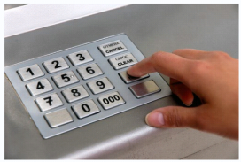
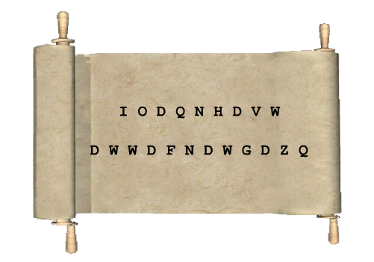
Secure Communications Requires …
Authentication
Integrity
Confidentiality

Slide 4
Authentication
Authentication guarantees that the message:
  Is not a forgery.
  Does actually come from who it states it comes from.
Authentication is similar to a secure PIN for banking at an ATM.
  The PIN should only be known to the user and the financial institution.
  The PIN is a shared secret that helps protect against forgeries.

Slide 5
Authentication
Data nonrepudiation is a similar service that allows the sender of a message to be uniquely identified.
This means that a sender / device cannot deny having been the source of that message.
  It cannot repudiate, or refute, the validity of a message sent.

Slide 6
Integrity
Data integrity ensures that messages are not altered in transit.
  The receiver can verify that the received message is identical to the sent message and that no manipulation occurred.
European nobility ensured the data integrity by creating a wax seal to close an envelope.
  The seal was often created using a signet ring.
  An unbroken seal on an envelope guaranteed the integrity of its contents.
  It also guaranteed authenticity based on the unique signet ring impression.

Slide 7
Confidentiality
Data confidentiality ensures privacy so that only the receiver can read the message.
Encryption is the process of scrambling data so that it cannot be read by unauthorized parties.
  Readable data is called plaintext, or cleartext.
  Encrypted data is called ciphertext.
A key is required to encrypt and decrypt a message.
  The key is the link between the plaintext and ciphertext.

Slide 8
Managing Administrative Access
Authentication, integrity, and confidentiality are components of cryptography.
Cryptography is both the practice and the study of hiding information.
It has been used for centuries to protect secret documents.
  Today, modern day cryptographic methods are used in multiple ways to ensure secure communications.

Slide 9
History of Cryptography

Slide 10
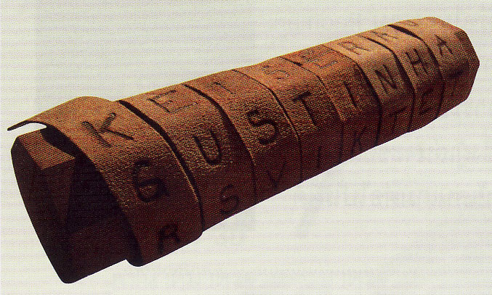
Scytale
Earliest cryptography method.
  Used by the Spartans in ancient Greece.

Slide 11
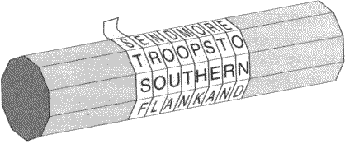

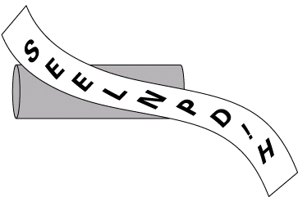
Scytale
It is a rod used as an aid for a transposition cipher.
  The sender and receiver had identical rods (scytale) on which to wrap a transposed messaged.

Slide 12
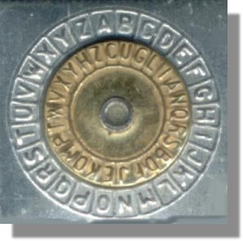
Caesar Cipher
When Julius Caesar sent messages to his generals, he didn't trust his messengers.
He encrypted his messages by replacing every letter:
  A with a D
  B with an E
  and so on
His generals knew the "shift by 3" rule and could decipher his messages.

Slide 13
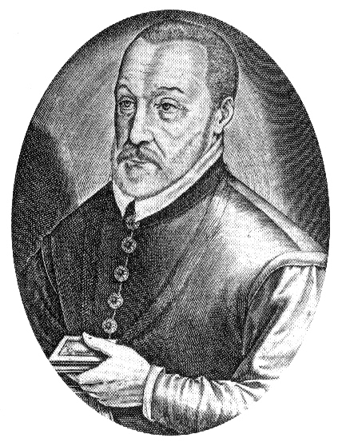
Vigenère Cipher
In 1586, Frenchman Blaise de Vigenère described a poly alphabetic system of encryption.
  It became known as the Vigenère Cipher.
Based on the Caesar cipher, it encrypted plaintext using a multi-letter key.
  It is also referred to as an autokey cipher.

Slide 14
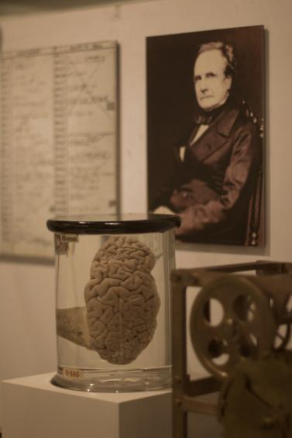
Note of interest …
It took 300 years for the Vigenère Cipher to be broken by Englishman Charles Babbage.
  Father of modern computers
Babbage created the first mechanical computer called the difference engine to calculate numerical tables.
  He then designed a more complex version called the analytical engine that could use punch cards.
  He also invented the pilot (cow-catcher).

Slide 15
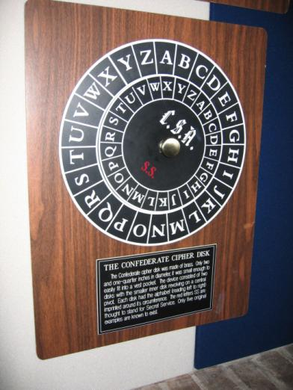
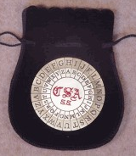
Confederate Cipher Disk
Thomas Jefferson, the third president of the United States, invented an encryption system that was believed to have been used when he served as secretary of state from 1790 to 1793.

Slide 16
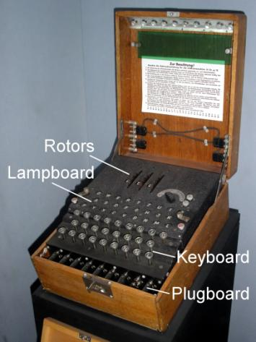
German Enigma Machine
Arthur Scherbius invented the Enigma in 1918 and sold it to Germany.
  It served as a template for the machines that all the major participants in World War II used.
It was estimated that if 1,000 cryptanalysts tested four keys per minute, all day, every day, it would take 1.8 billion years to try them all.
  Germany knew their ciphered messages could be intercepted by the allies, but never thought they could be deciphered.
http://users.telenet.be/d.rijmenants/en/enigma.htm

Slide 17
Code Talkers
During World War II, Japan was deciphering every code the Americans came up with.
  A more elaborate coding system was needed.
  The answer came in the form of the Navajo code talkers.
Code talkers were bilingual Navajo speakers specially recruited during World War II by the Marines.
Other Native American code talkers were Cherokee, Choctaw and Comanche soldiers.

Slide 18

Code Talkers
Not only were there no words in the Navajo language for military terms, the language was unwritten and less than 30 people outside of the Navajo reservations could speak it, and not one of them was Japanese.
  By the end of the war, more than 400 Navajo Indians were working as code talkers.

Slide 19
Cipher Text

Slide 20
Cipher Text
A cipher is a series of well-defined steps that can be followed as a procedure when encrypting and decrypting messages.
Each encryption method uses a specific algorithm, called a cipher, to encrypt and decrypt messages.
There are several methods of creating cipher text:
  Transposition
  Substitution
  Vernam

Slide 21
Transposition Ciphers
In transposition ciphers, no letters are replaced; they are simply rearranged.
For example:
  Spell it backwards.
Modern encryption algorithms, such as the DES (Data Encryption Standard) and 3DES, still use transposition as part of the algorithm.

Slide 22
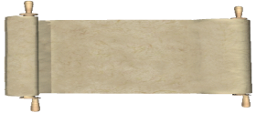
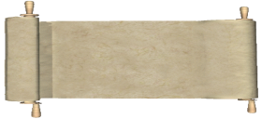
Transposition Rail Fence Cipher
1
FKTTAW
LNESATAKTAN
AATCD
Solve the ciphertext.
Ciphered text
F...K...T...T...A...W.
.L.N.E.S.A.T.A.K.T.A.N
..A...A...T...C...D...
2
Use a rail fence cipher and a key of 3.
3
The clear text message.
FLANK EAST
ATTACK AT DAWN
Clear text

Slide 23
Substitution Cipher
Substitution ciphers substitute one letter for another.
  In their simplest form, substitution ciphers retain the letter frequency of the original message.
Examples include:
  Caesar Cipher
  Vigenère Cipher

Slide 24
Let’s Encode using the Caesar Cipher!
1
The cleartext message.
FLANK EAST
ATTACK AT DAWN
Clear text
2
Encode using a key of 3. Therefore, A becomes a D, B an E, …
A B C D E F G H I J K L M N O P Q R S T U V W X Y Z
A B C D E F G H I J K L M N O P Q R S T U V W X Y Z A B C
3
The encrypted message becomes …
IODQN HDVW
DWWDFN DW GDZQ
Ciphered text

Slide 25
Let’s Decode
1
Solve the ciphertext.
OZ OY IUUR
Ciphered text
2
Use a shift of 6 (ROT6).
A B C D E F G H I J K L M N O P Q R S T U V W X Y Z
A B C D E F G H I J K L M N O P Q R S T U V W X Y Z A B C
D E F G H I J K L M
3
The clear text message.
IT is cool
Clear text

Slide 26
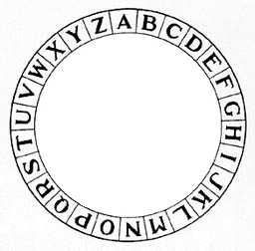
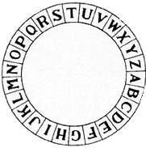
Caesar Cipher Disk
1
FLANK EAST
ATTACK AT DAWN
The clear text message would be encoded using a key of 3.
Clear text
2
Shifting the inner wheel by 3, then the A becomes D, B becomes E, and so on.
3
The clear text message would appear as follows using a key of 3.
IODQN HDVW
DWWDFN DW GDZQ
Ciphered text

Slide 27
Vigenère Cipher
The Vigenère cipher is based on the Caesar cipher, except that it encrypts text by using a different polyalphabetic key shift for every plaintext letter.
  The different key shift is identified using a shared key between sender and receiver.
  The plaintext message can be encrypted and decrypted using the Vigenere Cipher Table.
For example:
  A sender and receiver have a shared secret key: SECRETKEY.
  Sender uses the key to encode: FLANK EAST ATTACK AT DAWN.

Slide 28
Vernam Cipher
In 1917, Gilbert Vernam, an AT&T Bell Labs engineer invented and patented the stream cipher and later co-invented the one-time pad cipher.
  Vernam proposed a teletype cipher in which a prepared key consisting of an arbitrarily long, non-repeating sequence of numbers was kept on paper tape.
  It was then combined character by character with the plaintext message to produce the ciphertext.
  To decipher the ciphertext, the same paper tape key was again combined character by character, producing the plaintext.
Each tape was used only once, hence the name one-time pad.
  As long as the key tape does not repeat or is not reused, this type of cipher is immune to cryptanalytic attack because the available ciphertext does not display the pattern of the key.

Slide 29
Vernam Cipher
Several difficulties are inherent in using one-time pads in the real world.
  Key distribution is challenging.
  Creating random data is challenging and if a key is used more than once, it becomes easier to break.
Computers, because they have a mathematical foundation, are incapable of creating true random data.
RC4 is a one-time pad cipher that is widely used on the Internet.
  However, because the key is generated by a computer, it is not truly random.

Slide 30
Cryptanalysis

Slide 31
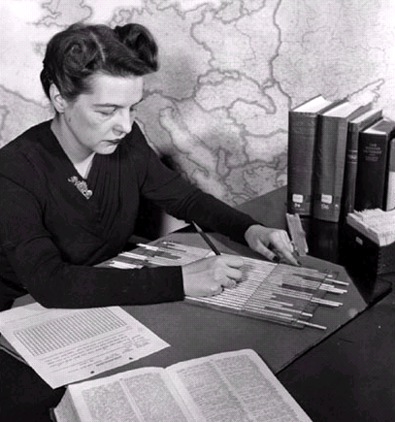
Cryptanalysis
The practice and study of determining the meaning of encrypted information (cracking the code), without access to the shared secret key.
Been around since cryptography.

Slide 32
Cryptanalysis Methods
Brute-Force Method
Ciphertext-Only Method
Known-Plaintext Method
Chosen-Plaintext Method
Chosen-Ciphertext Method
Meet-in-the-Middle Method

Slide 33
Brute-Force Method
An attacker tries every possible key with the decryption algorithm knowing that eventually one of them will work.
  All encryption algorithms are vulnerable to this attack.
The objective of modern cryptographers is to have a keyspace large enough that it takes too much time (money) to accomplish a brute-force attack.
For example: The best way to crack Caesar cipher encrypted code is to use brute force.
  There are only 25 possible rotations.
  Therefore, it is not a big effort to try all possible rotations and see which one returns something that makes sense.

Slide 34
Brute-Force Method
On average, a brute-force attack succeeds about 50 percent of the way through the keyspace, which is the set of all possible keys.
  A DES cracking machine recovered a 56-bit DES key in 22 hours using brute force.
  It is estimated it would take 149 trillion years to crack an AES key using the same method.

Slide 35
Frequency Analysis Method
The English alphabet is used more often than others.
  E, T, and A are the most popular letters.
  J, Q, X, and Z are the least popular.
Caesar ciphered message:
  The letter D appears 6 times.
  The letter W appears 4 times.
  Therefore it is probable that they represent the more popular letters.
In this case, the D represents the letter A, and the W represents the letter T.
IODQN HDVW
DWWDFN DW GDZQ
Ciphered text
FLANK EAST
ATTACK AT DAWN
Clear text

Slide 36
Ciphertext-Only Method
An attacker has:
  The ciphertext of several messages, all of which have been encrypted using the same encryption algorithm, but the attacker has no knowledge of the underlying plaintext.
  The attacker could use statistical analysis to deduce the key.
These kinds of attacks are no longer practical, because modern algorithms produce pseudorandom output that is resistant to statistical analysis.

Slide 37
Known-Plaintext Method
An attacker has:
  Access to the ciphertext of several messages.
  Knowledge (underlying protocol, file type, or some characteristic strings) about the plaintext underlying that ciphertext.
The attacker uses a brute-force attack to try keys until decryption with the correct key produces a meaningful result.
Modern algorithms with enormous keyspaces make it unlikely for this attack to succeed because, on average, an attacker must search through at least half of the keyspace to be successful.

Slide 38
Meet-in-the-Middle Method
The meet-in-the-middle attack is a known plaintext attack.
The attacker knows:
  A portion of the plaintext and the corresponding ciphertext.
The plaintext is encrypted with every possible key, and the results are stored.
  The ciphertext is then decrypted using every key, until one of the results matches one of the stored values.

Slide 39
Chosen-Plaintext Method
An attacker chooses which data the encryption device encrypts and observes the ciphertext output.
  A chosen-plaintext attack is more powerful than a known-plaintext attack because the chosen plaintext might yield more information about the key.
This attack is not very practical because it is often difficult or impossible to capture both the ciphertext and plaintext.

Slide 40
Chosen-Ciphertext Method
An attacker chooses different ciphertext to be decrypted and has access to the decrypted plaintext.
  With the pair, the attacker can search through the keyspace and determine which key decrypts the chosen ciphertext in the captured plaintext.
This attack is analogous to the chosen-plaintext attack.
  Like the chosen-plaintext attack, this attack is not very practical.
  Again, it is difficult or impossible for the attacker to capture both the ciphertext and plaintext.

Slide 41
Cryptology

Slide 42
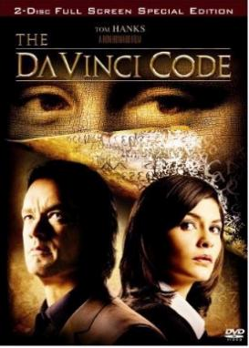


Cryptology in Movies
A murder inside the Louvre and clues in Da Vinci paintings lead to the discovery of a religious mystery protected by a secret society for two thousand years -- which could shake the foundations of Christianity.
A treasure hunter is in hot pursuit of a mythical treasure that has been passed down for centuries, while his employer turned enemy is onto the same path that he's on.
After a brilliant but asocial mathematician accepts secret work in cryptography, his life takes a turn to the nightmarish.

Slide 43
Cryptology = Cryptography + Cryptanalysis
Cryptology is the science of making and breaking secret codes.
  It combines cryptography (development and use of codes), and cryptanalysis, (breaking of those codes).
There is a symbiotic relationship between the two disciplines, because each makes the other one better.
  National security organizations employ members of both disciplines and put them to work against each other.
There have been times when one of the disciplines has been ahead of the other.
  Currently, it is believed that cryptographers have the edge.

Slide 44
Jobs in Cryptology
Ironically, it is impossible to prove an algorithm secure.
  It can only be proven that it is not vulnerable to known cryptanalytic attacks.
There is a need for mathematicians, scholars, and security forensic experts to keep trying to break the encryption methods.
Cryptanalysis are most used employed by:
  Governments in military and diplomatic surveillance.
  Enterprises in testing the strength of security procedures.

Slide 45
Cryptology = Cryptography + Cryptanalysis
There are two kinds of cryptography in the world:
  Cryptography that will stop someone you know from reading your files.
  Cryptography that will stop major governments from reading your files.
This is about the latter.

Slide 46
Cryptology in Networking
Authentication, integrity, and data confidentiality are implemented in many ways using various protocols and algorithms.
  Choice depends on the security level required in the security policy.
Integrity
Authentication
Confidentiality
Common cryptographic hashes, protocols, and algorithms
MD5 (weaker)
SHA (stronger)
HMAC-MD5
HMAC-SHA-1
RSA and DSA
DES (weaker)
3DES
AES (stronger)

Slide 47
Cryptology in Networking
Security of encryption lies in the secrecy of the keys, not the algorithm.
Old encryption algorithms were based on the secrecy of the algorithm to achieve confidentiality.
With modern technology, algorithm secrecy no longer matters since reverse engineering is often simple therefore public-domain algorithms are often used.
  Now, successful decryption requires knowledge of the keys.
How can the keys be kept secret?

Slide 48
Cryptographic Hashes

Slide 49
Cryptographic Hashes
A hash function takes binary data (message), and produces a condensed representation, called a hash.
  The hash is also commonly called a Hash value, Message digest, or Digital fingerprint.
Hashing is based on a one-way mathematical function that is relatively easy to compute, but significantly harder to reverse.
Hashing is designed to verify and ensure:
  Data integrity
  Authentication

Slide 50
Hashes are used …
To provide proof of authenticity when it is used with a symmetric secret authentication key, such as IP Security (IPsec) or routing protocol authentication.
To provide authentication by generating one-time and one-way responses to challenges in authentication protocols such as the PPP CHAP.
To provide a message integrity check proof such as those accepted when accessing a secure site using a browser.
To confirm that a downloaded file (e.g., Cisco IOS images) has not been altered.

Slide 51
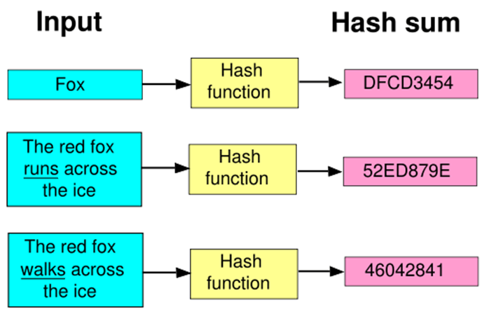
Collision Free
Hashing is collision free which means that two different input values will result in different hash results.

Slide 52

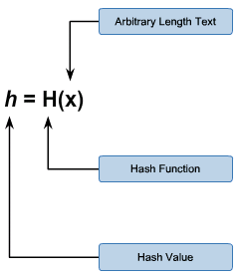
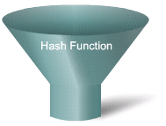

Cryptographic Hash Math
Take an arbitrarily length of clear text data to be hashed.
Put it through a hash function.
It produces a fixed length message digest (hash value).
H(x) is:
  Relatively easy to computer for any given x.
  One way and not reversible.
If a hash function is hard to invert, it is considered a one-way hash.
MD5
SHA-1

Slide 53
Hashing for
Integrity

Slide 54

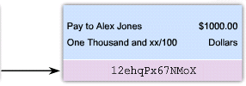
Hash for Integrity
Hash functions (MD5 and SHA-1) can ensure message integrity but not confidentiality.
  For instance, the sender wants to ensure that the message is not altered on its way to the receiver.

Slide 55

Hash for Integrity
The receiving device removes the fingerprint from the message and inputs the message into the same hashing algorithm.
The sending device inputs the message into a hashing algorithm and computes its fixed-length digest or fingerprint.
MD5
SHA-1
MD5
SHA-1
If the resulting hash is equal to the one that is attached to the message, the message has not been altered during transit.
The fingerprint is attached to the message and both are sent to the receiver in plaintext.

Slide 56
Hash for Integrity
Hashing only prevents the message from being changed accidentally, such as by a communication error.
It’s still susceptible to man-in-the-middle attacks.
  A potential attacker could intercept the message, change it, recalculate the hash, and append it to the message.
  There is nothing unique to the sender in the hashing procedure, so anyone can compute a hash for any data, as long as they have the correct hash function.
These are two well-known hash functions:
  Message Digest 5 (MD5) with 128-bit digests
  Secure Hash Algorithm 1 (SHA-1) with 160-bit digests

Slide 57
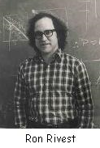
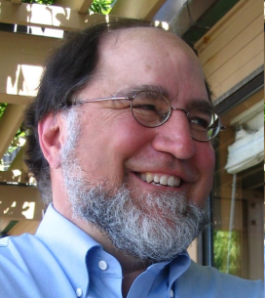
Message Digest 5 (MD5)
The MD5 algorithm was developed by Ron Rivest and is used in a variety of Internet applications today.
  It is a one-way function.
  It is also collision resistant.
MD5 is essentially a complex sequence of simple binary operations, such as exclusive OR (XORs) and rotations, that are performed on input data and produce a 128-bit digest.

Slide 58
Secure Hash Algorithm (SHA)
The U.S. National Institute of Standards and Technology (NIST) developed the Secure Hash Algorithm (SHA).
  SHA-1, published in 1994, corrected an unpublished flaw in SHA.
  It’s very similar to the MD4 and MD5 hash functions.
The SHA-1 algorithm takes a message of less than 2⁶⁴ bits in length and produces a 160-bit message digest.
This makes SHA-1 slightly slower than MD5, but the larger message digest makes it more secure against brute-force collision and inversion attacks.

Slide 59
MD5 versus SHA-1
MD5
SHA-1
Based on MD4
Based on MD4
Computation involves 64 steps
Computation involves 80 steps
Algorithm must process a 128-bit buffer
Algorithm must process a 160-bit buffer
Faster
Slower
Less Secure
More secure

Slide 60
Secure Hash Algorithm (SHA)
NIST published four additional hash functions collectively known as SHA-2 with longer digests:
  SHA-224 (224 bit)
  SHA-256 (256 bit)
  SHA-384 (384 bit)
  SHA-512 (512 bit)
In response to a SHA-1 vulnerability announced in 2005, NIST recommends a transition from SHA-1 to the approved SHA-2 family.
A newer more secure cryptographic hashing algorithm called SHA-3 has been developed by NIST. SHA-3 will eventually replace SHA-1 and SHA-2 and it should be used if available.

Slide 61
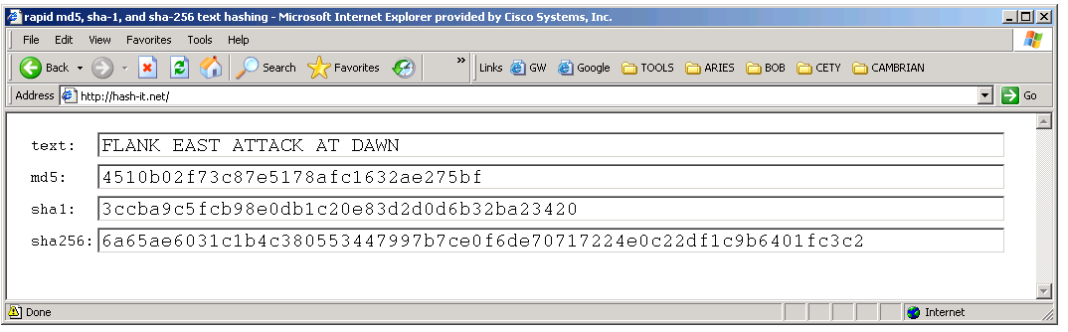
Secure Hash Algorithm (SHA)
SHA-1 and SHA-2 are more resistant to brute-force attacks because their digest is at least 32 bits longer than the MD5 digest.

Slide 62
Hashing for
Authenticity

Slide 63
Keyed-Hash Message Authentication Code
HMAC (or KHMAC) is a message authentication code (MAC) that is calculated using a hash function and a secret key.
  Hash functions are the basis of the protection mechanism of HMACs.
  The output of the hash function now depends on the input data and the secret key.
Authenticity is guaranteed because only the sender and the receiver know the secret key.
  Only they can compute the digest of an HMAC function.
  This characteristic defeats man-in-the-middle attacks and provides authentication of the data origin.

Slide 64
Keyed-Hash Message Authentication Code
The cryptographic strength of the HMAC depends on the:
  Cryptographic strength of the underlying hash function.
  Size and quality of the key.
  Size of the hash output length in bits.
Cisco technologies use two well-known HMAC functions:
  Keyed MD5 or HMAC-MD5 is based on the MD5 hashing algorithm.
  Keyed SHA-1 or HMAC-SHA-1 is based on the SHA-1 hashing algorithm.

Slide 65

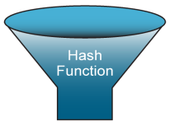

HMAC in Action
Data
Received Data
Pay to Terry Smith $100.00
One Hundred and xx/100 Dollars
Secret
Key
Pay to Terry Smith $100.00
One Hundred and xx/100 Dollars
Secret
Key
HMAC
(Authenticated
Fingerprint)
HMAC
(Authenticated
Fingerprint)
4ehIDx67NMop9
4ehIDx67NMop9
Pay to Terry Smith $100.00
One Hundred and xx/100 Dollars
If the generated HMAC matches the sent HMAC, then integrity and authenticity have been verified.
If they don’t match, discard the message.
4ehIDx67NMop9

Slide 66
HMAC and Cisco Products
Cisco products use hashing for entity authentication, data integrity, and data authenticity purposes.
For example:
  Authenticating routing protocol updates.
  IPsec VPNs use MD5 and SHA-1 in HMAC mode, to provide packet integrity and authenticity.
  IOS images downloaded from Cisco.com have an MD5-based checksum to check the integrity of downloaded images.
  TACACS+ uses an MD5 hash as the key to encrypt the session.

Slide 67
Key Management

Slide 68
Key Management
Often considered the most difficult part of designing a cryptosystem.
There are several essential characteristics of key management to consider:
  Key Generation
  Key Verification
  Key Storage
  Key Exchange
  Key Revocation and destruction

Slide 69
Key Management
Key Generation:
  Caesar to choose the key of his cipher and the Sender/Receiver chose a shared secret key for the Vigenère cipher.
  Modern cryptographic system key generation is usually automated.
Key Verification:
  Almost all cryptographic algorithms have some weak keys that should not be used (e.g., Caesar cipher ROT 0 or ROT 25).
  With the help of key verification procedures, these keys can be regenerated if they occur.
Key Storage:
  Modern cryptographic system store keys in memory.

Slide 70
Key Management
Key Exchange:
  Key management procedures should provide a secure key exchange mechanism over an untrusted medium.
Key Revocation and Destruction:
  Revocation notifies all interested parties that a certain key has been compromised and should no longer be used.
  Destruction erases old keys in a manner that prevents malicious attackers from recovering them.

Slide 71
Key Length and Keyspace
The key length is the measure in bits and the keyspace is the number of possibilities that can be generated by a specific key length.
As key lengths increase, keyspace increases exponentially:
  22 key = a keyspace of 4
  23 key = a keyspace of 8
  24 key = a keyspace of 16
  240 key = a keyspace of 1,099,511,627,776

Slide 72
Keyspace
Adding one bit to a key doubles the keyspace.
For each bit added to the DES key, the attacker would require twice the amount of time to search the keyspace.
Longer keys are more secure but are also more resource intensive and can affect throughput.
DES Key Length | Keyspace | # of Possible Keys
56 bit | 2⁵⁶ | 72,000,000,000,000,000
57 bit | 2⁵⁷ | 144,000,000,000,000,000
58 bit | 2⁵⁸ | 288,000,000,000,000,000
59 bit | 2⁵⁹ | 576,000,000,000,000,000

Slide 73
Types of Cryptographic Keys
Symmetric keys which can be exchanged between two routers supporting a VPN.
Asymmetric keys which are used in secure HTTPS applications.
Digital signatures which are used when connecting to a secure website.
Hash keys which are used in symmetric and asymmetric key generation, digital signatures, and other types of applications.

Slide 74
Protection Provided by Key Type
Symmetric Key
Asymmetric Key
Digital Signature
Hash
Protection up to 3 years
80
1248
160
160
Protection up to 10 years
96
1776
192
192
Protection up to 20 years
112
2432
224
224
Protection up to 30 years
128
3248
256
256
Protection against quantum computers
256
15424
512
512

Slide 75
Encryption = Confidentiality

Slide 76
Symmetric Encryption
Symmetric encryption algorithms, also called shared secret-key algorithms, use the same pre-shared secret key to encrypt and decrypt data.
  The pre-shared key is known by the sender and receiver before any encrypted communications begins.
Because both parties are guarding a shared secret, the encryption algorithms used can have shorter key lengths.
  Shorter key lengths mean faster execution.
For this reason symmetric algorithms are generally much less computationally intensive than asymmetric algorithms.

Slide 77
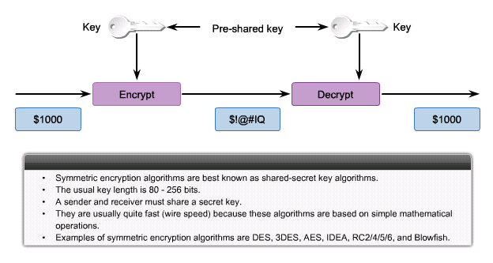
Symmetric Encryption

Slide 78
Asymmetric Encryption
Asymmetric encryption algorithms, also called public key algorithms, use different keys to encrypt and decrypt data.
Secure messages can be exchanged without having to have a pre-shared key.
Because both parties do not have a shared secret, very long key lengths must be used to thwart attackers.
  These algorithms are resource intensive and slower to execute.
In practice, asymmetric algorithms are typically 100 to 1,000 times slower than symmetric algorithms.

Slide 79
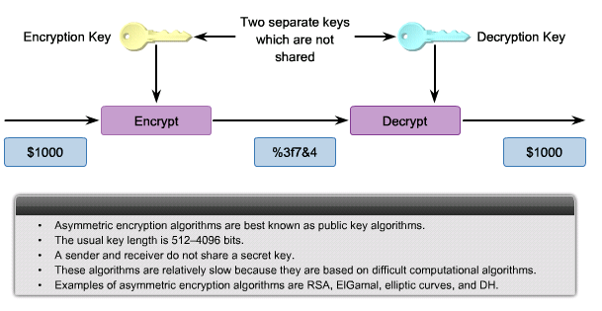
Asymmetric Encryption

Slide 80
Symmetric Algorithms

Slide 81
Symmetric Encryption
Symmetric, or secret key, encryption is the most commonly used form of cryptography, because the shorter key length increases the speed of execution.
  Symmetric key algorithms are based on simple mathematical operations that can easily be accelerated by hardware.
  Symmetric encryption is often used for wire-speed encryption in data networks and to provide bulk encryption when data privacy is required, such as to protect a VPN.

Slide 82
Symmetric Key Management
Key management can be a challenge since the encryption and decryption keys are the same.
The security of a symmetric algorithm rests in the secrecy of the symmetric key.
  By obtaining the key, anyone can encrypt and decrypt messages.
  Sender and receiver must exchange the secret key using a secure channel before any encryption can occur.

Slide 83
Symmetric Key Management
Well-known encryption algorithms that use symmetric keys including:
  DES
  3DES
  AES
  Software Encryption Algorithm (SEAL)
  Rivest ciphers (RC) series (RC2, RC4, RC5, and RC6)
Other symmetric encryption algorithms include Blowfish, Twofish, Threefish, and Serpent.
  However, these protocols are either not supported on Cisco platforms or have yet to gain wide acceptance.

Slide 84
Symmetric Encryption Algorithms
Symmetric Encryption Algorithm | Key length (in bits) | Description
DES | 56 | Designed at IBM during the 1970s and adopted as the NIST standard until 1997. Although considered outdated, DES remains widely in use. DES was designed to be implemented only in hardware, and is therefore extremely slow in software.
3DES | 112 and 168 | Based on using DES three times which means that the input data is encrypted three times and therefore considered much stronger than DES. However, it is rather slow compared to some new block ciphers such as AES.
AES | 128, 192, and 256 | AES is fast in both software and hardware, is relatively easy to implement, and requires little memory. As a new encryption standard, it is currently being deployed on a large scale.
Software Encryption Algorithm (SEAL) | 160 | SEAL is an alternative algorithm to DES, 3DES, and AES. It uses a 160-bit encryption key and has a lower impact to the CPU when compared to other software-based algorithms.
The RC series | RC2 (40 and 64) RC4 (1 to 256) RC5 (0 to 2040) RC6 (128, 192, and 256) | RC algorithms are a set of symmetric-key encryption algorithms invented by Ron Rivest. RC1 was never published and RC3 was broken before ever being used. RC4 is the world's most widely used stream cipher. RC6, a 128-bit block cipher based heavily on RC5, was an AES finalist developed in 1997.

Slide 85
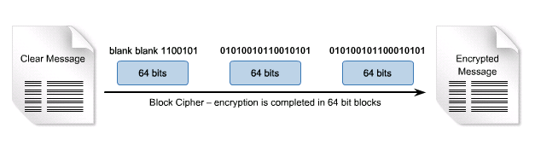
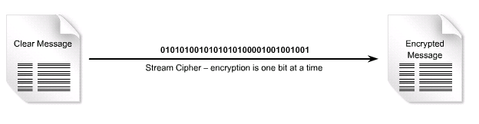
Symmetric Encryption Techniques
There are two types of encryption method used:
  Block Ciphers
  Stream Ciphers

Slide 86
Block Ciphers
Block ciphers transform a fixed-length block of plaintext into a common block of ciphertext of 64 or 128 bits.
  Block size refers to how much data is encrypted at any one time.
  The key length refers to the size of the encryption key that is used.
  This ciphertext is decrypted by applying the reverse transformation to the ciphertext block, using the same secret key.
Common block ciphers include:
  DES with a 64-bit block size
  AES with a 128-bit block size
  RSA with a variable block size

Slide 87
Stream Ciphers
Stream ciphers encrypt plaintext one byte or one bit at a time.
  Think of it like a block cipher with a block size of one bit.
  The Vigenère cipher is an example of a stream cipher.
  Can be much faster than block ciphers, and generally do not increase the message size.
Common stream ciphers include:
  A5 used to encrypt GSM cell phone communications.
  RC4 cipher.
  DES can also be used in stream cipher mode.

Slide 88
How to Choose an Encryption Algorithm?
Is the algorithm trusted by the cryptographic community?
  Algorithms that have been resisting attacks for a number of years are preferred.
Does the algorithm adequately protects against brute-force attacks?
  With the appropriate key lengths, these attacks are usually considered unfeasible.
Does the algorithm support variable and long key lengths?
Does the algorithm have export or import restrictions?

Slide 89
How to Choose an Encryption Algorithm?
DES
3DES
AES
Is the algorithm trusted by the cryptographic community?
Been replaced by 3DES
Yes
Verdict is still out
Does the algorithm adequately protect against brute-force attacks?
No
Yes
Yes

Slide 90
Data Encryption Standard (DES)
The most popular symmetric encryption standards.
  Developed by IBM
  Thought to be unbreakable in the 1970s
  Shared keys enable the encryption and decryption
DES converts blocks of 64-bits of clear text into ciphertext by using an encryption algorithm.
  The decryption algorithm on the remote end restores ciphertext to clear text.

Slide 91
DES Scorecard
Description
Data Encryption Standard
Timeline
Standardized 1976
Type of Algorithm
Symmetric
Key size (in bits)
56 bits
Speed
Medium
Time to crack
(Assuming a computer could try 255 keys per second)
Days (6.4 days by the COPACABANA machine, a specialized cracking device)
Resource Consumption
Medium

Slide 92
DES Security Rating
Because of its short key length, DES is considered a good protocol to protect data for a very short time.
  3DES is a better choice to protect data because it has an algorithm that is very trusted and has higher security strength.
Recommendations:
  Change keys frequently to help prevent brute-force attacks.
  Use a secure channel to communicate the DES key from the sender to the receiver.

Slide 93
Triple DES (3DES or TDES)
3DES is 256 times stronger than DES.
It takes a 64-bit block of data and performs three DES operations in sequence:
  Encrypts, decrypts, and encrypts.
  Requires additional processing time.
  Can use 1, 2, or 3 different keys (when used with only one key, it is the same as DES).
3DES software is subject to US export laws.

Slide 94
3DES Scorecard
Description
Triple Data Encryption Standard
Timeline
Standardized 1977
Type of Algorithm
Symmetric
Key size (in bits)
112 and 168 bits
Speed
Low
Time to crack
(Assuming a computer could try 255 keys per second)
4.6 Billion years with current technology
Resource Consumption
Medium

Slide 95
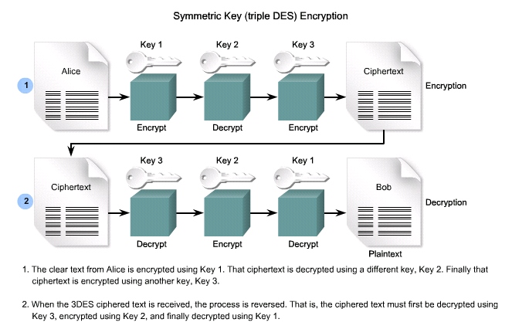
3DES
3DES Scorecard

Slide 96
3DES Security Rating
Although 3DES is very secure, it is also very resource intensive and for this reason the AES encryption algorithm was developed.
  AES has proven to be as secure as 3DES, but with much faster results.

Slide 97
Advanced Encryption Standard (AES)
AES is an extremely secure Federal Information Processing Standard (FIPS)-approved cryptographic algorithm.
  Based on the Rijndael (“Rhine dahl”) algorithm.
  It use keys with a length of 128, 192, or 256 bits to encrypt blocks with a length of 128, 192, or 256 bits.
    All 9 combinations of key length and block length are possible.
AES is now available in the latest Cisco router images that have IPsec DES/3DES functionality.

Slide 98
AES Scorecard
Description
Advanced Encryption Standard
Timeline
Official Standard since 2001
Type of Algorithm
Symmetric
Key size (in bits)
128, 192, and 256
Speed
High
Time to crack
(Assuming a computer could try 255 keys per second)
149 Trillion years
Resource Consumption
Low
Notes:
More Information: For more information on AES, go to http://www.nist.gov/aes. Also, in 2008, the NIST held a similar competition to develop a new SHA version, SHA-3. For more information, refer to http://csrc.nist.gov/groups/ST/hash/sha-3/index.html.

Slide 99
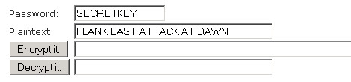
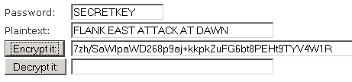
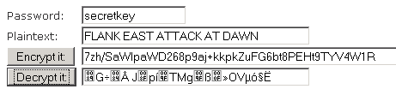
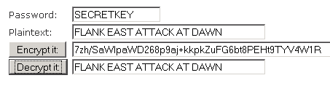
AES Example
In this example, the SECRETKEY key and plaintext are entered.
They are now encrypted using 128 AES.
An attempt at deciphering the text using a lowercase, and incorrect key.
A second attempt at deciphering the text using the correct key displays the original plaintext.

Slide 100
AES
AES was chosen to replace DES for a number of reasons:
  The key length of AES makes the key much stronger than DES.
  AES runs faster than 3DES on comparable hardware.
  AES is more efficient than DES and 3DES on comparable hardware, usually by a factor of five when it is compared with DES.
  AES is more suitable for high-throughput, low-latency environments, especially if pure software encryption is used.
However, AES is a relatively young algorithm and the golden rule of cryptography states that a mature algorithm is always more trusted.
3DES is therefore a more trusted choice in terms of strength, because it has been tested and analyzed for 35 years.

Slide 101
Software-optimized Encryption Algorithm (SEAL)
The Software-optimized Encryption Algorithm (SEAL) is an alternative algorithm to software-based DES, 3DES, and AES.
  Designed in 1993, it is a stream cipher that uses a 160-bit encryption key.
  Because it is a stream cipher, data to be encrypted is continuously encrypted and, therefore, much faster than block ciphers.
  However, it has a longer initialization phase during which a large set of tables is created using SHA.
SEAL has a lower impact on the CPU compared to other software-based algorithms.
  SEAL support was added to Cisco IOS Software Release 12.3(7)T.

Slide 102
SEAL Scorecard
Description
Software-Optimized Encryption Algorithm
Timeline
First published in 1994. Current version is 3.0 (1997)
Type of Algorithm
Symmetric
Key size (in bits)
160
Speed
High
Time to crack
(Assuming a computer could try 255 keys per second)
Unknown but considered very safe
Resource Consumption
Low

Slide 103
RC Algorithms
The RC algorithms were designed all or in part by Ronald Rivest, who also invented MD5.
The RC algorithms are widely deployed in many networking applications because of their favorable speed and variable key-length capabilities.
There are several variation of RC algorithms including:
  RC2
  RC4
  RC5
  RC6

Slide 104
Ron’s Code or Rivest Codes Scorecard
Description
RC2
RC4
RC5
RC6
Timeline
1987
1987
1994
1998
Type of Algorithm
Block cipher
Stream cipher
Block cipher
Block cipher
Key size (in bits)
40 and 64
1 - 256
0 to 2040 bits (128 suggested)
128, 192, or 256
Use
Variable key-size block cipher that was designed as a "drop-in" replacement for DES.
Most widely used stream cipher based on a variable key-size Vernam stream cipher.
It is often used in file encryption products and secure communications, such as within SSL.
The cipher can be expected to run very quickly in software and is considered secure.
A fast block cipher that has a variable block size and key size.
It can be used as a drop-in replacement for DES if the block size is set to 64-bit.
An AES finalist (Rijndael won).
A 128-bit to 256- bit block cipher that was designed by Rivest, Sidney, and Yin and is based on RC5.
Its main design goal was to meet the requirement of AES.

Slide 105
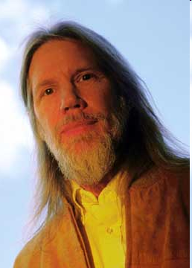
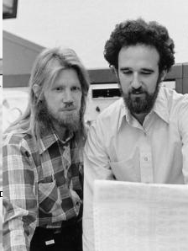
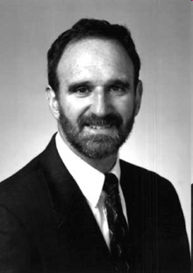
Diffie-Hellman (DH)
DH is an asymmetric cryptographic protocol that allows two parties that have no prior knowledge of each other to jointly establish a shared secret key over an insecure communications channel.
  This key can then be used to encrypt subsequent communications using a symmetric key cipher.
Published by Whitfield Diffie and Martin Hellman in 1976.

Slide 106
DH
DH is commonly used when data is exchanged using an IPsec VPN, data is encrypted on the Internet using either SSL or TLS, or when SSH data is exchanged.
It is not an encryption mechanism and is not typically used to encrypt data because it is extremely slow for any sort of bulk encryption.
This is why it is common to encrypt the bulk of the traffic using a symmetric algorithm and use the DH algorithm to create keys that will be used by the encryption algorithm.

Slide 107
DH Scorecard
Description
Diffie-Hellman Algorithm
Timeline
1976
Type of Algorithm
Asymmetric
Key size (in bits)
512, 1024, 2048
Speed
Slow
Time to crack
(Assuming a computer could try 255 keys per second)
Unknown but considered very safe
Resource Consumption
Medium

Slide 108
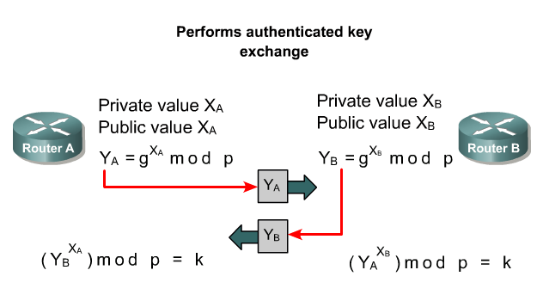
Diffie-Hellman Algorithm

Slide 109

Alice and Bob DH Key Exchange
Alice
Bob
Shared
Secret
Calc
Shared
Secret
Calc
5, 23
5, 23
6
5⁶mod 23 = 8
Bob and Alice agree to use a base number g=5 and prime number p=23.
Alice chooses a secret integer a=6.
Alice sends Bob (gª mod p) or 5⁶ mod 23 = 8.

Slide 110
Modulo
In computing, the modulo operation finds the remainder of division of one number by another.
Given two numbers, X and Y, a modulo N (abbreviated as a mod N) is the remainder, on division of a by N.
For instance:
  "8 mod 3" would evaluate to 2.
  "9 mod 3" would evaluate to 0.

Slide 111
Alice and Bob DH Key Exchange
Alice
Bob
Shared
Secret
Calc
Shared
Secret
Calc
5, 23
5, 23
6
5⁶mod 23 = 8
15
5¹⁵mod 23 = 19
19⁶mod 23 = 2
8¹⁵mod 23 = 2
Meanwhile Bob chooses a secret integer b=15.
Bob sends Alice (gª mod p) or 5¹⁵ mod 23 = 19.
Alice computes (xª mod p) or 19⁶ mod 23 = 2.
Bob computes (xª mod p) or 8⁶ mod 23 = 2.

Slide 112
Alice and Bob DH Key Exchange
Alice
Bob
Shared
Secret
Calc
Shared
Secret
Calc
5, 23
5, 23
6
5⁶mod 23 = 8
15
5¹⁵mod 23 = 19
19⁶mod 23 = 2
8¹⁵mod 23 = 2
The result (2) is the same for both Alice and Bob.
They will now use this as the secret key for encryption.

Slide 113
Alice and Bob DH Key Exchange
BTW:
  The initial secret integer used by Alice (6) and Bob (15) are very, very large numbers (1024 bits).
  8 bits = 10101010
  1024 bits =
101010101010101010101010101010101010101010101010101010101010101010101010101010101010
101010101010101010101010101010101010101010101010101010101010101010101010101010101010
101010101010101010101010101010101010101010101010101010101010101010101010101010101010
101010101010101010101010101010101010101010101010101010101010101010101010101010101010
101010101010101010101010101010101010101010101010101010101010101010101010101010101010
101010101010101010101010101010101010101010101010101010101010101010101010101010101010
101010101010101010101010101010101010101010101010101010101010101010101010101010101010
101010101010101010101010101010101010101010101010101010101010101010101010101010101010
101010101010101010101010101010101010101010101010101010101010101010101010101010101010
101010101010101010101010101010101010101010101010101010101010101010101010101010101010
101010101010101010101010101010101010101010101010101010101010101010101010101010101010
101010101010101010101010101010101010101010101010101010101010101010101010101010101010
101010101010101010101010101010101010101010101010101010101010101010101010101010101010
101010101010101010101010101010101010101010101010101010101010101010101010101010101010
101010101010101010101010101010101010101010101010101010101010101010101010101010101010
101010101010101010101010101010101010101010101010101010101010101010101010101010101010
1010101010101010101010101010101010101010101010101010101010101010

Slide 114
Public Key Cryptography

Slide 115
Public-key Algorithms
Public-key algorithms are asymmetric algorithms based on the use of two different keys instead of one.
  Private key: This key must be know only by its owner.
  Public key: This key is known to everyone (it is public).
The key that is used for encryption is different from the key that is used for decryption.
  However, the decryption key cannot, in any reasonable amount of time, be calculated from the encryption key and vice versa.
Public-key systems have a clear advantage over symmetric algorithms:
  There is no need to agree on a common key for both the sender and the receiver.

Slide 116
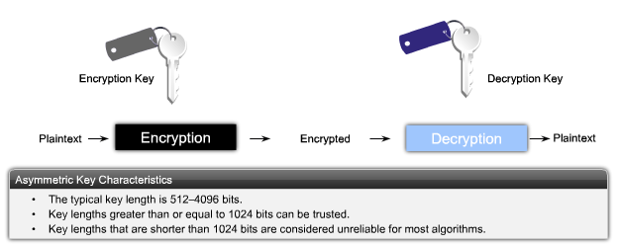
Fundamental Concept
Either key can be used for encryption but the complementary matched key is required for decryption.
  If a public key encrypts data, the matching private key decrypts data.
  If a private key encrypts data, the matching public key decrypts data.

Slide 117
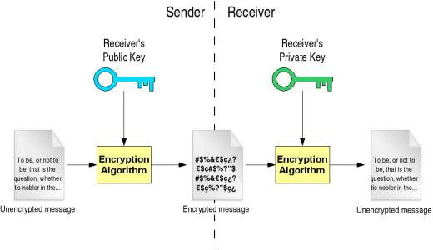
Process
Sender encrypts the message using the receiver's public key.
  Remember that this key is known to everyone.
The encrypted message is sent to the receiving end, who will decrypt the message with his private key.
  Only the receiver can decrypt the message because no one else has the private key.

Slide 118
CIA
This process enables asymmetric algorithms to achieve:
  Confidentiality
  Integrity
  Authentication
Authentication = Private Key (Encrypt) + Public Key (Decrypt)
Confidentiality = Public Key (Decrypt) + Private Key (Encrypt)

Slide 119
Authentication
Authentication is achieved when the encryption process is started with the private key.
  The corresponding public key must be used to decrypt the data.
Since only one host has the private key, only that host could have encrypted the message, providing authentication of the sender.

Slide 120


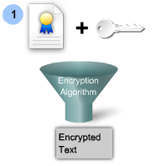

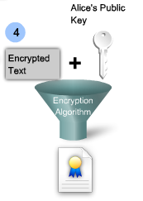


Asymmetric Algorithms for Authentication
1. Alice encrypts a message with her private key.
2. Alice transmits the encrypted message to Bob.
3. To verify that the message actually came from Alice, Bob requests and acquires Alice’s public key.
4. Bob uses the public key to successfully decrypt the message and authenticate that the message did, indeed, come from Alice.

Slide 121
Confidentiality
Confidentiality is achieved when the encryption process is started with the public key.
When the public key is used to encrypt the data, the private key must be used to decrypt the data.
  Only one host has the private key guaranteeing confidentiality.

Slide 122

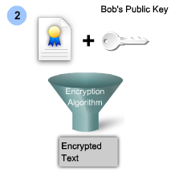
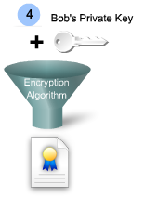
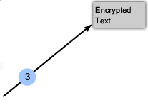
Asymmetric Algorithms for Confidentiality
Alice asks Bob for his public key and Bob sends it to her.
2. Alice uses Bob’s public key to encrypt a message using an agreed-upon algorithm.
3. Alice sends the encrypted message to Bob.
4. Bob uses his private key to decrypt and reveal the message.

Slide 123
Combining Authentication and Confidentiality
To provide confidentiality, authentication and integrity, the combination of two phases is necessary.
  Phase 1 - Confidentiality
  Phase 2 - Authentication

Slide 124
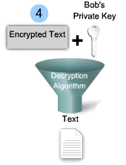
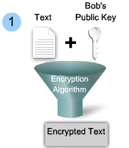
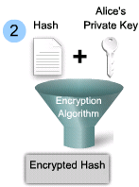
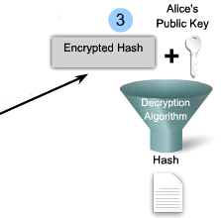

Combining Authentication and Confidentiality
Alice encrypts a message using Bob’s public key.
2. Alice encrypts a hash of the message using her private key.
3. Bob uses Alice’s public key to decrypt and reveal the hash.
4. Bob uses his private key to decrypt and reveal the message.

Slide 125
Asymmetric Key Algorithms
Well-known asymmetric key algorithms:
  Diffie-Hellman
  Digital Signature Standard (DSS), which incorporates the Digital Signature Algorithm
  RSA encryption algorithms
  ElGamal
  Elliptical curve techniques

Slide 126
Asymmetric Encryption Algorithms
Algorithm | Key length (in bits) | Description
Diffie-Hellman (DH) | 512, 1024, 2048 | Public key algorithm invented in 1976 by Whitfield Diffie and Martin Hellman that allows two parties to agree on a key that they can use to encrypt messages. Security depends on the assumption that it is easy to raise a number to a certain power, but difficult to compute which power was used given the number and the outcome.
Digital Signature Standard (DSS) and Digital Signature Algorithm (DSA) | 512 - 1024 | Created by NIST and specifies DSA as the algorithm for digital signatures. DSA is a public key algorithm based on the ElGamal signature scheme. Signature creation speed is similar with RSA, but is 10 to 40 times as slow for verification.
RSA encryption algorithms | 512 to 2048 | Developed by Ron Rivest, Adi Shamir, and Leonard Adleman at MIT in 1977. It is an algorithm for public-key cryptography based on the difficulty of factoring very large numbers. It is the first algorithm known to be suitable for signing as well as encryption, and one of the first great advances in public key cryptography. Widely used in electronic commerce protocols, and is believed to be secure given sufficiently long keys and the use of up-to-date implementations.
EIGamal | 512 - 1024 | An asymmetric key encryption algorithm for public-key cryptography which is based on the Diffie-Hellman key agreement. Developed in 1984 and used in GNU Privacy Guard software, PGP, and other cryptosystems. A disadvantage is that the encrypted message becomes very big, about twice the size of the original message and for this reason it is only used for small messages such as secret keys.
Elliptical curve techniques | 160 | Elliptic curve cryptography was invented by Neil Koblitz in 1987 and by Victor Miller in 1986. Can be used to adapt many cryptographic algorithms, such as Diffie-Hellman or ElGamal. The main advantage of elliptic curve cryptography is that the keys can be much smaller.

Slide 127
Asymmetric Key Algorithms
Although the mathematics differ with each algorithm, they all share one trait in that the calculations required are complicated.
Design is based on factoring extremely large numbers or computing discrete logarithms of extremely large numbers.
  As a result, computation takes more time for asymmetric algorithms.
  Can be up to 1,000 times slower than symmetric algorithms.
Because they lack speed, they are typically used in low-volume cryptographic mechanisms.

Slide 128
Key Lengths
Typical key lengths for asymmetric algorithms range from 512 to 4096 bits.
  Key lengths >= 1024 bits Considered to be trustworthy
  Key lengths < 1024 bits Considered unreliable
Do not compare asymmetric and symmetric algorithms because they’re underlying designs differ greatly.
  For example:
    2048-bit encryption key of RSA is roughly equivalent to a 128-bit key of RC4 in terms of resistance against brute-force attacks.

Slide 129
Digital Signatures

Slide 130
Digital Signatures Security Services
Authenticity of digitally signed data:
  Digital signatures authenticate a source, proving that a certain party has seen and signed the data in question.
Integrity of digitally signed data:
  Digital signatures guarantee that the data has not changed from the time it was signed.
Nonrepudiation of the transaction:
  The recipient can take the data to a third party, and the third party accepts the digital signature as a proof that this data exchange did take place.
  The signing party cannot repudiate that it has signed the data.

Slide 131
Digital Signatures
Digital signatures are often used in the following situations:
  To provide a unique proof of data source, which can only be generated by a single party, such as contract signing in e-commerce environments.
  To authenticate a user by using the private key of that user and the signature it generates.
  To prove the authenticity and integrity of PKI certificates.
  To provide nonrepudiation using a secure timestamp and a trusted time source.
    Each party has a unique, secret signature key, which is not shared with any other party, making nonrepudiation possible.

Slide 132
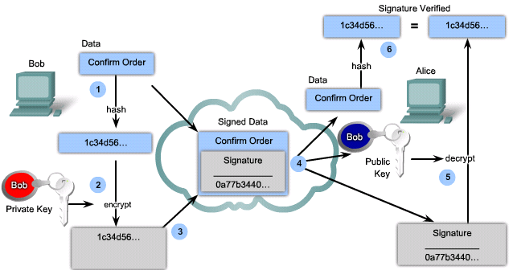
Digital Signatures
Bob creates a hash of the document.
2. Bob encrypts the hash with the private key.
3. The encrypted hash, known as the signature, is appended to the document.
4. Alice accepts the document with the digital signature and obtains Bob’s public key.
5. Alice decrypts the signature using Bob’s public key to unveil the assumed hash value.
6. Alice calculates the hash of the received document, without its signature, and compares this hash to the decrypted signature hash and if the hashes match = document is authentic.

Slide 133

Code Signing
Digital signatures are commonly used for code signing:
  Provide assurance of the authenticity and integrity of software codes.
  The executable files, or possibly the entire installation package of a program, are wrapped with a digitally signed envelope, which allows the end user to verify the signature before installing the software.

Slide 134
Digital Signing
Well-known asymmetric algorithms, such as RSA or Digital Signature Algorithm (DSA), are typically used to perform digital signing.
In 1994, the U.S. NIST selected the DSA as the Digital Signature Standard (DSS).
  DSA is based on the discrete logarithm problem and can only provide digital signatures.
A network administrator must decide whether RSA or DSA is more appropriate for a given situation.
  DSA signature generation is faster than DSA signature verification.
  RSA signature verification is much faster than signature generation.

Slide 135
DSA Scorecard
Description
Digital Signature Algorithm (DSA)
Timeline
1994
Type of Algorithm
Provides digital signatures
Advantages
Signature generation is fast
Disadvantages
Signature verification is slow

Slide 136
RSA Scorecard
Description
Ron Rivest, Adi Shamir, and Len Adleman
Timeline
1977
Type of Algorithm
Asymmetric algorithm
Key size (in bits)
512 - 2048
Advantages
Signature verification is fast
Disadvantages
Signature generation is slow
Notes:
More Information: For a demonstration of the RSA algorithm refer to http://www.securecottage.com/demo/rsa2.html

Slide 137
PKI

Slide 138
PKI
PKI is the service framework needed to support large-scale public key-based technologies.
  Very scalable solutions which is an extremely important authentication solution for VPNs.
PKI is a set of technical, organizational, and legal components that are needed to establish a system that enables large-scale use of public key cryptography to provide authenticity, confidentiality, integrity, and nonrepudiation services.
  The PKI framework consists of the hardware, software, people, policies, and procedures needed to create, manage, store, distribute, and revoke digital certificates.

Slide 139
PKI Terms
Certificates:
  Published public information containing the binding between the names and public keys of entities.
Certificate authority:
  A trusted third-party entity that issues certificates.
  The certificate of a user is always signed by a CA.
  Every CA also has a certificate containing its public key, signed by itself.
  This is called a CA certificate or, more properly, a self-signed CA certificate.

Slide 140






Vendors Certificate
http://www.verisign.com
http://www.entrust.com
http://www.verizonbusiness.com/
http://www.novell.com
http://www.microsoft.com
http://www.rsa.com/

Slide 141

PKI Example

Slide 142
PKI Standards

Slide 143


Current Status
Interoperability between different PKI vendors is still an issue.
To address this interoperability concern, the IETF formed the Public-Key Infrastructure X.509 (PKIX) workgroup, that is dedicated to promoting and standardizing PKI in the Internet.
This workgroup has published a draft set of standards, X.509, detailing common data formats and PKI-related protocols in a network.
X.509

Slide 144

X.509v3
Defines basic PKI formats such as the certificate and certificate revocation list (CRL) format to enable basic interoperability.
Widely used for years:
  Secure web servers: SSL and TLS
  Web browsers: SSL and TLS
  Email programs: S/MIME
  IPsec VPN: IKE

Slide 145
PKCS
The Public-Key Cryptography Standards (PKCS) refers to a group of Public Key Cryptography Standards devised and published by RSA Laboratories.
  PKCS provides basic interoperability of applications that use public-key cryptography.
  PKCS defines the low-level formats for the secure exchange of arbitrary data, such as an encrypted piece of data or a signed piece of data.

Slide 146
PKI Standards
PKCS #1: RSA Cryptography Standard
PKCS #3: DH Key Agreement Standard
PKCS #5: Password-Based Cryptography Standard
PKCS #6: Extended-Certificate Syntax Standard
PKCS #7: Cryptographic Message Syntax Standard
PKCS #8: Private-Key Information Syntax Standard
PKCS #10: Certification Request Syntax Standard
PKCS #12: Personal Information Exchange Syntax Standard
PKCS #13: Elliptic Curve Cryptography Standard
PKCS #15: Cryptographic Token Information Format Standard

Slide 147
SCEP
The IETF designed the Simple Certificate Enrollment Protocol (SCEP) to make issuing and revocation of digital certificates as scalable as possible.
The goal of SCEP is to support the secure issuance of certificates to network devices in a scalable manner using existing technology whenever possible.

Slide 148
Certificate Authorities

Slide 149
Level of Trust
PKIs can form different topologies of trust, including:
  Single-root PKI topologies
  Hierarchical CA topologies
  Cross-certified CA topologies

Slide 150

Single-Root PKI Topology (Root CA)

Slide 151

Hierarchical CA Topology

Slide 152

Cross-certified CA Topology

Slide 153
PKI Enrollment Process
The issuing CA may be a:
  Root CA (the top-level CA in the hierarchy)
  Subordinate CA
The PKI might employ registration authorities (RAs) to accept requests for enrollment in the PKI.
  This reduces the burden on CAs in an environment that supports a large number of certificate transactions or where the CA is offline.

Slide 154

PKI Enrollment Process

Slide 155
PKI Enrollment Process
Usually tasks offloaded to an RA:
  Authentication of users when they enroll with the PKI.
  Key generation for users that cannot generate their own keys.
  Distribution of certificates after enrollment.
Additional tasks include:
  Verifying user identity.
  Establishing passwords for certificate management transactions.
  Submitting enrollment requests to the CA.
  Handling certificate revocation and re-enrollment.

Slide 156
CA Authentication Procedure
The first step of the user is to securely obtain a copy of the public key of the CA.
  The public key verifies all the certificates issued by the CA and is vital for the proper operation of the PKI.
The public key, called the self-signed certificate, is also distributed in the form of a certificate issued by the CA itself.
Only a root CA issues self-signed certificates.

Slide 157






CA Authentication Procedure
2
2
1
CA
Certificate
CA
Certificate
1
3
3
Alice and Bob request the CA certificate that contains the CA public key.
Upon receipt of the CA certificate, each system (of Alice and Bob) verifies the validity of the certificate using public key cryptography.
Alice and Bob follow up the technical verification done by their system by telephoning the CA administrator and verifying the public key and serial number of the certificate.

Slide 158
CA Authentication Retrieval
3
3
1
CA
Certificate
CA
Certificate
1
2
2
Alice and Bob forward a certificate request which includes their public key along and information that is encrypted using the public key of the CA.
2. Upon receipt of the certificate requests, the CA administrator telephones Alice and Bob to confirm their submittal and the public key and issues the certificate by adding some additional data to the certificate request, and digitally signing it all.
3. Either the end user manually retrieves the certificate or SCEP automatically retrieves the certificate, and the certificate is installed onto the system.

Slide 159


