Slide 1
Implementing Intrusion Prevention

Slide 2
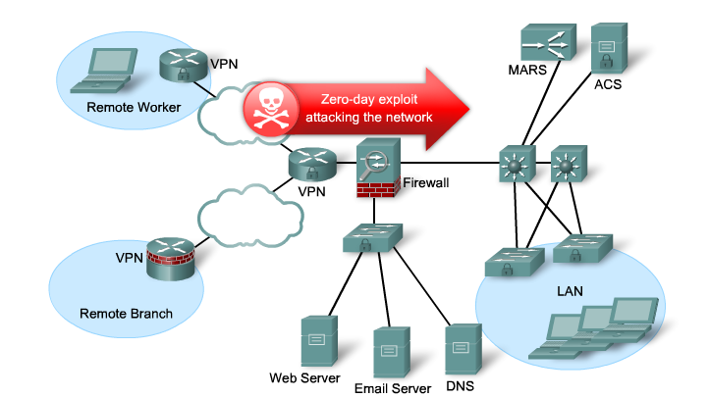
Zero-Day Exploits
Worms and viruses can spread across the world in minutes.
  Zero-day attack (zero-day threat), is a computer attack that tries to exploit software vulnerabilities.
  Zero-hour describes the moment when the exploit is discovered.

Slide 3
Zero-Day Exploits
How does an organization stop zero-day attacks?
  Firewalls can’t!
Firewalls do not stop malware or zero-day attacks.

Slide 4
How do you protect your computer?
Do you constantly:
  Sit there looking at Task Manager for nefarious processes?
  Look at the Event Viewer logs looking for anything suspicious?
You rely on anti-virus software and firewall features.

Slide 5
How do you protect a network?
Have someone continuously monitor the network and analyze log files.
Obviously the solution is not very scalable.
  Manually analyzing log file information is a time-consuming task.
  It provides a limited view of the attacks being launched.
  By the time that the logs are analyzed, the attack has already begun.

Slide 6
Solutions
Networks must be able to instantly recognize and mitigate worm and virus threats.
Two solution has evolved:
  Intrusion Detection Systems (IDS)  First generation
  Intrusion Prevention Systems (IPS)  Second generation
IDS and IPS technologies use sets of rules, called signatures, to detect typical intrusive activity.

Slide 7
IDS and IPS Sensors
IDS and IPS technology are deployed as a sensor in:
  A router configured with Cisco IOS IPS Software.
  A network module installed in router, an ASA, or a Catalyst switch.
  An appliance specifically designed to provide dedicated IDS or IPS services.
  Host software running on individual clients and servers.
Note:
  Some confusion can arise when discussing IPS.
  There are many ways to deploy it and every method differs slightly from the other.
  The focus of this chapter is on Cisco IOS IPS Software.
Notes:
4

Slide 8
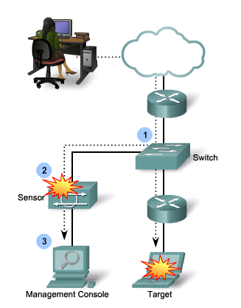
Intrusion Detection System
An IDS monitors traffic offline and generates an alert (log) when it detects malicious traffic including:
  Reconnaissance attacks
  Access attacks
  Denial of Service attacks
It is a passive device because it analyzes copies of the traffic stream traffic.
  Only requires a promiscuous interface.
  Does not slow network traffic.
  Allows some malicious traffic into the network.
Notes:
The intrusion detection system (IDS) is a software- or hardware-based solution that passively listens to network traffic. The IDS is not in the traffic path, but listens promiscuously to all traffic on the network. Typically, only one promiscuous interface is required for network monitoring. Additional promiscuous interfaces can be used to monitor multiple networks. When the IDS detects malicious traffic, the IDS sends an alert to the management station.
The IDS has limited active response capabilities. When configured, the IDS can block further malicious traffic by actively configuring network devices (for example, security appliances or routers) in response to malicious traffic detection. However, the original malicious traffic has already passed through the network to the intended destination and cannot be blocked. Only subsequent traffic will be blocked. The IDS also has the capability of sending a TCP reset to the end host to terminate any malicious TCP connections.

Slide 9
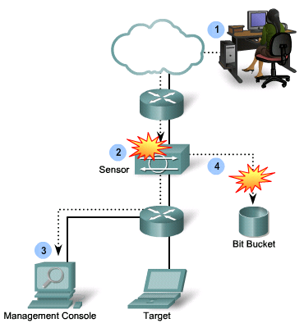
Intrusion Prevention System
It builds upon IDS technology to detect attacks.
  However, it can also immediately address the threat.
An IPS is an active device because all traffic must pass through it.
  Referred to as “inline-mode”, it works inline in real time to monitor Layer 2 through Layer 7 traffic and content.
  It can also stop single-packet attacks from reaching the target system (IDS cannot).

Slide 10
Intrusion Prevention
The ability to stop attacks against the network and provide the following active defense mechanisms:
  Detection – Identifies malicious attacks on network and host resources.
  Prevention – Stops the detected attack from executing.
  Reaction – Immunizes the system from future attacks from a malicious source.
Either technology can be implemented at a network level, host level, or both for maximum protection.

Slide 11
Comparing IDS and IPS Solutions
 | IDS (Promiscuous Mode) | IPS (Inline Mode)
Advantages | No impact on network (latency, jitter). No network impact if there is a sensor failure or a sensor overload. | Stops trigger packets. Can use stream normalization techniques.
Disadvantages | Response action cannot stop trigger packets. Correct tuning required for response actions. More vulnerable to network evasion techniques. | Some impact on network (latency, jitter). Sensor failure or overloading impacts the network.

Slide 12
Which should be implemented?
The technologies are not mutually exclusive.
IDS and IPS technologies can complement each other.
  For example, an IDS can be implemented to validate IPS operation, because IDS can be configured for deeper packet inspection offline allowing the IPS to focus on fewer but more critical traffic patterns inline.
Deciding which implementation is used should be based on the security goals stated in the network security policy.

Slide 13
Network-Based IPS

Slide 14
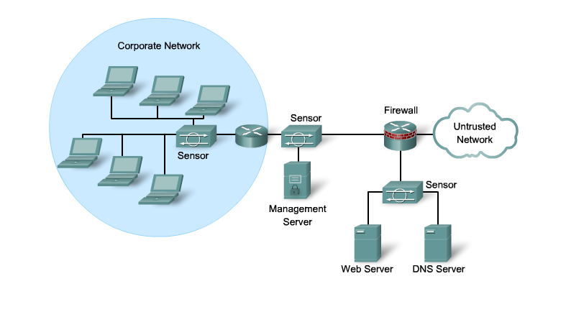
Network-Based IPS
Implementation analyzes network-wide activity looking for malicious activity.
  Configured to monitor known signatures but can also detect abnormal traffic patterns.
Configured on:
  Dedicated IPS appliances
  ISR routers
  ASA firewall appliances
  Catalyst 6500 network modules

Slide 15
Network-Based IPS Features
Sensors are connected to network segments.
  A single sensor can monitor many hosts.
Sensors are network appliances tuned for intrusion detection analysis.
  The operating system is “hardened.”
  The hardware is dedicated to intrusion detection analysis.
Growing networks are easily protected.
  New hosts and devices can be added without adding sensors.
  New sensors can be easily added to new networks.
Notes:
4

Slide 16
Cisco Network IPS Deployment

Slide 17
IPS Signatures

Slide 18
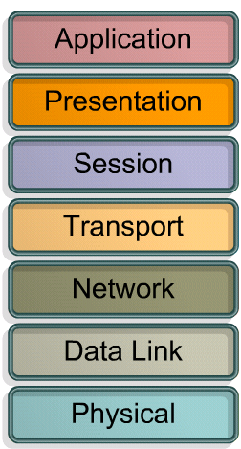



Exploit Signatures
Notes:
The type of exploit signature can be matched with the level of the operating system. Exploit-specific signatures seek to identify network activity or upper-level protocol transactions that are unique to a specific exploit or attack tool.
The specificity of exploit signatures may provide an analyst with some insight into the methodology of an attacker and may allow the analyst to identify and mitigate targeted vulnerabilities. Exploit signatures are often relatively easy to produce for simple protocols and attacks and are often employed in “pattern matching” IDS and IPS products. Examples of exploit signatures are grouped by OSI layer.
These are examples of exploit signatures in the network layer:
The most common fragmentation attack attempts to exhaust target resources by sending many non-initial fragments and tying up reassembly buffers.
Target systems can be configured to not accept IP datagrams with certain IP options, such as source routing. Signatures can analyze these datagrams before the datagrams are discarded. The configuration for this analysis is based on the target operating system or the default. This analysis is enabled by default, but may be turned off to enhance performance.
Distributed DoS (DDoS) attacks are the “next generation” of DoS attacks on the Internet. Examples of DDoS attacks on the network layer include Internet Control Message Protocol (ICMP) echo request floods and ICMP-directed broadcasts (also known as smurf attacks).
These are examples of exploit signatures in the transport layer:
Port sweep: An attacker scans multiple hosts for specific listening ports. The goal is usually to find a specific service.
Port scan: An attacker scans all ports or all well-known ports in an attempt to find services running.
TCP SYN flooding: An attacker tries to compromise the availability of a server to serve legitimate sessions. The aim is to make the server run out of resources.
These are examples of exploit signatures in the application layer:
When hackers attempt to penetrate a particular network, the hackers often need to learn as much information as possible about the network before launching attacks. An example of how an attacker learns information is a Domain Name System (DNS) query, which reveals information such as who owns a particular domain and what addresses have been assigned to that domain.
Malicious code that operates at the application layer including worms, viruses, Trojan horses, adware, and malware.

Slide 19
IPS Signatures
To stop incoming malicious traffic, the network must first be able to identify it.
  Fortunately, malicious traffic displays distinct characteristics or "signatures."
A signature is a set of rules that an IDS and an IPS use to detect typical intrusive activity, such as DoS attacks.
  Signatures uniquely identify specific worms, viruses, protocol anomalies, or malicious traffic.
  IPS sensors are tuned to look for matching signatures or abnormal traffic patterns.
IPS signatures are conceptually similar to the virus.dat file used by virus scanners.

Slide 20
Signature Attributes
Signatures have three distinctive attributes:
  Signature Type
    Atomic (one packet required)
    Composite (many packets required)
  Trigger (alarm)
  Action

Slide 21
Signature Type

Slide 22
Signature Type – Atomic Signature
Simplest form of an attack as it consists of a single packet, activity, or event that is examined to determine if it matches a configured signature.
  If it does, an alarm is triggered, and a signature action is performed.
  It does not require any knowledge of past or future activities (No state information is required).

Slide 23
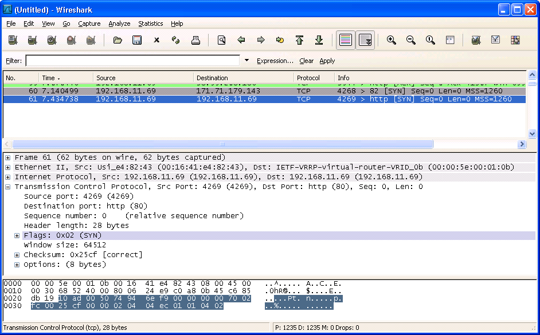
Signature Type – Atomic Signature Example
A LAND attack contains a spoofed TCP SYN packet with the IP address of the target host as both source and destination causing the machine to reply to itself continuously.

Slide 24
Signature Type – Composite Signature
Also called a stateful signature, it identifies a sequence of operations distributed across multiple hosts over an arbitrary period of time (event horizon).
  Event horizon: The length of time that the signatures must maintain state.
Usually requires several pieces of data to match an attack signature, and an IPS device must maintain state.

Slide 25
Signature Type – Composite Signature
The length of an event horizon varies from one signature to another.
  An IPS cannot maintain state information indefinitely without eventually running out of resources.
Therefore, an IPS uses a configured event horizon to determine how long it looks for a specific attack signature when an initial signature component is detected.
  Configuring the length of the event horizon is a tradeoff between consuming system resources and being able to detect an attack that occurs over an extended period of time.

Slide 26
Signature File
As new threats are identified, new signatures must be created and uploaded to an IPS.
To make this process easier, all signatures are contained in a signature file and uploaded to an IPS on a regular basis.
  Networks deploying the latest signature files are better protected against network intrusions.

Slide 27
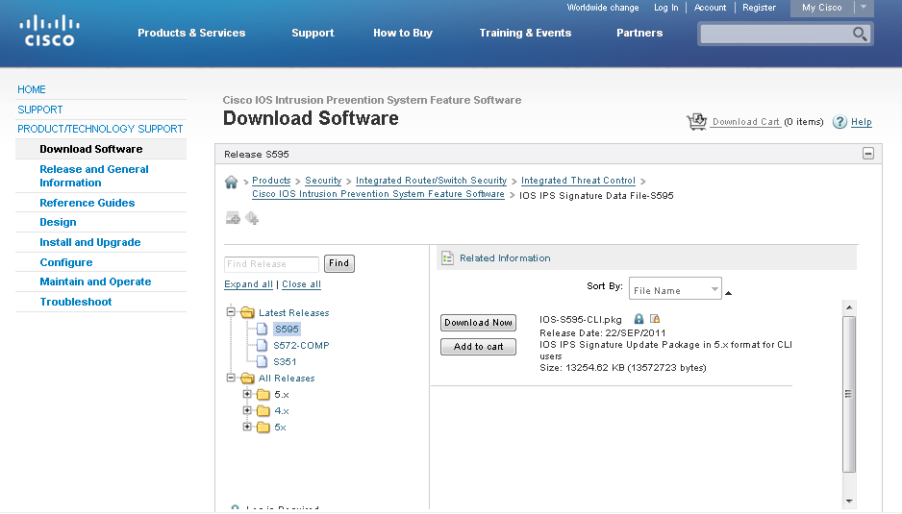
Signature File
For example, the LAND attack is identified in the Impossible IP Packet signature (signature 1102.0).
  A signature file contains that signature and many more.

Slide 28
Signature Examples
ID | Name | Description
1101 | Unknown IP Protocol | This signature triggers when an IP datagram is received with the protocol field set to 134 or greater.
1307 | TCP Window Size Variation | This signature will fire when the TCP window varies in a suspect manner.
3002 | TCP SYN Port Sweep | This signature triggers when a series of TCP SYN packets have been sent to a number of different destination ports on a specific host.
3227 | WWW HTML Script Bug | This signature triggers when an attempt is made to view files above the HTML root directory.
Notes:
This table lists the signature ID, name, and description of common signatures.

Slide 29
Signature Micro - Engines
To make the scanning of signatures more efficient, Cisco IOS software relies on signature micro-engines (SME), which categorize common signatures in groups.
  Cisco IOS software can then scan for multiple signatures based on group characteristics, instead of one at a time.
The available SMEs vary depending on the platform, Cisco IOS version, and version of the signature file.

Slide 30
Signature Micro - Engines
SMEs are constantly being updated.
  For example, before Release 12.4(11T), the Cisco IPS signature format used version 4.x.
Since IOS 12.4(11)T, Cisco introduced version 5.x, an improved IPS signature format.
  The new version supports encrypted signature parameters and other features such as signature risk rating, which rates the signature on security risk.

Slide 31
Signature Micro - Engines
Cisco IOS Release 12.4(6)T defines five micro-engines:
Signature | Description
Atomic | Signatures that examine simple packets, such as ICMP and UDP
Service | Signatures that examine the many services that are attacked.
String | Signatures use regular expression patterns to detect intrusions.
Multi-string | Supports flexible pattern matching and Trend Labs signatures.
Other | Internal engine that handles miscellaneous signatures.

Slide 32
Signature Micro - Engines
Version 4.x SME Prior 12.4(11)T | Version 5.x SME 12.4(11)T and later | Description
ATOMIC.IP | ATOMIC.IP | Provides simple Layer 3 IP alarms.
ATOMIC.ICMP | ATOMIC.IP | Provides simple Internet Control Message Protocol (ICMP) alarms based on the following parameters: type, code, sequence, and ID.
ATOMIC.IPOPTIONS | ATOMIC.IP | Provides simple alarms based on the decoding of Layer 3 options.
ATOMIC.UDP | ATOMIC.IP | Provides simple User Datagram Protocol (UDP) packet alarms based on the following parameters: port, direction, and data length.
ATOMIC.TCP | ATOMIC.IP | Provides simple TCP packet alarms based on the following parameters: port, destination, and flags.
SERVICE.DNS | SERVICE.DNS | Analyzes the Domain Name System (DNS) service.
SERVICE.RPC | SERVICE.RPC | Analyzes the remote-procedure call (RPC) service.
SERVICE.SMTP | STATE | Inspects Simple Mail Transfer Protocol (SMTP).
SERVICE.HTTP | SERVICE.HTTP | Provides HTTP protocol decode-based string engine that includes ant evasive URL de-obfuscation.
SERVICE.FTP | SERVICE.FTP | Provides FTP service special decode alarms.

Slide 33
Signature Micro - Engines
Version 4.x SME Prior 12.4(11)T | Version 5.x SME 12.4(11)T and later | Description
STRING.TCP | STRING.TCP | Offers TCP regular expression-based pattern inspection engine services
STRING.UDP | STRING.UDP | Offers UDP regular expression-based pattern inspection engine services
STRING.ICMP | STRING.ICMP | Provides ICMP regular expression-based pattern inspection engine services
MULTI-STRING | MULTI-STRING | Supports flexible pattern matching and supports Trend Labs signatures
OTHER | NORMALIZER | Provides internal engine to handle miscellaneous signatures

Slide 34
Updating Signatures
Cisco investigates / creates signatures for new threats as they are discovered and publishes them regularly.
  Lower priority IPS signature files are published biweekly.
  If the threat is severe, Cisco publishes signature files within hours of identification.
Update the signature file regularly to protect the network.
  Each update includes new signatures and all the signatures in the previous version.
    For example, signature file IOS-S361-CLI.pkg includes all signatures in file IOS-S360-CLI.pkg plus signatures created for threats discovered subsequently.
New signatures are downloadable from CCO.
  Requires a valid CCO login.

Slide 35
Updating Signatures

Slide 36
Signature Trigger

Slide 37
Signature Trigger (Signature Alarm)
The signature trigger for an IPS sensor is anything that can reliably signal an intrusion or security policy violation.
  E.g., a packet with a payload containing a specific string going to a specific port.
The Cisco IPS 4200 Series Sensors and Cisco Catalyst 6500 - IDSM can use four types of signature triggers:
  Pattern-based detection
  Policy-based detection
  Anomaly-based detection
  Honey pot-based detection

Slide 38
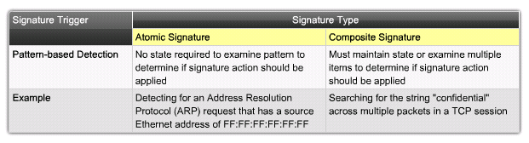
Pattern-Based Detection
Pattern-based detection (signature-based detection), is the simplest triggering mechanism because it searches for a specific, pre-defined pattern.
The IPS sensor compares the network traffic to a database of known attacks and triggers an alarm or prevents communication if a match is found.

Slide 39
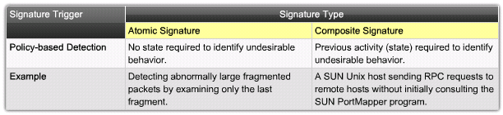
Policy-Based Detection
Similar to pattern-based detection, but instead of trying to define specific patterns, the administrator defines behaviors that are suspicious based on historical analysis.

Slide 40
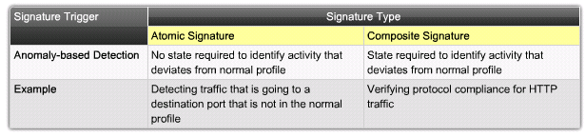
Anomaly-Based Detection
It can detect new and previously unpublished attacks.
Normal activity is defined and any activity that deviates from this profile is abnormal and triggers a signature action.
  Note that an alert does not necessarily indicate an attack since a small deviation can sometimes occur from valid user traffic.
  As the network evolves, the definition of normal usually changes, so the definition of normal must be redefined.

Slide 41
Types of Signature Triggers
 | Advantages | Disadvantages
Pattern detection (Signature-based) | Easy configuration Fewer false positives Good signature design | No detection of unknown signatures Initially a lot of false positives Signatures must be created, updated, and tuned
Policy-based detection (Behavior-based) | Simple and reliable Customized policies Can detect unknown attacks | Generic output Policy must be created
Anomaly detection (Profile-based) | Easy configuration Can detect unknown attacks | Difficult to profile typical activity in large networks Traffic profile must be constant
Honey Pot-based | Window to view attacks Distract and confuse attackers Slow down and avert attacks Collect information about attack | Dedicated honey pot server Honey pot server must not be trusted

Slide 42
Tuning Alarms
Triggering mechanisms can generate various types of alarms including:
Alarm Type
Network Activity
IPS Activity
Outcome
True positive
Attack traffic
Alarm generated
Ideal setting
True negative
Normal user traffic
No alarm generated
Ideal setting
False positive
Normal user traffic
Alarm generated
Tune alarm
False negative
Attack traffic
No alarm generated
Tune alarm

Slide 43
Tuning Alarms
False Positive:
  False positive alarm is an expected but undesired result.
  It occurs when an intrusion system generates an alarm after processing normal user traffic that should not have resulted in the alarm.
  The administrator must be sure to tune the IPS to change these alarm types to true negatives.
False Negative:
  The IPS fails to generate an alarm after processing attack traffic that it is configured to detect.
  It is imperative that the IPS does not generate false negatives, because it means that known attacks are not being detected.
  The goal is to render these alarm types as true positive.

Slide 44
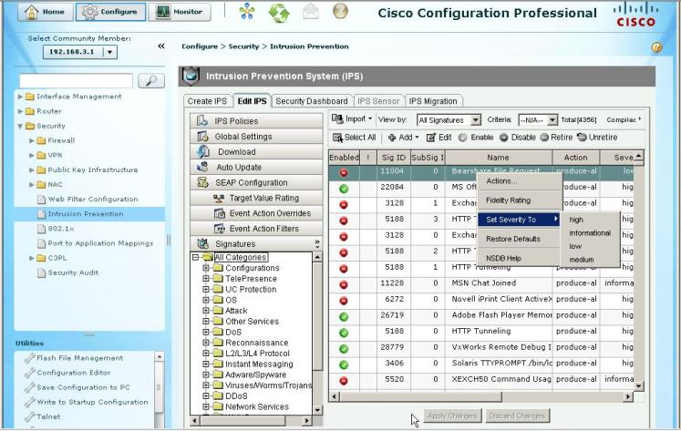
Tuning IPS Signature Alarms
A signature is tuned to one of four levels, based on the perceived severity of the signature:

Slide 45
Tuning IPS Signature Alarms
Low
  Abnormal network activity is detected that could be perceived as malicious, but an immediate threat is not likely.
Medium
  Abnormal network activity is detected that could be perceived as malicious, and an immediate threat is likely.
High
  Attacks used to gain access or cause a DoS attack are detected, and an immediate threat is extremely likely.
Informational
  Activity that triggers the signature is not considered an immediate threat, but the information provided is useful information.

Slide 46
Signature Action

Slide 47
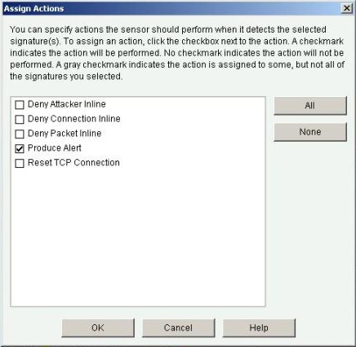
IPS Signature Actions
Whenever a signature detects the activity for which it is configured, the signature triggers one or more actions.
Several actions can be performed:
  Allow the activity.
  Drop or prevent the activity.
  Block future activity.
  Generate an alert.
  Log the activity.
  Reset a TCP connection.

Slide 48
IPS Signature Actions
Category | Specific Alert | Description
Generating an alert | Produce alert | This action writes the event to the Event Store as an alert.
 | Produce verbose alert | This action includes an encoded dump of the offending packet in the alert.
Logging the activity | Log attacker packets | This action starts IP logging on packets that contain the attacker address and sends an alert.
 | Log pair packets | This action starts IP logging on packets that contain the attacker and victim address pair.
 | Log victim packets | This action starts IP logging on packets that contain the victim address and sends an alert.
Dropping or preventing the activity | Deny attacker inline | This action terminates the current packet and future packets from this attacker address for a specified period of time. The sensor maintains a list of the attackers currently being denied by the system. Entries may be removed from the list manually or wait for the timer to expire. The timer is a sliding timer for each entry. Therefore, if attacker A is currently being denied, but issues another attack, the timer for attacker A is reset and attacker A remains on the denied attacker list until the timer expires. If the denied attacker list is at capacity and cannot add a new entry, the packet is still denied.
 | Deny connection inline | This action terminates the current packet and future packets on this TCP flow.
 | Deny packet inline | This action terminates the packet.

Slide 49
IPS Signature Actions
Category | Specific Alert | Description
Resetting a TCP connection | Reset TCP connection | This action sends TCP resets to hijack and terminate the TCP flow.
Blocking future activity | Request block connection | This action sends a request to a blocking device to block this connection.
 | Request block host | This action sends a request to a blocking device to block this attacker host.
 | Request SNMP trap | This action sends a request to the notification application component of the sensor to perform Simple Network Management Protocol (SNMP) notification.

Slide 50
Managing and
Monitoring IPS

Slide 51
Event Monitoring and Management
There are two key functions of event monitoring and management:
  Real-time event monitoring and management.
  Analysis based on archived information (reporting).
Event monitoring and management can be hosted on a single server or on separate servers for larger deployments.
  It is recommended that a maximum of 25 well-tuned sensors report to a single IPS management console.

Slide 52
Cisco IOS IPS
The Cisco IOS IPS feature can send a syslog message or an alarm in Secure Device Event Exchange (SDEE) format.
An SDEE system alarm message has this type of format:
  %IPS-4-SIGNATURE:Sig:1107 Subsig:0 Sev:2 RFC1918 address [192.168.121.1:137 ->192.168.121.255:137]

Slide 53
Event Monitoring and Management
Several Cisco device management software solutions are available to help administrators manage an IPS solution.
  Cisco Router and Security Device Manager (SDM)
  Cisco IPS Manager Express (IME)
  Cisco Security Manager (CSM)

Slide 54
Cisco Configuration Professional (CCP)
Cisco IOS IPS monitors and prevents intrusions by comparing traffic against signatures of known threats and blocking the traffic when a threat is detected.
CCP allows administrators to control the application of Cisco IOS IPS on interfaces, import and edit signature definition files (SDF) from Cisco.com, and to configure the action that Cisco IOS IPS is to take if a threat is detected.

Slide 55
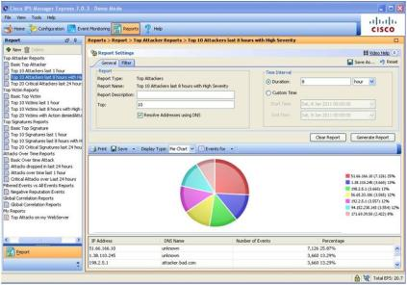
Cisco IPS Manager Express (IME)
Cisco IME is a GUI-based configuration and management tool for IPS appliances.
All-in-one IPS management application to provision, monitor, troubleshoot and generate reports for up to five sensors.
Supports live RSS feed for most recent security intelligence.
After downloading and installing the approximately 120MB setup.exe file, two desktop shortcuts are created: one for actual sensor use and the second for demo mode only.

Slide 56
Cisco Security Manager (CSM)
Cisco Security Manager is a powerful, but very easy-to-use solution to centrally provision all aspects of device configurations and security policies for Cisco firewalls, VPNs, and IPS.
Supports automatic policy-based IPS sensor software and signature updates.
Includes a signature update wizard allowing easy review and editing prior to deployment.
Provides support for IPS sensors and Cisco IOS IPS.

Slide 57
Cisco SensorBase Network
With global correlation, Cisco IPS devices receive regular threat updates from a centralized Cisco threat database called the Cisco SensorBase Network.
The Cisco SensorBase Network contains real-time, detailed information about known threats on the Internet.
Participating IPS devices are part of the SensorBase Network, and receive global correlation updates that include information on network devices with a reputation for malicious activity.

Slide 58
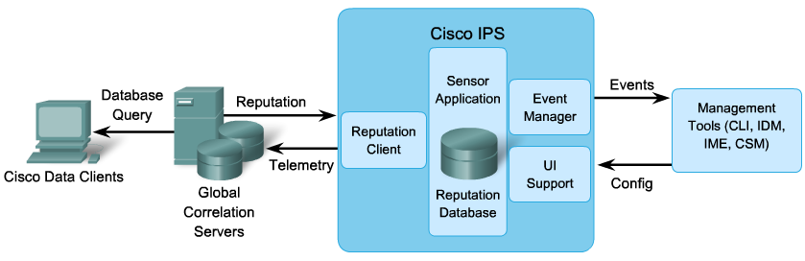
IPS Global Correlation
When participating in global correlation, the Cisco SensorBase Network provides information to the IPS sensor about IP addresses with a reputation.
The sensor uses this information to determine which actions, if any, to perform when potentially harmful traffic is received from a host with a known reputation.

Slide 59
Configuring Cisco IOS IPS

Slide 60
Cisco IOS IPS
Cisco IOS IPS enables administrators to manage intrusion prevention on routers that use Cisco IOS Release 12.3(8)T4 or later.
Cisco IOS IPS monitors and prevents intrusions by comparing traffic against signatures of known threats and blocking the traffic when a threat is detected.
Several steps are necessary to use the Cisco IOS CLI to work with IOS IPS 5.x format signatures.
  Cisco IOS version 12.4(10) or earlier used IPS 4.x format signatures and some IPS commands have changed.

Slide 61
Steps to implement Cisco IOS IPS
Download the IOS IPS files.
Create an IOS IPS configuration directory in flash.
Configure an IOS IPS crypto key.
Enable IOS IPS (consists of several substeps).
Load the IOS IPS signature package to the router.

Slide 62
1. Download the IOS IPS files.
Download the IOS IPS signature file and public crypto key.
  IOS-Sxxx-CLI.pkg - This is the latest signature package.
  realm-cisco.pub.key.txt - This is the public crypto key used by IOS IPS.
The specific IPS files to download vary depending on the current release.
  Only registered customers can download the package files and key.
Notes:
Cisco SDFs are updated and posted to Cisco.com on a regular basis. Thus, customers can download signatures that help protect networks from the latest known network attacks.
Multiple definition sources are available, such as the default, built-in signatures that are shipped with the routers, or the SDF files named 64MB.sdf, 128MB.sdf, and 256MB.sdf. The files differ in the number of configured signatures. The administrator should select the appropriate SDF file based on the amount of RAM memory in the router.

Slide 63
2. Create an IOS IPS directory in Flash
Create a directory in flash to store the signature files and configurations.
  Use the mkdir directory-name privileged EXEC command to create the directory.
  Use the rename current-name new-name command to change the name of the directory.
To verify the contents of flash, enter the dir flash: privileged EXEC command.
R1# mkdir ips
Create directory filename [ips]?
Created dir flash:ips
R1#
R1# dir flash:
Directory of flash:/
5 -rw- 51054864 Jan 10 2009 15:46:14 -08:00
c2800nm-advipservicesk9-mz.124-20.T1.bin
6 drw- 0 Jan 15 2009 11:36:36 -08:00 ips
64016384 bytes total (12693504 bytes free)
R1#

Slide 64
3. Configure an IOS IPS crypto key
Configure the crypto key to verify the digital signature for the master signature file (sigdef-default.xml).
  The file is signed by a Cisco to guarantee its authenticity and integrity.
To configure the IOS IPS crypto key, open the text file, copy the contents of the file, and paste it in the global configuration prompt.
  The text file issues the various commands to generate the RSA key.

Slide 65
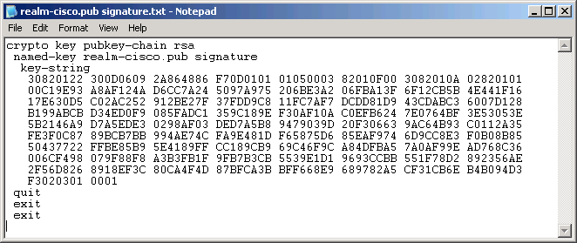
3. Configure an IOS IPS crypto key
Highlight and copy the text in the public key file.
Paste the copied text at the global config prompt.
R1# conf t
R1(config)#

Slide 66
3. Configure an IOS IPS crypto key
Issue the show run command to verify that the key was copied.
R1# show run
<Output omitted>
crypto key pubkey-chain rsa
named-key realm-cisco.pub signature
key-string
30820122 300D0609 2A864886 F70D0101 01050003 82010F00 3082010A 02820101
00C19E93 A8AF124A D6CC7A24 5097A975 206BE3A2 06FBA13F 6F12CB5B 4E441F16
17E630D5 C02AC252 912BE27F 37FDD9C8 11FC7AF7 DCDD81D9 43CDABC3 6007D128
B199ABCB D34ED0F9 085FADC1 359C189E F30AF10A C0EFB624 7E0764BF 3E53053E
5B2146A9 D7A5EDE3 0298AF03 DED7A5B8 9479039D 20F30663 9AC64B93 C0112A35
FE3F0C87 89BCB7BB 994AE74C FA9E481D F65875D6 85EAF974 6D9CC8E3 F0B08B85
50437722 FFBE85B9 5E4189FF CC189CB9 69C46F9C A84DFBA5 7A0AF99E AD768C36
006CF498 079F88F8 A3B3FB1F 9FB7B3CB 5539E1D1 9693CCBB 551F78D2 892356AE
2F56D826 8918EF3C 80CA4F4D 87BFCA3B BFF668E9 689782A5 CF31CB6E B4B094D3
F3020301 0001
<Output omitted>

Slide 67
3. Configure an IOS IPS crypto key
At the time of signature compilation, an error message is generated if the public crypto key is invalid.
  If the key is configured incorrectly, the key must be removed and then reconfigured using the no crypto key pubkey-chain rsa and the no named-key realm-cisco.pub signature commands.

Slide 68
4a. Enable IOS IPS
Identify the IPS rule name and specify the location.
  Use the ip ips name [rule name] [optional ACL] command to create a rule name.
  An optional extended or standard ACL can be used to filter the traffic.
  Traffic that is denied by the ACL is not inspected by the IPS.
Use the ip ips config location flash:directory-name command to configure the IPS signature storage location.
  Prior to IOS 12.4(11)T, the ip ips sdf location command was used.
R1(config)# ip ips name IOSIPS
R1(config)# ip ips name ips list ?
<1-199> Numbered access list
WORD Named access list
R1(config)#
R1(config)# ip ips config location flash:ips
R1(config)#

Slide 69
4b. Enable IOS IPS
Enable SDEE and logging event notification.
  The HTTP server must first be enabled using the ip http server command.
  SDEE notification must be explicitly enabled using the ip ips notify sdee command.
IOS IPS also supports logging to send event notification.
  SDEE and logging can be used independently or simultaneously.
  Logging notification is enabled by default.
  Use the ip ips notify log command to enable logging.
R1(config)# ip http server
R1(config)# ip ips notify sdee
R1(config)# ip ips notify log
R1(config)#

Slide 70
4c. Configure the Signature Category
All signatures are grouped into three common categories:
  All
  Basic
  Advanced
Signatures that IOS IPS uses to scan traffic can be retired or unretired.
  Retired means that IOS IPS does not compile that signature into memory.
  Unretired instructs the IOS IPS to compile the signature into memory and use it to scan traffic.

Slide 71
4c. Configure the Signature Category
When IOS IPS is first configured, all signatures in the all category should be retired, and then selected signatures should be unretired in a less memory-intensive category.
  To retire and unretired signatures, first enter IPS category mode using the ip ips signature-category command.
  Next use the category category-name command to change a category.
R1(config)# ip ips signature-category
R1(config-ips-category)# category all
R1(config-ips-category-action)# retired true
R1(config-ips-category-action)# exit
R1(config-ips-category)#
R1(config-ips-category)# category IOSIPS basic
R1(config-ips-category-action)# retired false
R1(config-ips-category-action)# exit
R1(config-ips-category)# exit
Do you want to accept these changes? [confirm] y
R1(config)#

Slide 72
4d. Configure the Signature Category
Apply the IPS rule to a desired interface, and specify the direction.
Use the ip ips rule-name [in | out] interface configuration command to apply the IPS rule.
  The in argument means that only traffic going into the interface is inspected by IPS.
  The out argument specifies that only traffic going out of the interface is inspected.
R1(config)# interface GigabitEthernet 0/1
R1(config-if)# ip ips IOSIPS in
R1(config-if)# ip ips IOSIPS out
R1(config-if)# exit
R1(config)# exit

Slide 73
5. Load the IOS IPS signature
Upload the signature package to the router using either FTP or TFTP.
  To copy the downloaded signature package from the FTP server to the router, make sure to use the idconf parameter at the end of the command.
  copy ftp://ftp_user:password@Server_IP_address/signature_package idconf
R1# copy ftp://cisco:cisco@10.1.1.1/IOS-S376-CLI.pkg idconf
Loading IOS-S310-CLI.pkg !!!!!!!!!!!!!!!!!!!!!!!!!!!!!!
[OK - 7608873/4096 bytes]
*Jan 15 16:44:47 PST: %IPS-6-ENGINE_BUILDS_STARTED: 16:44:47 PST Jan 15 2008
*Jan 15 16:44:47 PST: %IPS-6-ENGINE_BUILDING: multi-string - 8 signatures - 1 of 13 engines
*Jan 15 16:44:47 PST: %IPS-6-ENGINE_READY: multi-string - build time 4 ms - packets for this engine will be scanned
*Jan 15 16:44:47 PST: %IPS-6-ENGINE_BUILDING: service-http - 622 signatures - 2 of 13 engines
*Jan 15 16:44:53 PST: %IPS-6-ENGINE_READY: service-http - build time 6024 ms - packets for this engine will be scanned
<Output omitted>

Slide 74
5. Load the IOS IPS signature
Verify that the signature package is properly compiled using the show ip ips signature count command.
R1# show ip ips signature count
Cisco SDF release version S310.0 ← signature package release version
Trend SDF release version V0.0
Signature Micro-Engine: multi-string: Total Signatures 8
multi-string enabled signatures: 8
multi-string retired signatures: 8
<output omitted>
Signature Micro-Engine: service-msrpc: Total Signatures 25
service-msrpc enabled signatures: 25
service-msrpc retired signatures: 18
service-msrpc compiled signatures: 1
service-msrpc inactive signatures - invalid params: 6
Total Signatures: 2136
Total Enabled Signatures: 807
Total Retired Signatures: 1779
Total Compiled Signatures:
351 ← total compiled signatures for the IOS IPS Basic category
Total Signatures with invalid parameters: 6
Total Obsoleted Signatures: 11
R1#

Slide 75
Configuring IPS using CCP

Slide 76
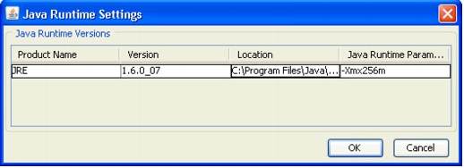
Increase the Java Memory Heap Size
CCP needs a minimum Java memory heap size of 256MB to support IOS IPS.
  Exit CCP and open the Windows Control Panel.
  Click on the Java option which opens the Java Control Panel.
  Select the Java tab and click on the View button under the Java Applet Runtime Settings.
  In the Java Runtime Parameter field enter -Xmx256m and click OK.

Slide 77
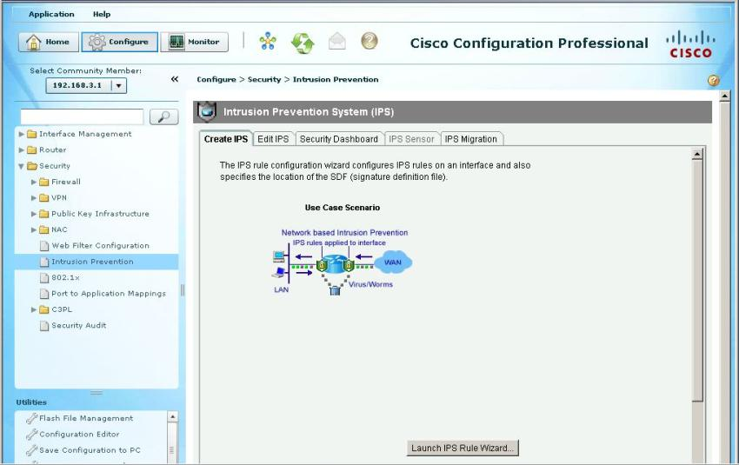
Configuring IOS IPS using CCP

Slide 78
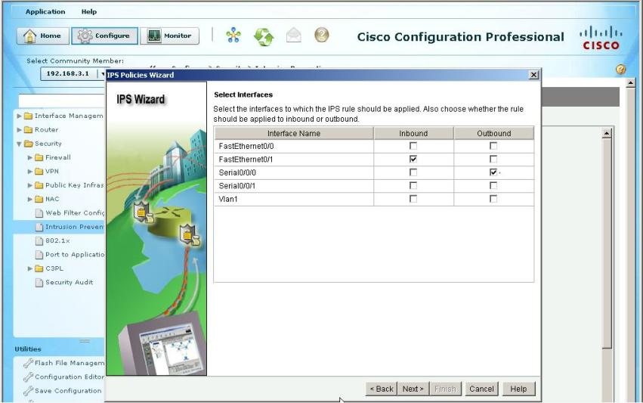
Select the Interfaces

Slide 79
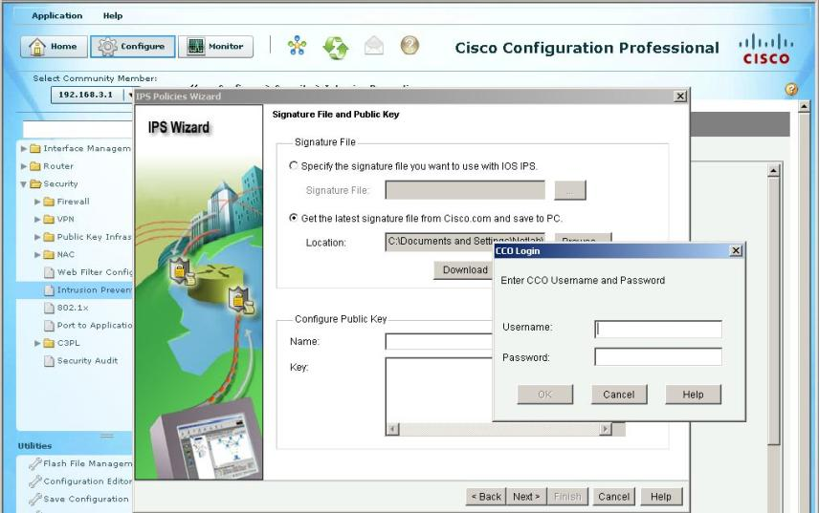
Download the Signature File

Slide 80
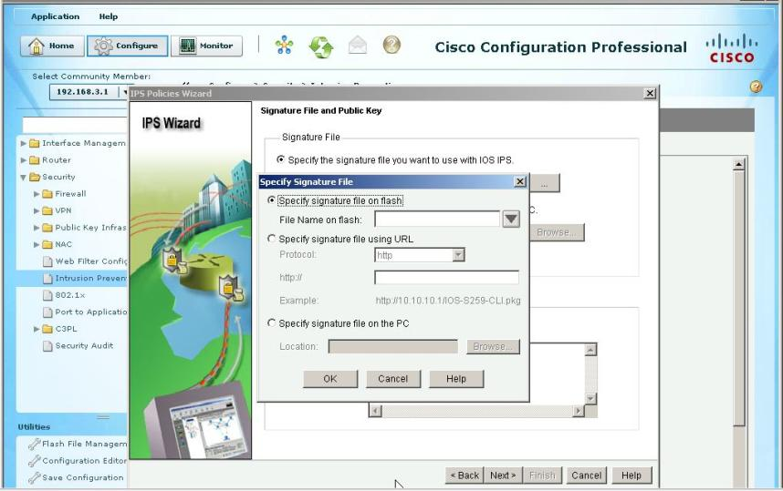
Select the Signature File

Slide 81
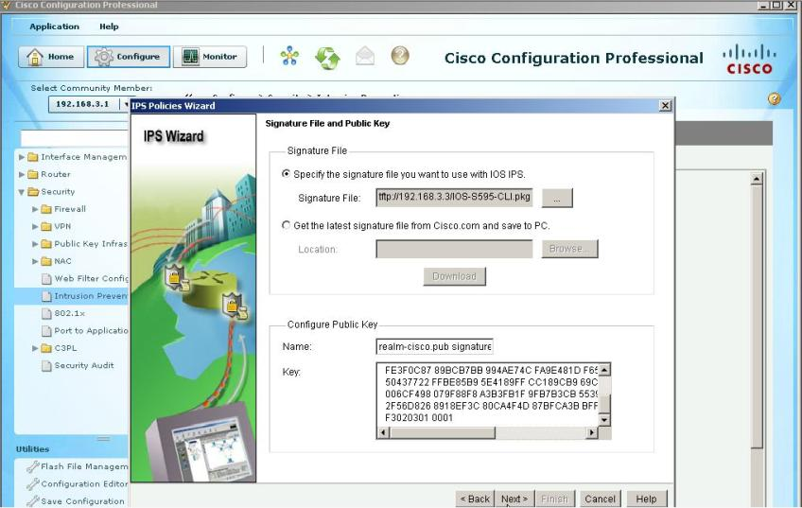
Configure the Public Key

Slide 82
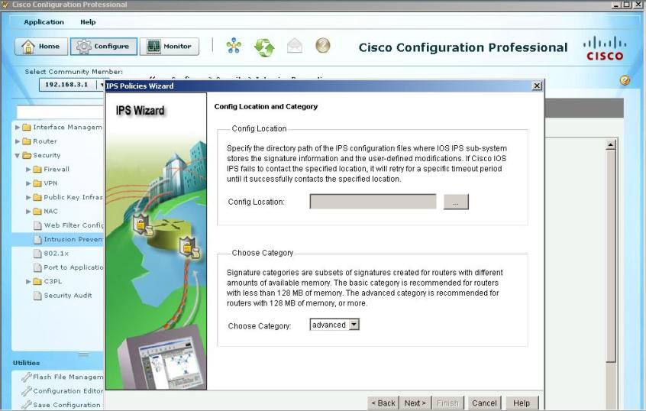
Specify Location of Signature Files

Slide 83
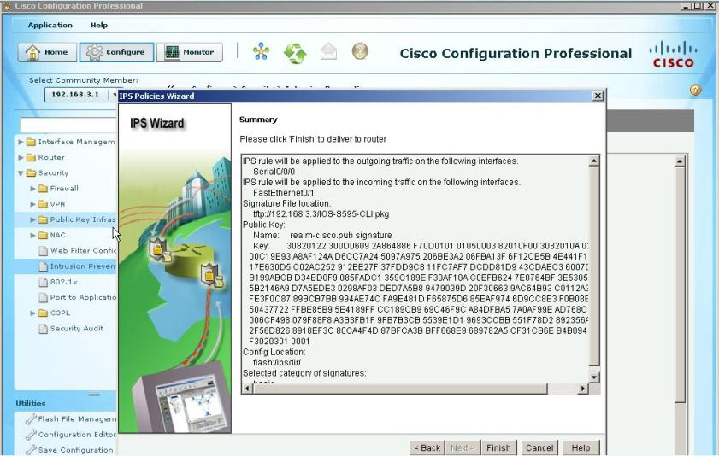
Summary

Slide 84
Modifying Signatures
This example shows how to retire individual signatures.
  In this example, signature 6130 with subsig ID of 10 is retired.
R1# configure terminal
Enter configuration commands, one per line. End with CNTL/Z.
R1(config)# ip ips signature-definition
R1(config-sigdef)# signature 6130 10
R1(config-sigdef-sig)# status
R1(config-sigdef-sig-status)# retired true
R1(config-sigdef-sig-status)# exit
R1(config-sigdef-sig)# exit
R1(config-sigdef)# exit
Do you want to accept these changes? [confirm] y
R1(config)#

Slide 85
Modifying Signatures
This example shows how to unretire all signatures that belong to the IOS IPS Basic category.
R1# configure terminal
Enter configuration commands, one per line. End with CNTL/Z.
R1(config)# ip ips signature-category
R1(config-ips-category)# category ios_ips basic
R1(config-ips-category-action)# retired false
R1(config-ips-category-action)# exit
R1(config-ips-category)# exit
Do you want to accept these changes? [confirm] y
R1(config)#

Slide 86
Change Actions for a Signature
This example shows how to change signature actions to alert, drop, and reset for signature 6130 with subsig ID of 10.
R1# configure terminal
Enter configuration commands, one per line. End with CNTL/Z.
R1(config)# ip ips signature-definition
R1(config-sigdef)# signature 6130 10
R1(config-sigdef-sig)# engine
R1(config-sigdef-sig-engine)# event-action produce-alert
R1(config-sigdef-sig-engine)# event-action deny-packet-inline
R1(config-sigdef-sig-engine)# event-action reset-tcp-connection
R1(config-sigdef-sig-engine)# exit
R1(config-sigdef-sig)# exit
R1(config-sigdef)# exit
Do you want to accept these changes? [confirm] y
R1(config)

Slide 87
Change Actions for a Category
This example shows how to change event actions for all signatures that belong to the signature IOS IPS Basic category.
R1# configure terminal
Enter configuration commands, one per line. End with CNTL/Z.
R1(config)# ip ips signature-definition
R1(config-ips-category)# category ios_ips basic
R1(config-ips-category-action)# event-action produce-alert
R1(config-ips-category-action)# event-action deny-packet-inline
R1(config-ips-category-action)# event-action reset-tcp-connection
R1(config-ips-category-action)# exit
R1(config-ips-category)# exit
Do you want to accept these changes? [confirm] y
R1(config)#

Slide 88

Modifying IOS IPS Signatures

Slide 89

Tuning a Signature

Slide 90
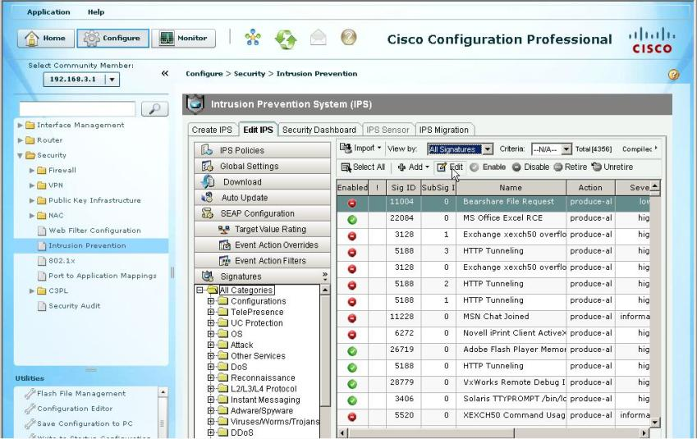
Edit a Signature

Slide 91
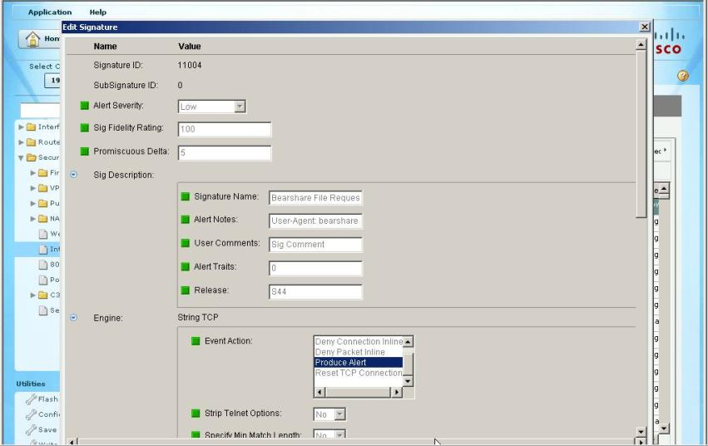
Signature Parameters

Slide 92
Verifying IOS IPS

Slide 93
Verify IOS IPS
R1# show ip ips all
IPS Signature File Configuration Status
Configured Config Locations: flash:/ipsdir/
Last signature default load time: 04:39:33 UTC Jan 15 2009
Last signature delta load time: -none-
Last event action (SEAP) load time: -none-
General SEAP Config:
Global Deny Timeout: 3600 seconds
Global Overrides Status: Enabled
Global Filters Status: Enabled
IPS Auto Update is not currently configured
IPS Syslog and SDEE Notification Status
Event notification through syslog is enabled
Event notification through SDEE is enabled
IPS Signature Status
Total Active Signatures: 693
Total Inactive Signatures: 1443
IPS Packet Scanning and Interface Status
IPS Rule Configuration
IPS name myips
IPS fail closed is disabled
IPS deny-action ips-interface is false
Fastpath ips is enabled
Quick run mode is enabled
Interface Configuration
Interface FastEthernet0/1
Inbound IPS rule is not set
Outgoing IPS rule is myips
<output omitted>

Slide 94
View Configuration
R1# show ip ips configuration
Event notification through syslog is enabled
Event notification through Net Director is enabled
Default action(s) for info signatures is alarm
Default action(s) for attack signatures is alarm
Default threshold of recipients for spam signature is 25
PostOffice:HostID:5 OrgID:100 Addr:10.2.7.3 Msg dropped:0
HID:1000 OID:100 S:218 A:3 H:14092 HA:7118 DA:0 R:0
CID:1 IP:172.21.160.20 P:45000 S:ESTAB (Curr Conn)
Audit Rule Configuration
Audit name AUDIT.1
info actions alarm
<output omitted>

Slide 95
View IPS Interface Configuration
R1# show ip ips interfaces
Interface Configuration
Interface FastEthernet0/0
Inbound IPS rule is sdm_ips_rule
Outgoing IPS rule is not set
Interface FastEthernet0/1
Inbound IPS rule is sdm_ips_rule
Outgoing IPS rule is not set
R1#

Slide 96
Show Signature Status
R1# show ip ips signature | include 5000
SigID:SubID On Action Sev Trait MH AI CT TI AT FA WF Version
----------- -- ------ --- ----- -- -- -- -- ----- ----------
50000:0 N A HIGH 0 0 0 0 0 FA N OPACL
50000:1 N A HIGH 0 0 0 0 0 FA N OPACL
50000:2 N A HIGH 0 0 0 0 0 FA N OPACL
R1#

Slide 97
View Alarm and Packet Statistics
R1# show ip ips statistics
Signature audit statistics [process switch:fast switch]
signature 2000 packets audited: [0:2]
signature 2001 packets audited: [9:9]
signature 2004 packets audited: [0:2]
signature 3151 packets audited: [0:12]
Interfaces configured for audit 2
Session creations since subsystem startup or last reset 11
Current session counts (estab/half-open/terminating) [0:0:0]
Maxever session counts (estab/half-open/terminating) [2:1:0]
Last session created 19:18:27
Last statistic reset never
HID:1000 OID:100 S:218 A:3 H:14085 HA:7114 DA:0 R:0
R1#

Slide 98
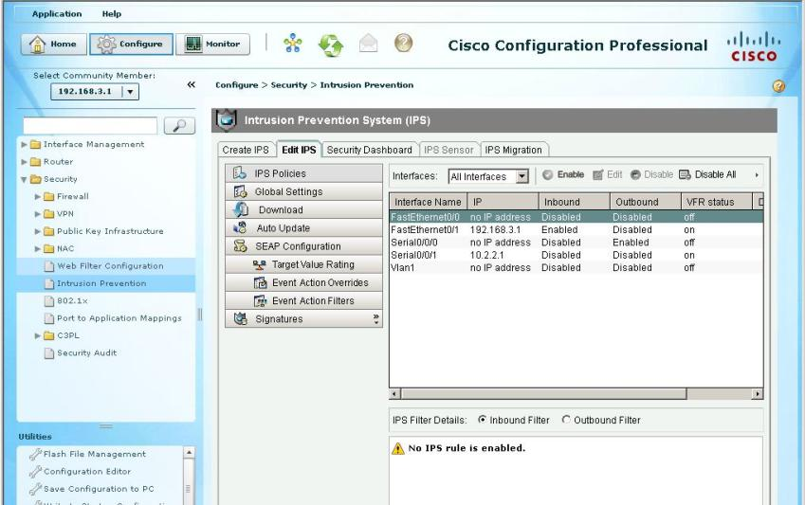
Verify the IPS Configuration

Slide 99
Monitoring IOS IPS
R1# config t
R1(config)# logging 192.168.10.100
R1(config)# ip ips notify log
R1(config)# logging on
R1(config)#
R1# config t
R1(config)# ip http server
R1(config)# ip http secure-server
R1(config)# ips notify sdee
R1(config)# ip sdee events 500
R1(config)#

Slide 100
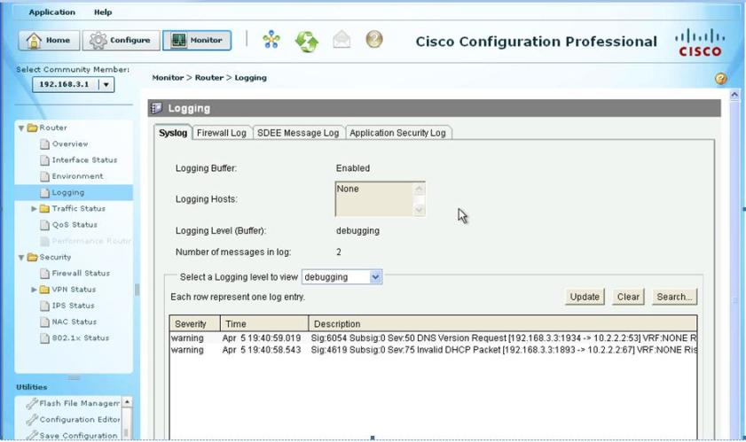
CCP Syslog

Slide 101
Extra Stuff
Cisco IPS
  www.cisco.com/go/ips
Shields Up! Time to Start Blocking with your Cisco IPS Sensors
  http://www.networkworld.com/community/node/45922
Cisco IPS Sensor Tuning Timesavers
  http://www.networkworld.com/community/node/55244?source=NWWNLE_nlt_cisco_2010-01-18

Slide 102


