Slide 1
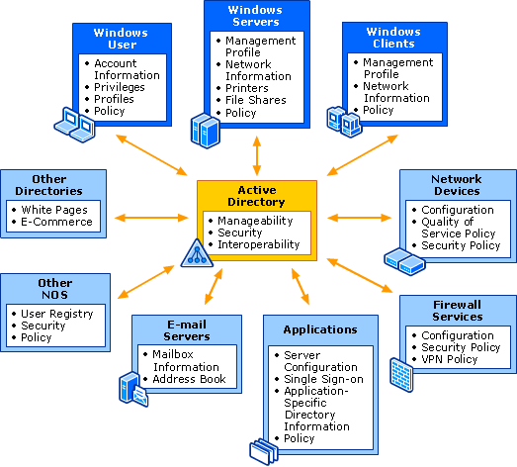
Active Directory Administration
By Joseph Cheung
April 27, 2016

Slide 3
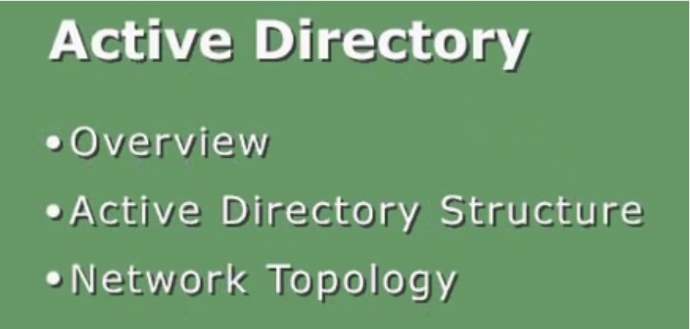
Active Directory administration By Joseph Cheung

Slide 4

CONCEPTS OF ACTIVE DIRECTORY
An active directory stores information about all the resources on a network; such as users, groups, computers, files, printers, and applications.
Plus
It provides all the services, making the information available and useful.

Slide 5
CONCEPTS OF ACTIVE DIRECTORY
Active directory stores information about resources in hierarchical structure
It contains objects that represents different types of network resources, users, printers and so on.
AD information is used to authenticate/authorize users, computers, resources which are part of a network

Slide 6
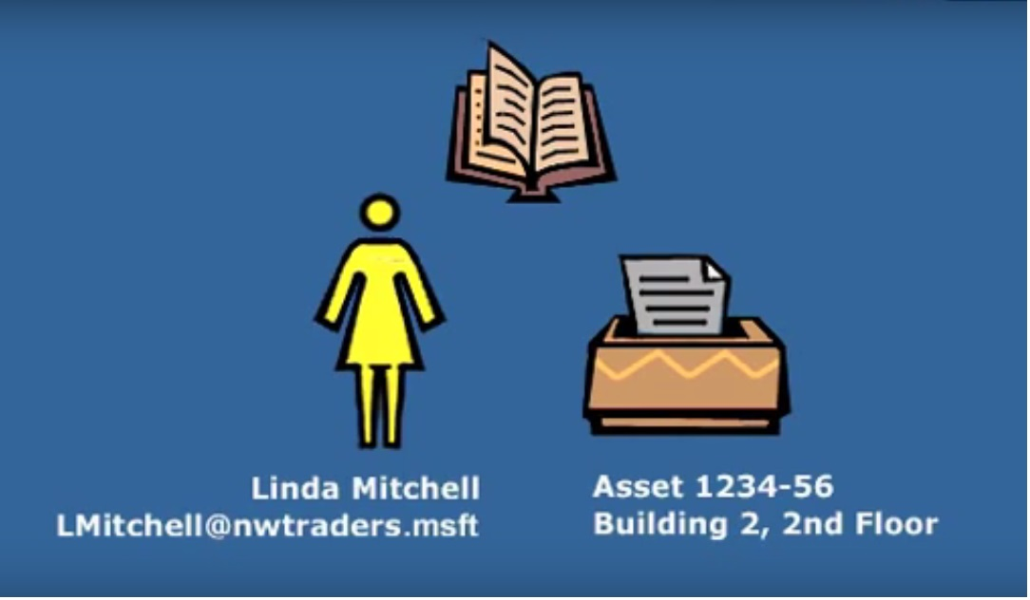
Object has attributes
Each object has
attributes,
a. such as the user’s first name, last name and email address; or
b. A printer’s asset number and location
2. GUID – 128bit global identifier
3. SID – Security identifier

Slide 7
Object Examples
Forest | Computer
Domain | Shared Folder
Organizational Unit | Printer
User | Site
Group | Subnet
Contact

Slide 8
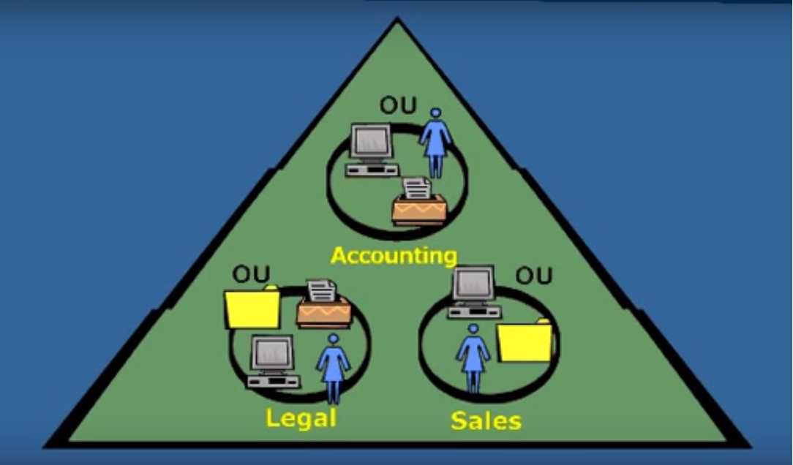
STRUCTURE
Objects are maintained in a domain
A domain is a basic unit of organization and security in active directory

Slide 9
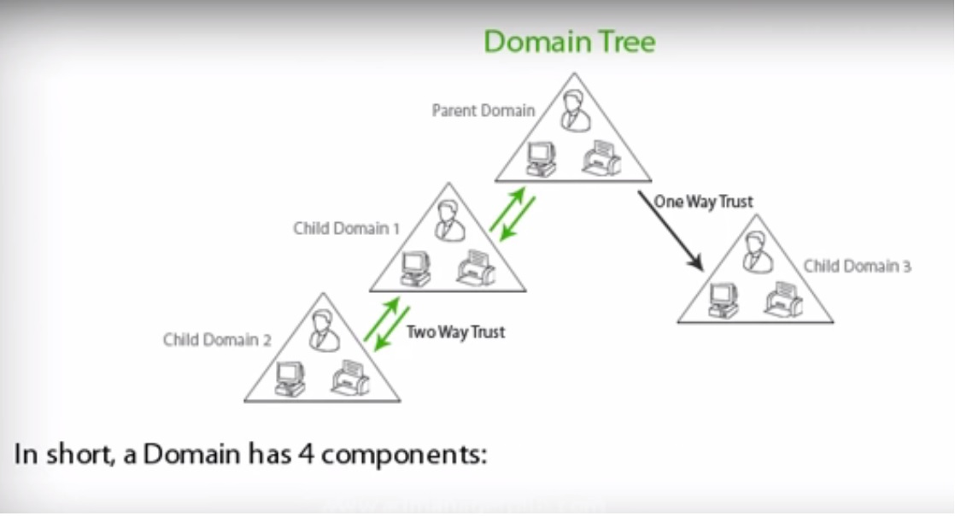
STRUCTURE A Domain Has 4 Components
A hierarchical structure of containers, objects
An unique Domain Name
A security mechanism to authenticate and authorize access to Domain Resources
Policies that show how functionality is allowed or restricted for users, computers in a domain

Slide 10
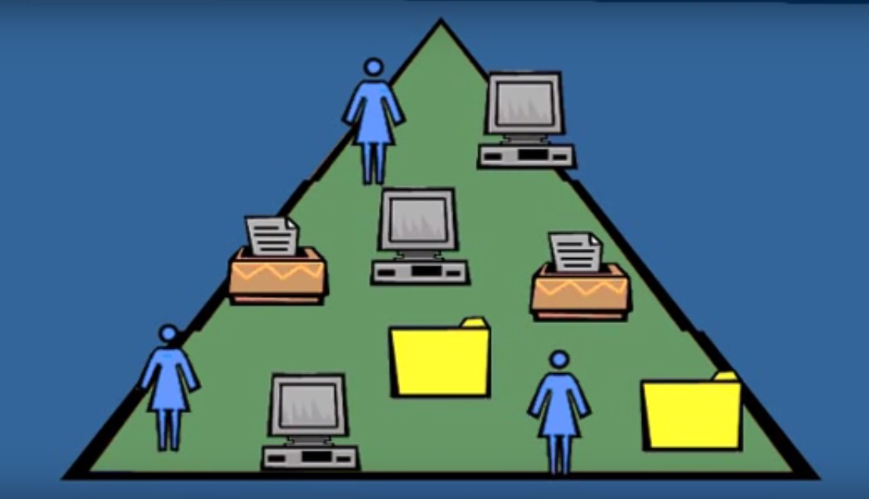
STRUCTURE
Within a domain, objects can be organized into logical containers called organizational units or OUs

Slide 11
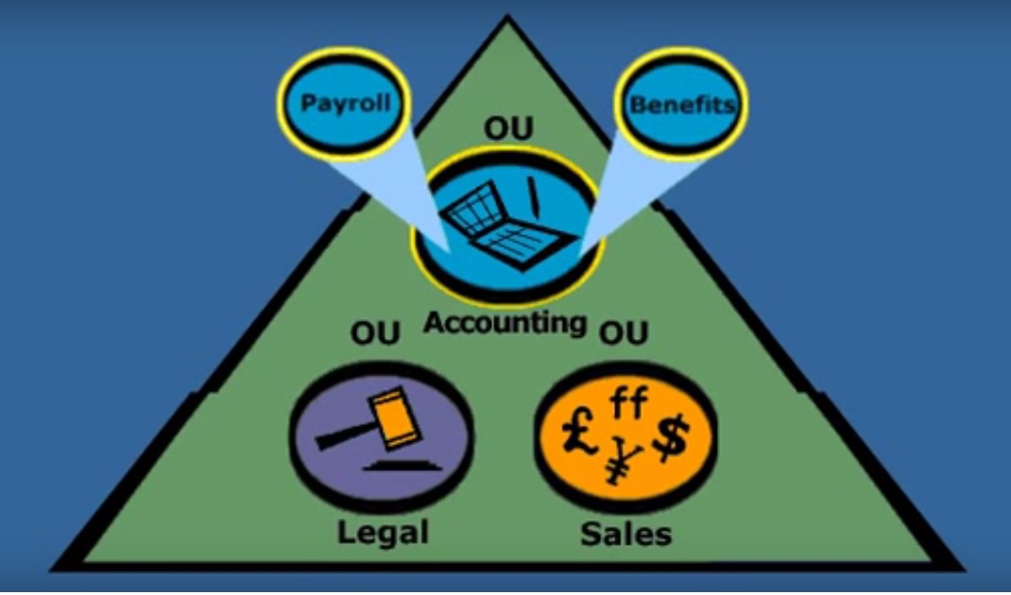
Organizational Unit [OU]
Using organizational unit you can create a hierarchical structure that duplicates the structure of your organization.
Even more importantly you can delegate some administrative responsibilities for these small units.
While administrators have full administrative rights for the entire domain. A user, such as a department or team manager can be granted rights for a particular sub-trees of organizational units or even a single organizational unit

Slide 12
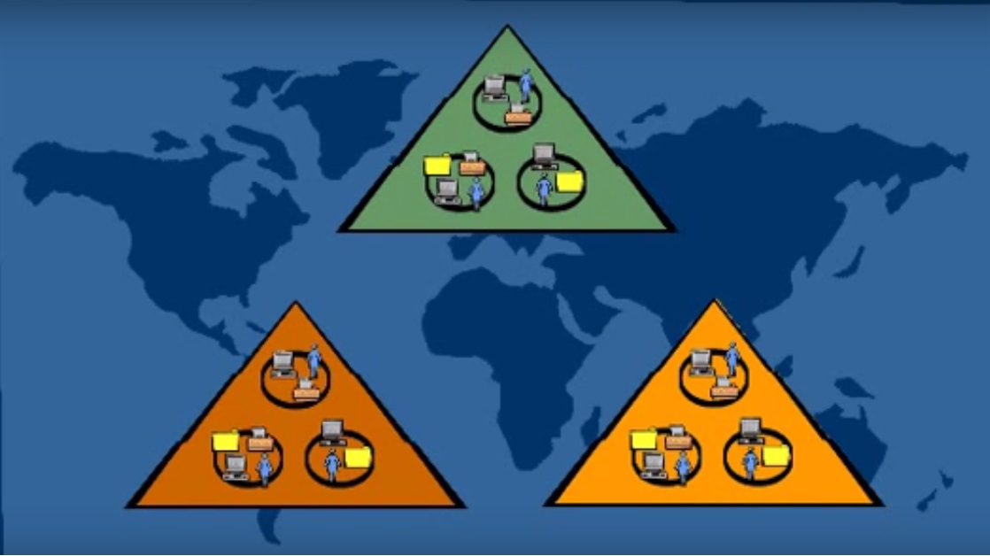
Multiple Domain
Although organizational units are useful for delegating administrative responsibilities within a domain.
Multiple domains are useful for network administrations done by separate authorities, such as in an international organization where resources maybe maintained in different languages

Slide 13
Multiple Domain
Multiple domains can form a domain tree; the root domain is always created first
It becomes the parent domain to child-domains that are added directly below it

Slide 14
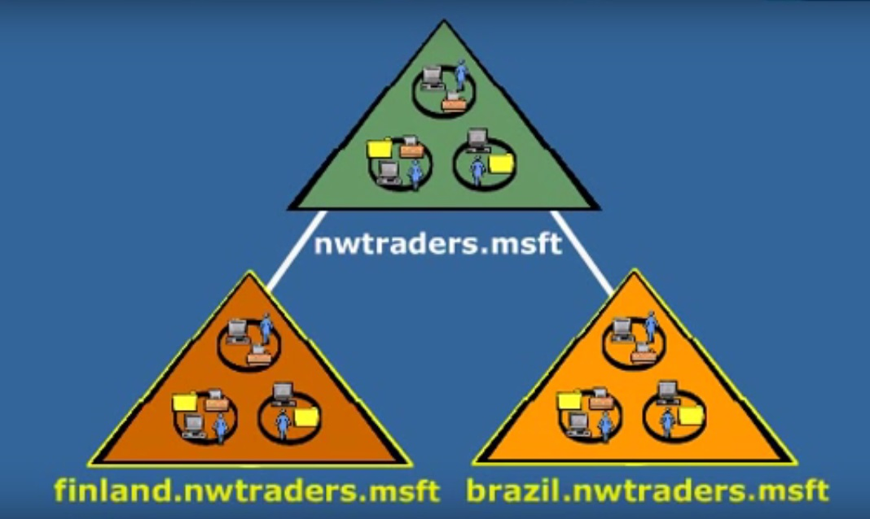
DNS
Each domain in a tree is assigned a name using the hierarchical domain naming system or DNS
As other domains are joint to a tree, the name of a child is added to the parents name, reflecting their relationship
To make network resources globally available to users, by default, active directory transparently joint domains to a 2-way transitive relationship

Slide 15
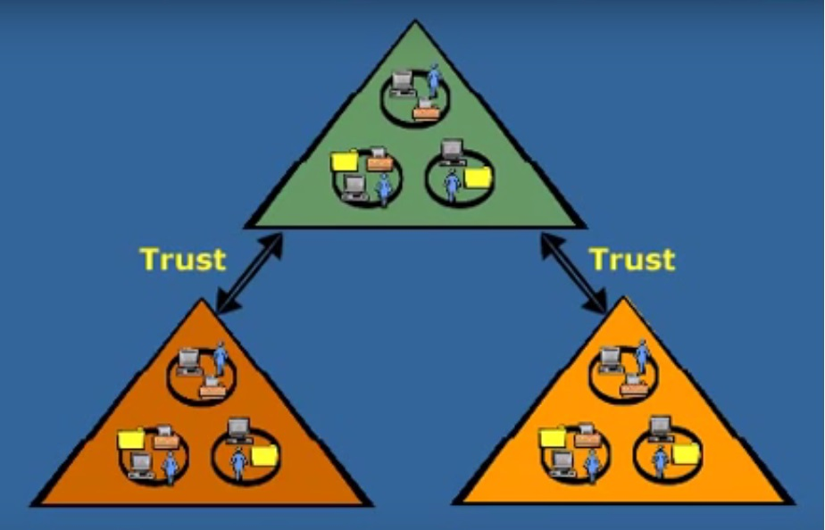
TRUST RELATIONSHIPS
Trust relationship make the domain resources available to users in other domains.
Transitive means that the trust relationship carry thru automatically to other domains in the tree

Slide 16
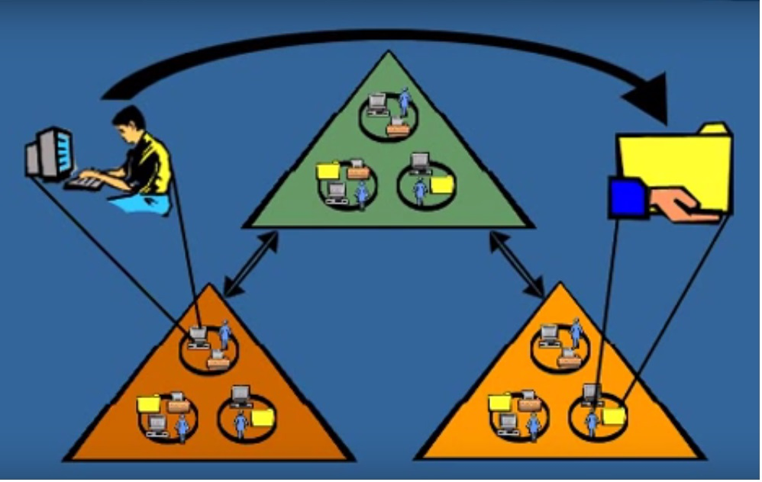
TRUST RELATIONSHIPS
So, users in one domain may have access to resources anywhere in the tree; except of course to resources that have been restricted.

Slide 17
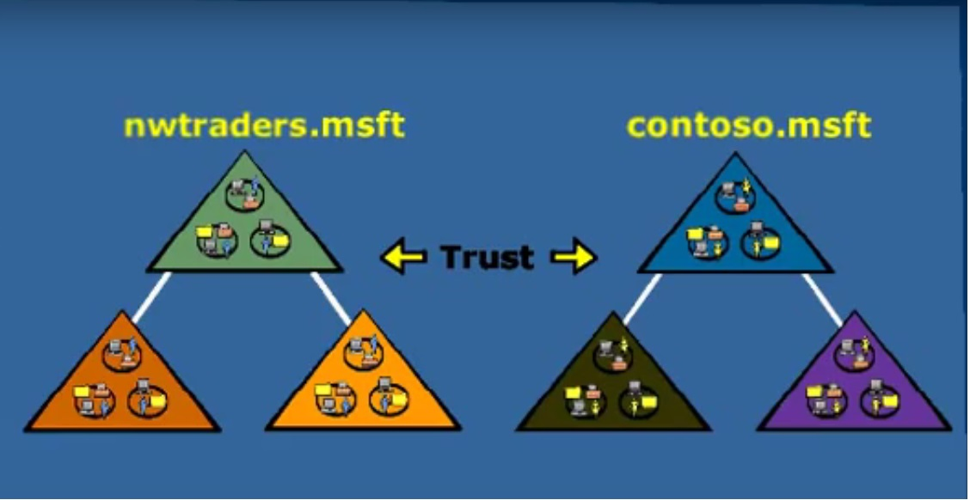
TRUST RELATIONSHIPS
The tree model of multiple domains can be extended to a forest of trees.
Or organizations who need to maintain a separate organizational structures, such as a company that needs distinct public identities for its subsidiaries.

Slide 18
TREES IN A FOREST SHARE
Although each tree can have different naming scheme, they share 3 things
Transitive trust relationships between any domain within the forest
A common schema - a complete set of object types; and
They share a comprehensive global catalog

Slide 19
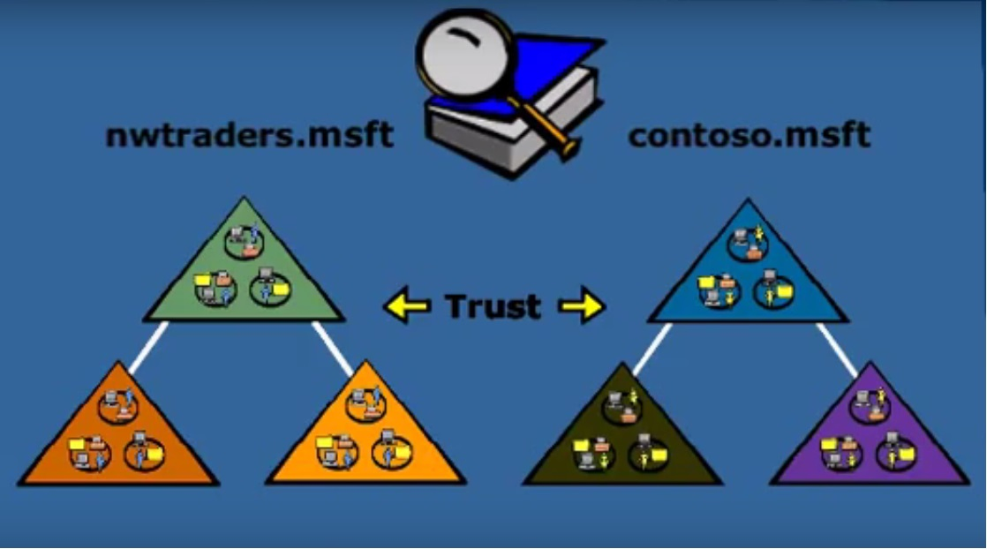
Global Catalog
The global catalog holds all the objects for all domains, so it’s easy for users to locate a specific object anywhere in the Enterprise.
To keep query response time fast, the global catalog maintains only a sub-set of attributes for each object.

Slide 20
Global Catalog
The global catalog is automatically replicated to those domain controllers throughout the forest that are designated as global catalog service

Slide 21
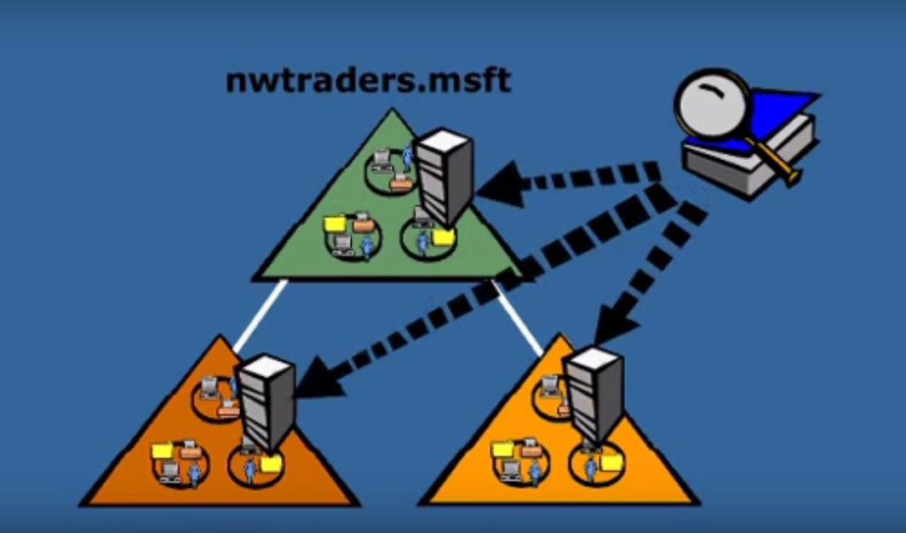
Global Catalog
DOMAIN CONTROLLER
manages ACTIVE DIRECTORY information and users interactions, including directory searches across the enterprise;
Is responsible for all the authentications, authorizations, additions, deletions, audits, modifications, inside a Domain.

Slide 22
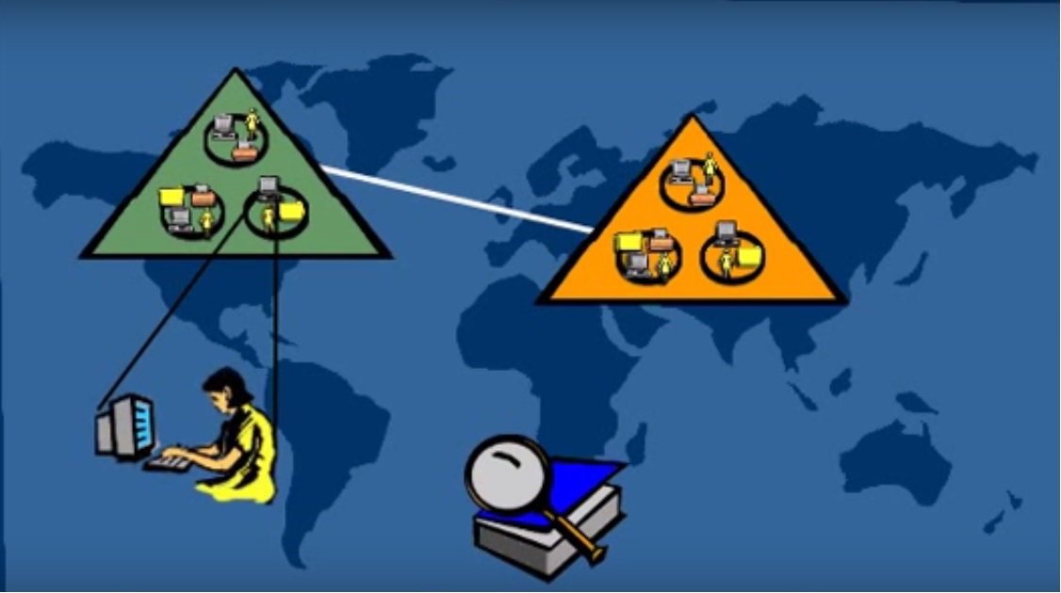
Global Catalog
For example if the marketing manager in the Minneapolis’s office wants to send a hard copy of the file out to the subsidiary in Paris, she can query the ACTIVE DIRECTORY global catalog for a printer on the 2nd floor office of Rue Lafayette, the global catalog resolves the query and returns the location

Slide 23
ACTIVE DIRECTORY - Network Topology
Finally, let’s look how AD relates to network topology
To optimize active directory performance it may be beneficial to divide the network into sites, especially it has geographic separate locations connected by slow links

Slide 24
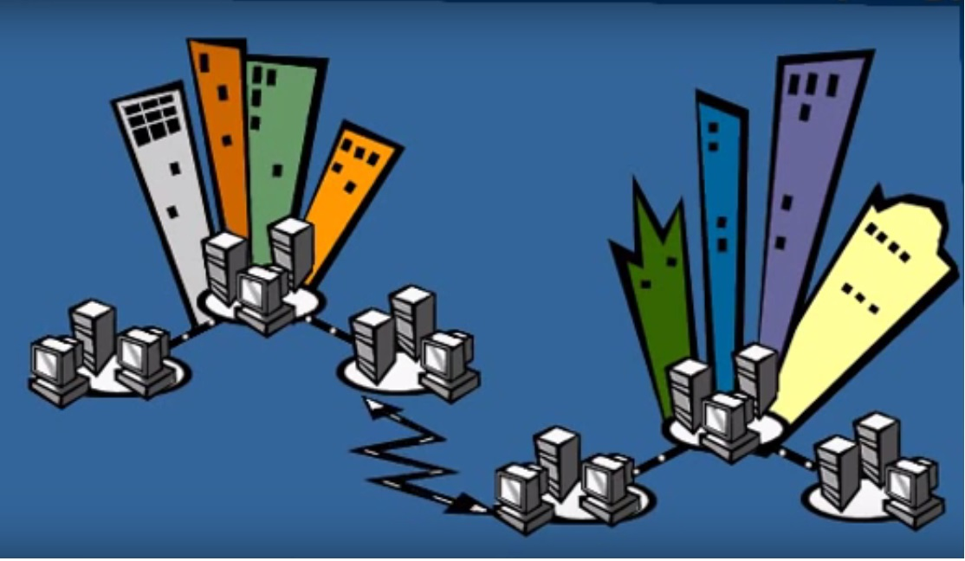
SITES
A site is one or more IP subnets connected by a hi-speed link.
Sites help reduce active directory traffic, such as work stations logged-on in replication
For example when a user who logs on win2012 will try to find the active directory controller in the same site of the user’s computer to validate the logon request.

Slide 25
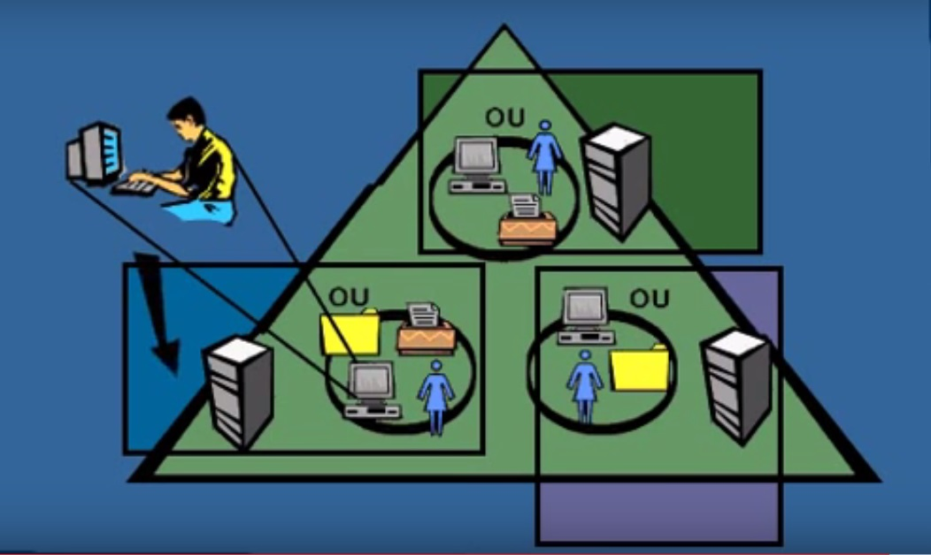
SITES
Staying within the same site serve to reduce unnecessary traffic between the domain controllers; and the network operates more efficiently

Slide 26
SITES
In addition, replication of active directory between sites can be scheduled in off-peak hours when demand for resources between sites is usually lower

Slide 27
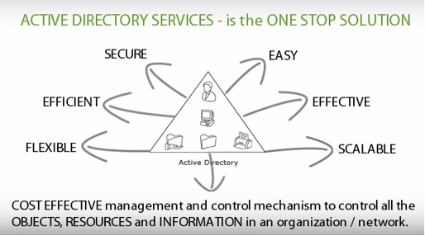
ACTIVE DIRECTORY - conclusion
Active directory enable users to access resources and
The administrators to secure the resources across the enterprise network.

Slide 28
Active Directory Administration
Thank You
By Joseph Cheung
April 27, 2016

